Slide 1


Volume
National 4
Counting Volume cubes
Volume of a cuboid
www.mathsrevision.com
Liquid Volumes
Volume of cylinder
Volume of triangular prism
12 Jul 2026
Compiled by Mr. Lafferty Maths Dept.

Slide 2
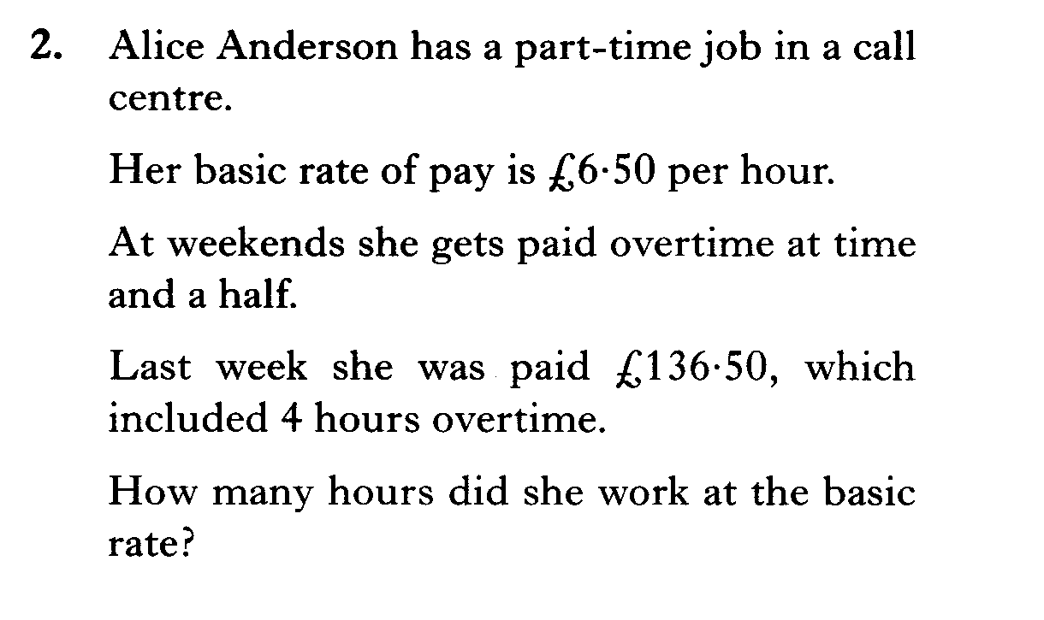
Starter Questions
National 4
www.mathsrevision.com
12 Jul 2026
Compiled by Mr. Lafferty Maths Dept.

Slide 3
Volumes by Counting Cubes
National 4
Learning Intention
Success Criteria
  To understand the
  term volume in terms of
  counting cubes.
  To know what volume means.
Work out volumes using 1cm³ cubes.
www.mathsrevision.com
Answer to contain
appropriate units.
12 Jul 2026
Compiled by Mr. Lafferty Maths Dept.

Slide 4
Volumes by Counting Cubes
National 4
Volume is the amount of space a 3D - shape takes up
1cm
1cm
www.mathsrevision.com
1cm
One Unit of Volume is the “CUBIC CENTIMETRE”
= 1 centimetre cube
= 1 cm³
12 Jul 2026
Compiled by Mr. Lafferty Maths Dept.

Slide 5
Volumes by Counting Cubes
National 4
This shape is made up of 1 centimetre cubes placed next to each other. What is its volume in cm³?
1cm
www.mathsrevision.com
1cm
1cm
1cm
= 2 centimetre cubes
= 2 cm³
12 Jul 2026
Compiled by Mr. Lafferty Maths Dept.

Slide 6
Volumes by Counting Cubes
National 4
This shape is made up of 1 centimetre cubes placed next to each other. What is its volume in cm³
1cm
www.mathsrevision.com
1cm
1cm
1cm
= 3 centimetre cubes
= 3 cm³
12 Jul 2026
Compiled by Mr. Lafferty Maths Dept.

Slide 7
Volumes by Counting Cubes
National 4
What is its volume in cm³ of these shapes.
www.mathsrevision.com
5 cm³
5 cm³
6 cm³
12 Jul 2026
Compiled by Mr. Lafferty Maths Dept.

Slide 8
Volumes by Counting Cubes
National 4
One unit of Volume is the “CUBIC CENTIMETRE”
3cm
www.mathsrevision.com
2cm
4cm
Volume = 24 centimetre cube
= 24 cm³
12 Jul 2026
Compiled by Mr. Lafferty Maths Dept.

Slide 9

Volumes by Counting Cubes
National 4
Now try Ex 1
Ch8 (page 89)
www.mathsrevision.com
12 Jul 2026
Compiled by Mr. Lafferty Maths Dept.

Slide 10
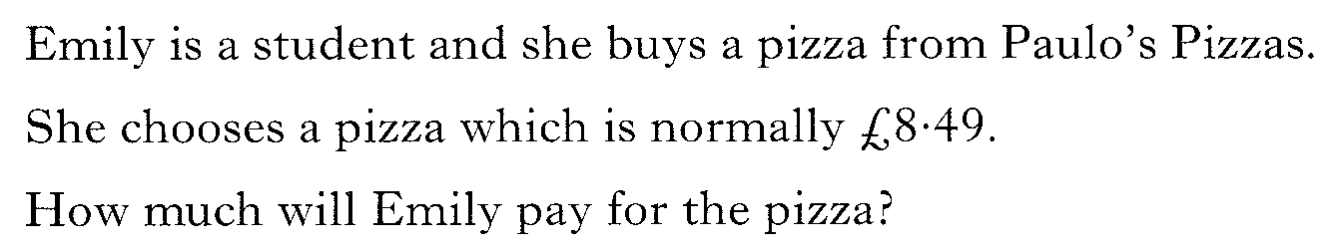
National 4 Starter Questions
National 4
Student Discount
⅓ off the price of each pizza
www.mathsrevision.com
12 Jul 2026
Compiled by Mr. Lafferty Maths Dept.

Slide 11
Volume of a cuboid
National 4
Learning Intention
Success Criteria
  To understand how to
  calculate the volume
  of cuboid.
  To know the formula.
Use formula correctly.
www.mathsrevision.com
Show working and
appropriate units.
12 Jul 2026
Compiled by Mr. Lafferty Maths Dept.

Slide 12
Volume of a cuboid
National 4
18 cubes fit the base.
4cm
3cm
6cm
www.mathsrevision.com
= 1 centimetre cube = 1 cm³
4 layers of 18 cubes
= 4 x 18
= 72 centimetre cubes
= 72 cm³
12 Jul 2026
Compiled by Mr. Lafferty Maths Dept.

Slide 13
A short cut !
National 4
height
4cm
Area of rectangle
breadth
3cm
6cm
www.mathsrevision.com
length
Volume =
6
x 3
x 4
= 72 cm³
Volume =
length
x breadth
x height
12 Jul 2026
Compiled by Mr. Lafferty Maths Dept.

Slide 14
Example 1
Working
National 4
Volume = l x b x h
V = 18 x 5 x 27
V = 2430 cm³
27cm
Heilander’s
Porridge Oats
5 cm
18 cm
12 Jul 2026
Compiled by Mr. Lafferty Maths Dept.

Slide 15
Example 2
Working
National 4
Volume = l x b x h
V = 2 x 2 x 2
V = 8 cm³
2cm
www.mathsrevision.com
12 Jul 2026
Compiled by Mr. Lafferty Maths Dept.

Slide 16
Example 3
Find the volume of the composite shape.
National 4
7 cm
V_{T} = V₁ + V₂
5 cm
V_{T} = 105 + 720
3 cm
V_{T} = 825 cm³
9 cm
V₁ = l x b x h
www.mathsrevision.com
= 3 x 5 x 7
= 105 cm³
10 cm
V₂ = l x b x h
= 8 x 10 x 9
8 cm
= 720 cm³
12 Jul 2026
Compiled by Mr. Lafferty Maths Dept.

Slide 17
Example 4
Find the length the cuboid
This just an equation.
We know how to solve them !
National 4
4 cm
Volume = L x B x H
V=200cm³
5 cm
200 = L x 5 x 4
www.mathsrevision.com
200 = 20L
10 cm
L
20L = 200
L = 10
12 Jul 2026
Compiled by Mr. Lafferty Maths Dept.

Slide 18
Volume of a cuboid
National 4
Now try Ex 2
Ch8 (page 92)
www.mathsrevision.com
12 Jul 2026
Compiled by Mr. Lafferty Maths Dept.

Slide 19
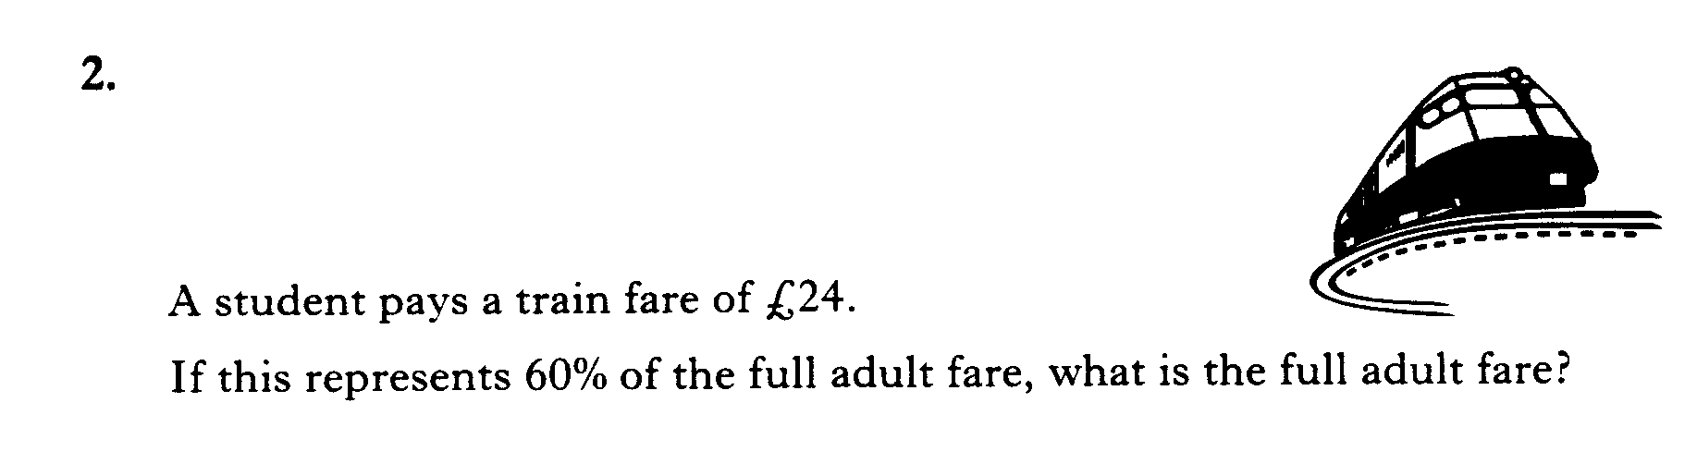
Starter Questions
National 4
www.mathsrevision.com
12 Jul 2026
Compiled by Mr. Lafferty Maths Dept.

Slide 20
Liquid Volume
National 4
Learning Intention
Success Criteria
  To understand the
  term liquid volume using millilitres and litres.
  To know the term liquid volume.
Work out volumes using 1ml and litres.
www.mathsrevision.com
Answer to contain
appropriate units.
12 Jul 2026
Compiled by Mr. Lafferty Maths Dept.

Slide 21


Liquid Volume
I’m a very small duck!
National 4
How much water does this hold?
1 cm
1 cm
1 cm
Volume =
x b
x h
l
= 1 cm³
A cube with volume 1cm³ holds exact 1 millilitre of liquid.
A volume of 1000 ml = 1 litre.
12 Jul 2026
Compiled by Mr. Lafferty Maths Dept.

Slide 22
Example 1
Liquid Volume
Working
Volume = l x b x h
National 4
V = 6 x 3 x 12
12 cm
V = 216 cm³
Orange
Flavour
= 216 ml
3 cm
www.mathsrevision.com
6 cm
So the carton can hold
216 ml of orange juice.
Remember:
1 cm³ = 1 ml
How much juice can
this carton hold?
12 Jul 2026
Compiled by Mr. Lafferty Maths Dept.

Slide 23
Example 2
Liquid Volume
Working
Volume = l x b x h
National 4
V = 100 x 30 x 50
V = 150 000 cm³
50 cm
= 150 000 ml
30 cm
= 150 litres
100 cm
How much water can this fish tank hold in litres?
1cm³ = 1 ml
1000 ml = 1 litre
So the fish tank can hold 150 litres of water.
12 Jul 2026
Compiled by Mr. Lafferty Maths Dept.

Slide 24
Liquid Volume
National 4
Now try Ex 3
Ch8 (page 94)
www.mathsrevision.com
12 Jul 2026
Compiled by Mr. Lafferty Maths Dept.

Slide 25
Starter Questions
National 4
Q1. Find the area of the triangle.
10cm
Q2. Factorise 4x - 64
6cm
www.mathsrevision.com
Q3. Calculate
Sunday 12 July 2026
Created by Mr.Lafferty
<number>

Slide 26
Volume of a Cylinder
National 4
Learning Intention
Success Criteria
  To derive the formula for the volume of a cylinder and apply it to solve problems.
  To know formula.
Apply formula correctly.
www.mathsrevision.com
Work backwards using formula.

Slide 27
Volume of a Cylinder
National 4
The volume of a cylinder can be thought as being a pile
of circles laid on top of each other.
Volume = Area x height
h
www.mathsrevision.com
= πr²
x h
Cylinder
(circular Prism)
= πr²h

Slide 28
Volume of a Cylinder
National 4
Example : Find the volume of the cylinder below.
5cm
V = πr²h
10cm
www.mathsrevision.com
= π(5)²x10
Cylinder
(circular Prism)
= 250π cm

Slide 29
Volume of Solids
National 4
Now try Extension Booklet
www.mathsrevision.com

Slide 30
Starter Questions
National 4
Q1. 35% of 360
Q2. Calculate 5 + 6 x 7
www.mathsrevision.com
Q3. Expand 2( y – 5 )
Sunday 12 July 2026
Created by Mr.Lafferty
<number>

Slide 31
Volume of Solids
Prisms
National 4
Learning Intention
Success Criteria
  To understand the
  prism formula for calculating volume.
  To know the volume formula for any prism.
Work out volumes for
various prisms.
www.mathsrevision.com
Answer to contain
appropriate units and working.

Slide 32
Volume of Solids
National 4
Definition : A prism is a solid shape with
uniform cross-section
www.mathsrevision.com
Hexagonal Prism
Cylinder
(circular Prism)
Triangular Prism
Pentagonal Prism
Volume = Area of Cross section x length

Slide 33
Any Triangle Area
National 4
h = vertical height
Sometimes called the altitude
h
www.mathsrevision.com
b
Sunday 12 July 2026
Created by Mr.Lafferty
<number>

Slide 34
Any Triangle Area
National 4
Example 1 : Find the area of the triangle.
6cm
www.mathsrevision.com
8cm
Sunday 12 July 2026
Created by Mr.Lafferty
<number>

Slide 35
Volume of Solids
National 4
Definition : A prism is a solid shape with
uniform cross-section
Q. Find the volume the triangular prism.
www.mathsrevision.com
Triangular Prism
Volume = Area x length
= 20 x 10 = 200 cm³
10cm
20cm²

Slide 36
Volume of a Triangular Prism
Working
National 4
Triangle Area =
= 2 x4 = 8 cm²
4cm
Volume = Area x length
= 8 x 10 = 80cm³
10cm
4cm
www.mathsrevision.com
12 Jul 2026
Created by Mr. Lafferty Maths Dept.

Slide 37
Example
Find the volume of the triangular prism.
Working
National 4
Triangle Area =
= 3 x 3 = 9 cm²
Volume = Area x length
= 9 x 30 = 270cm³
3cm
30cm
6cm
www.mathsrevision.com
Total Area
= 6+6+30+40+50 = 132cm²
12 Jul 2026
Compiled by Mr. Lafferty Maths Dept.

Slide 38
Volume of Solids
National 4
Now try Extension Booklet
www.mathsrevision.com

