Slide 1
The Sine Ratio
The Cosine Ratio
The Tangent Ratio
Mixed Problems

Slide 2


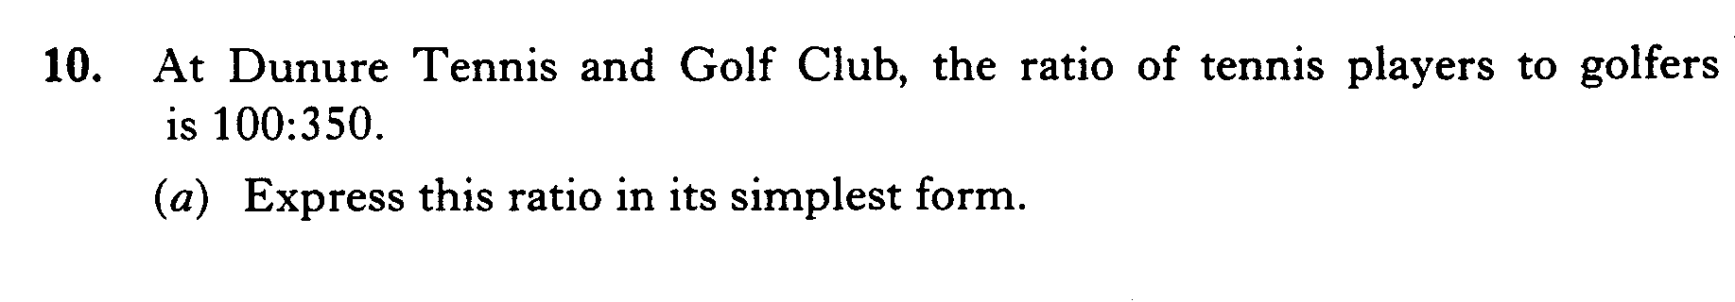
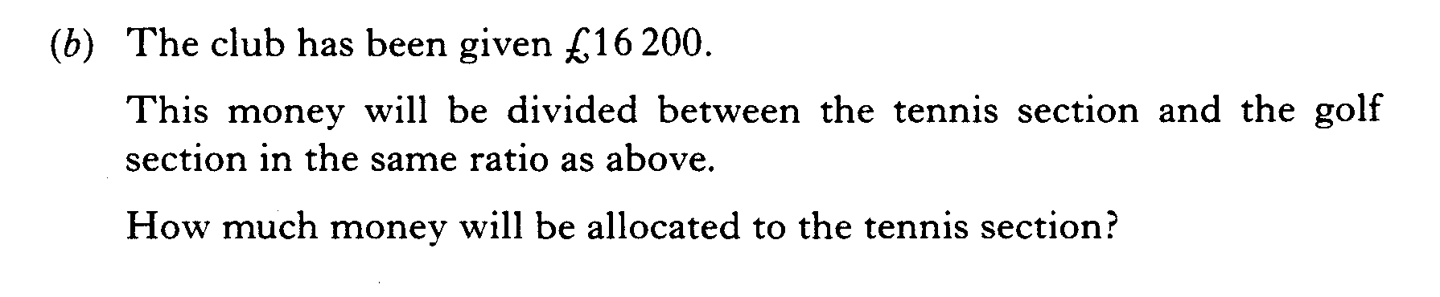
Starter Questions
S4
www.mathsrevision.com
www.mathsrevision.com

Slide 3
Trigonometry
Sine ratio
S4
Learning Intention
Success Criteria
  Definite the sine ratio and show how to find a length or angle using this ratio.
  1. Write down sine ratio.
www.mathsrevision.com
  2. Use sine ratio to find a length or angle.
12 Jul 2026
Created by Mr. Lafferty Maths Dept.

Slide 4
The Sine Ratio
S4
Opp
Sin x° =
Hyp
Opposite
hypotenuse
x°

Slide 5


Find the height h
Sine Ratio
S4
11cm
Hyp
h
Opp
Opp
Sin x° =
Hyp
34°
h
Sin 34° =
11
S^{O}H C^{A}H T^{O}A
11 x Sin 34°
= h
h =
11 x Sin 34°
= 6.2cm (1 d.p.)

Slide 6
Find the xº
Sine Ratio
S4
9m
Hyp
6m
Opp
x°
Opp
Sin x° =
Hyp
S^{O}H C^{A}H T^{O}A
6
Sin x° =
9
Sin x°
= 0.667 (3 d.p.)

Slide 7

Sine Ratio
Sin x°
=0.667 (3 d.p.)
How do we find x°?
We need to use Sin ⁻¹on the calculator.
Sin ⁻¹
Sin ⁻¹is written above
Sin
To get this press
2nd
Followed by
Sin

Slide 8
Sine Ratio
Sin x°
= 0.667 (3 d.p.)
Sin ⁻¹
Press
2nd
Sin
Enter
0.667
=
x =
Sin ⁻¹0.667
= 41.8° (1 d.p.)

Slide 9
Sine Ratio
The support rope is 11.7m long. The angle between the rope and ground is 70º. Use the sine ratio to calculate the height of the flag pole.
S^{O}H C^{A}H T^{O}A
11.7m
h
70º
12 Jul 2026
Compiled by Mr. Lafferty Maths Dept.

Slide 10

Sine Ratio
Use the sine ratio to find the angle of the ramp.
S^{O}H C^{A}H T^{O}A
20 m
10m
xº
12 Jul 2026
Compiled by Mr. Lafferty Maths Dept.

Slide 11
Sine Ratio
S4
S^{O}H C^{A}H T^{O}A
A road AB is right angled at B.
The road BC is 5 km.
Calculate the length of
the new road AC.
Opp
Sin x° =
Hyp
B
A
5
Sin 72° =
72°
r
5km
r =
r
r =
C
5.3 km

Slide 12

Sine Ratio
S4
Now try Ex 1 & 2
Ch 13 Page 148

Slide 13
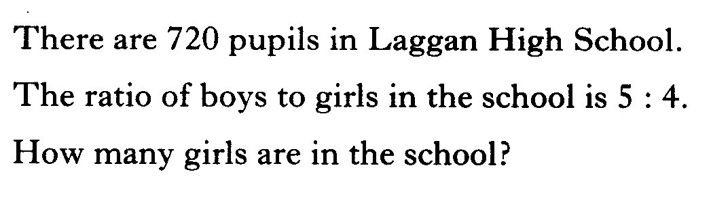
Starter Questions
S4
www.mathsrevision.com
www.mathsrevision.com

Slide 14
Trigonometry
Cosine Ratio
S4
Learning Intention
Success Criteria
  Definite the cosine ratio and show how to find an length or angle using this ratio.
  1. Write down cosine ratio.
www.mathsrevision.com
  2. Use cosine ratio to find a length or angle.
12 Jul 2026
Created by Mr. Lafferty Maths Dept.

Slide 15
Cosine Ratio
S4
Adj
Cos x° =
Hyp
hypotenuse
x°
Adjacent

Slide 16

Find the adjacent length b
Cosine Ratio
S4
b
Adj
40°
Adj
Cos x° =
Opp
Hyp
Hyp
35mm
b
Cos 40° =
35
S^{O}H C^{A}H T^{O}A
35 x Cos 40°
= b
b =
35 x Cos 40°
= 26.8mm (1 d.p.)

Slide 17

Find the angle xº
Cosine Ratio
S4
34cm
Adj
Adj
x°
Cos x° =
Hyp
Opp
Hyp
45cm
34
Cos x° =
45
S^{O}H C^{A}H T^{O}A
Cos x°
= 0.756 (3 d.p.)
x =
Cos ⁻¹0.756
=41°

Slide 18
Cosine Ratio
S4
Now try Ex 3
Ch 13 Page 153

Slide 19
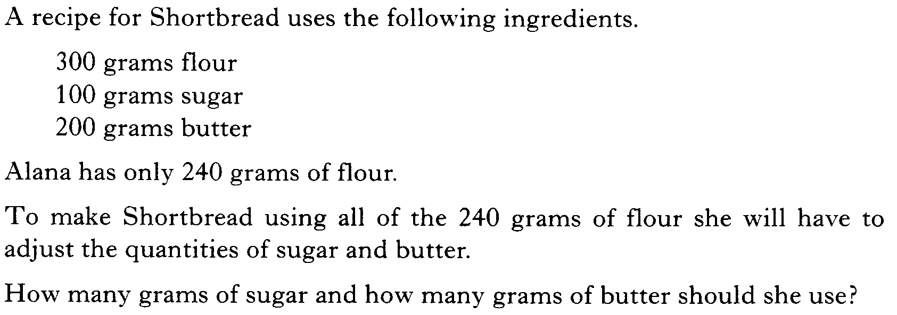
Starter Questions
S4
www.mathsrevision.com
www.mathsrevision.com

Slide 20
Angles & Triangles
Learning Intention
Success Criteria
  To use tan of the angle to solve problems.
  1. Write down tan ratio.
www.mathsrevision.com
  2. Use tan of an angle to solve problems.
12 Jul 2026
Created by Mr. Lafferty Maths Dept.

Slide 21
How high is the tower?
Opp
60°
12 m

Slide 22

Opposite
hypotenuse
Copy this!
60°
12 m
Adjacent

Slide 23
Opp
Tan x° =
Copy this!
Adj
Opp
Tan 60° =
12
12 x Tan 60°
= Opp
Opp =
12 x Tan 60°
= 20.8m (1 d.p.)

Slide 24
So the tower’s 20.8 m high!
20.8m
Don’t worry, you’ll be trying plenty of examples!!

Slide 25
S4
General
Opp
Tan x° =
Adj
Opposite
x°
Adjacent

Slide 26
Example
Find the height h
S4
General
S^{O}H C^{A}H T^{O}A
Opp
Hyp
Opp
h
Tan x° =
Adj
65°
h
Tan 65° =
8m
8
Adj
8 x Tan 65°
= h
h =
8 x Tan 65°
= 17.2m (1 d.p.)

Slide 27
Extension
Booklet

Slide 28
Past Paper Type Questions
Mixed Ratios
S4
S^{O}H C^{A}H T^{O}A

Slide 29







The Three Ratios
S4
opposite
adjacent
Cosine
Tangent
Sine
hypotenuse
Sine
adjacent
adjacent
Cosine
www.mathsrevision.com
Cosine
Tangent
hypotenuse
opposite
opposite
Sine
Sine
www.mathsrevision.com
hypotenuse

Slide 30
Mixed Ratios
S4
Opp
Adj
Opp
Sin x° =
Cos x° =
Tan x° =
Hyp
Hyp
Adj
S^{O}H
C^{A}H
T^{O}A

Slide 31


Mixed Ratios
S4
Process
1. Write down
S^{O}H C^{A}H T^{O}A
2.
Identify what you want to find
3.
what you know
Copy this!

Slide 32
Past Paper Type Questions
Mixed Ratios
S4
S^{O}H C^{A}H T^{O}A
(4 marks)

Slide 33
Past Paper Type Questions
Mixed Ratios
S4
S^{O}H C^{A}H T^{O}A

Slide 34
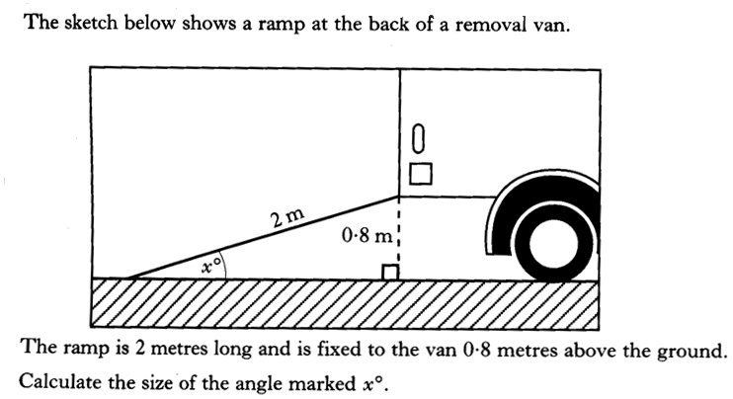
Past Paper Type Questions
Mixed Ratios
S4
S^{O}H C^{A}H T^{O}A
4 marks

Slide 35
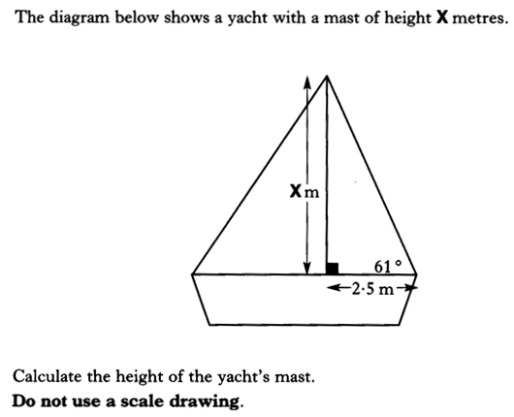
Past Paper Type Questions
Mixed Ratios
S4
S^{O}H C^{A}H T^{O}A

Slide 36
Past Paper Type Questions
Mixed Ratios
S4
S^{O}H C^{A}H T^{O}A
(4marks)

Slide 37
Past Paper Type Questions
Mixed Ratios
S4
S^{O}H C^{A}H T^{O}A

Slide 38
Past Paper Type Questions
Mixed Ratios
S4
S^{O}H C^{A}H T^{O}A
(4marks)

Slide 39
Mixed Ratios
S4
Now try Ex 4
Ch 13 Page 157

