Slide 1


Net and Surface Area
S4
Surface Area
www.mathsrevision.com
Net of Solids
12 Jul 2026
Compiled by Mr. Lafferty Maths Dept.

Slide 2
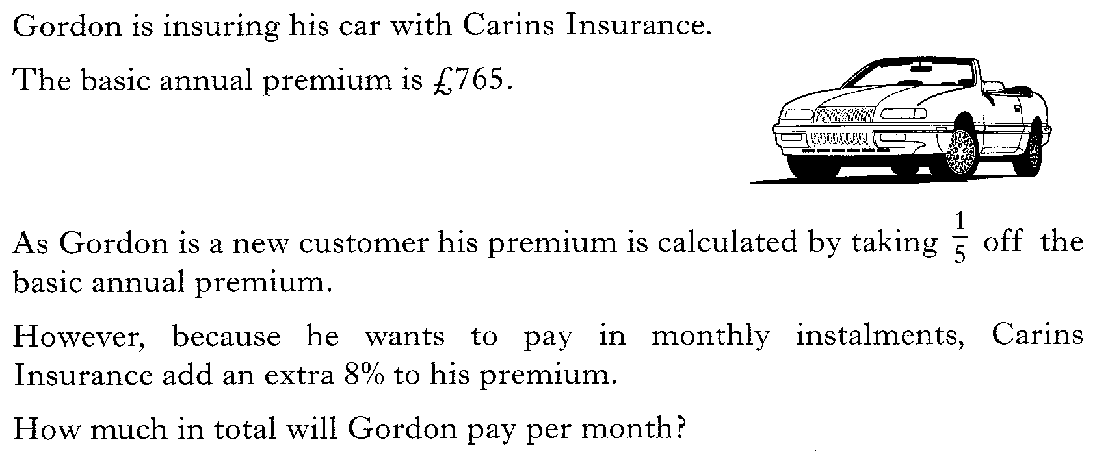
Starter Questions
S4
www.mathsrevision.com
12 Jul 2026
Compiled by Mr. Lafferty Maths Dept.

Slide 3
Faces Edges and Vertices
S4
Learning Intention
Success Criteria
  To understand the meaning of Face Edge and Vertex in relation to a various shapes an be able to identify them.
  To know the terms Face Edge and Vertex.
2. Calculate the number of Faces Edges and Vertices for various shapes.
www.mathsrevision.com
12 Jul 2026
Compiled by Mr. Lafferty Maths Dept.

Slide 4
Revision of Area
S4
The Square
The Rectangle
The RAT
l
b
h
l
b
www.mathsrevision.com
l
Sunday 12 July 2026
Created by Mr.Lafferty
<number>

Slide 5
Don’t forget the faces edges and corners we can’t see at the back
Face Edges and Vertices
S4
The shape below is called a cuboid.
It is made up of FACES, EDGES and VERTICES.
Edges are where the two faces meet (lines)
www.mathsrevision.com
Faces are the
sides of a shape
(surface area)
Vertices where lines meet (corners)
12 Jul 2026
Compiled by Mr. Lafferty Maths Dept.

Slide 6
Calculate the number of faces edges and vertices for a cuboid.
Face Edges and Vertices
S4
www.mathsrevision.com
6 faces
12 edges
Front and back are the same
Top and bottom are the same
8 vertices
Right and left are the same
12 Jul 2026
Compiled by Mr. Lafferty Maths Dept.

Slide 7
Calculate the number of faces edges and vertices for a cube.
Face Edges and Vertices
S4
www.mathsrevision.com
6 faces
12 edges
Faces are squares
8 vertices
12 Jul 2026
Compiled by Mr. Lafferty Maths Dept.

Slide 8
Example
Find the surface area of the cuboid
Working
S4
Front Area = l x b
= 5 x 4 =20cm²
Top Area = l x b
= 5 x 3 =15cm²
4cm
Side Area = l x b
= 3 x 4 =12cm²
3cm
www.mathsrevision.com
5cm
Total Area
= 20+20+15+15+12+12
= 94cm²
Front and back are the same
Top and bottom are the same
Right and left are the same
12 Jul 2026
Compiled by Mr. Lafferty Maths Dept.

Slide 9
Example
Find the surface area of the right angle prism
Working
S4
Triangle Area =
= 2 x3 =6cm²
Rectangle 1 Area = l x b
= 3 x10 =30cm²
5cm
Rectangle 2 Area = l x b
3cm
10cm
= 4 x 10 =40cm²
4cm
www.mathsrevision.com
Rectangle 3 Area = l x b
2 triangles the same
= 5 x 10 =50cm²
1 rectangle 3cm by 10cm
Total Area
= 6+6+30+40+50 = 132cm²
1 rectangle 4cm by 10cm
1 rectangle 5cm by 10cm
12 Jul 2026
Compiled by Mr. Lafferty Maths Dept.

Slide 10
Calculate the number of faces, edges and vertices for these shapes
Face Edges and Vertices
5 faces
S4
9 edges
6 Vertices
2 faces
1 edges
1 Vertices
Cone
Triangular
Prism
www.mathsrevision.com
Cylinder
Sphere
3 faces
2 edges
0 Vertices
1 faces
0 edges
12 Jul 2026
Compiled by Mr. Lafferty Maths Dept.
0 Vertices

Slide 11

Net and Surface Area
The Cube
S4
Now Try Ex 1
Ch7 (page 80)
www.mathsrevision.com
12 Jul 2026
Compiled by Mr. Lafferty Maths Dept.

Slide 12
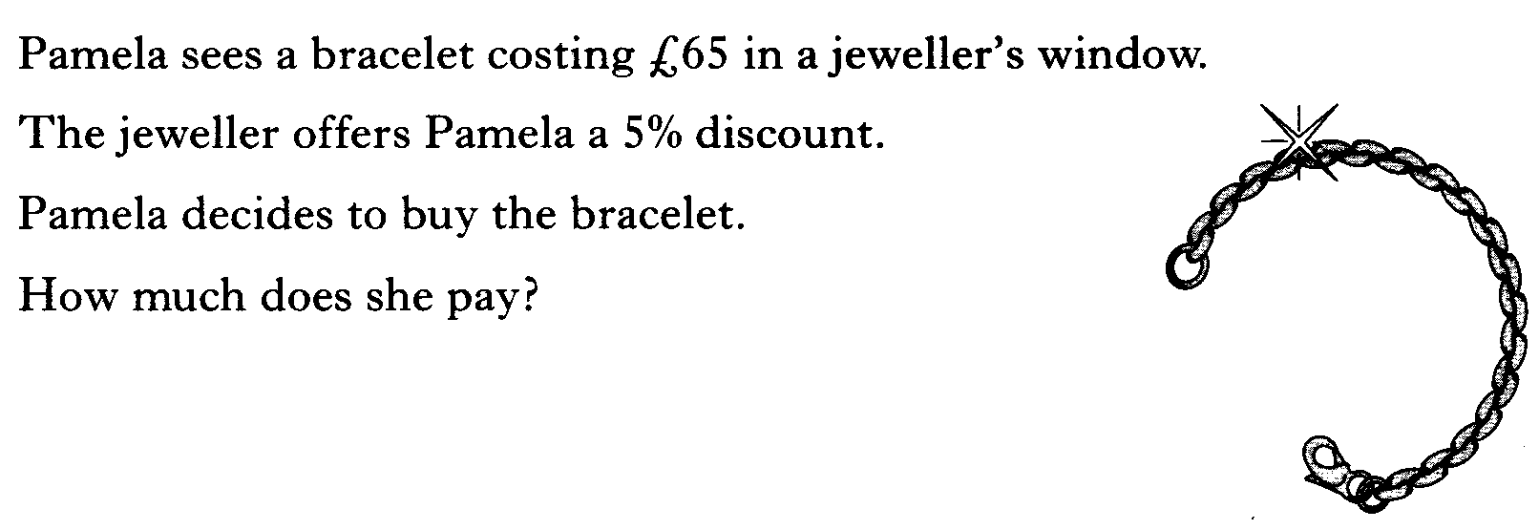
Starter Questions
S4
www.mathsrevision.com
12 Jul 2026
Compiled by Mr. Lafferty Maths Dept.

Slide 13
Net and Surface Area
The Cuboid
S4
Learning Intention
Success Criteria
  To draw the net of a cuboid and work out its surface area.
  Draw a net of a cuboid.
2. Work out the surface area of a cuboid using previous knowledge of the area of a rectangle.
www.mathsrevision.com
12 Jul 2026
Compiled by Mr. Lafferty Maths Dept.

Slide 14
Net and Surface Area
The Cube
S4
The net of a solid shape is the shape you would get
if it was made of cardboard and you “opened it up
and laid it out flat”.
Right
Side
www.mathsrevision.com
left
Side
Top
Back
Front
Bottom
6 faces
All congruent
This is a NET
for the cube
All squares
12 Jul 2026
Compiled by Mr. Lafferty Maths Dept.

Slide 15
Net and Surface Area
The Cube
S4
Question : Find the surface area of the cube below.
What do we know?
Made up of 6 faces
All the same (congruent)
All squares
Total
6 x 25 = 150cm²
www.mathsrevision.com
5cm
12 Jul 2026
Compiled by Mr. Lafferty Maths Dept.

Slide 16
Net and Surface Area
The Cuboid
S4
Bottom
3cm
4cm
LS
Back
RS
4cm
Top
3cm
3cm
www.mathsrevision.com
5cm
Front
4cm
6 faces
Top and bottom congruent
5cm
Front and back congruent
Left and right congruent
This is a NET for the cuboid
12 Jul 2026
Compiled by Mr. Lafferty Maths Dept.

Slide 17
Example
Find the surface area of the cuboid
Working
S4
Front Area = l x b
= 5 x 4 =20cm²
Top Area = l x b
= 5 x 3 =15cm²
4cm
Side Area = l x b
= 3 x 4 =12cm²
3cm
www.mathsrevision.com
5cm
Total Area
= 20+20+15+15+12+12
= 94cm²
Front and back are the same
Top and bottom are the same
Right and left are the same
12 Jul 2026
Compiled by Mr. Lafferty Maths Dept.

Slide 18
Net and Surface Area
The Cuboid
S4
Now try Ex 2
Ch7 (page 85)
www.mathsrevision.com
12 Jul 2026
Compiled by Mr. Lafferty Maths Dept.

