Slide 1


Straight Line Graphs
S4
The gradient Vertical ÷ Horizontal
Basic Lines
www.mathsrevision.com
Drawing Straight Lines y = ax
Drawing Straight Lines y =ax + b

Slide 2
Starter Questions
S4
Q1. Calculate 7 – 5 x 2
Q2. Calculate
www.mathsrevision.com
Q3. Is this triangle right angled ?
Explain
9
8
5
12 Jul 2026
Created by Mr.Lafferty Maths Dept

Slide 3
The Gradient of a Line
S4
Learning Intention
Success Criteria
  To explain how to calculate the gradient using a right angle triangle
  Gradient is :
  change in vertical height divided by
  change in horizontal distance
www.mathsrevision.com
  2. Calculate simple gradients.
12 Jul 2026
Created by Mr.Lafferty Maths Dept

Slide 4
The Gradient
Difference in
y -coordinates
S4
The gradient is the measure of steepness of a line
Change in vertical height
Change in horizontal distance
www.mathsrevision.com
Difference in
x -coordinates
The steeper a line the bigger the gradient
12 Jul 2026
Created by Mr.Lafferty Maths Dept

Slide 5
The Gradient
S4
3
4
3
2
www.mathsrevision.com
3
5
2
6
12 Jul 2026
Created by Mr.Lafferty Maths Dept

Slide 6

The Gradient
S4
Now Try MIA
Exercise 1
Ch6 (page 64)
www.mathsrevision.com
12 Jul 2026
Created by Mr.Lafferty Maths Dept

Slide 7
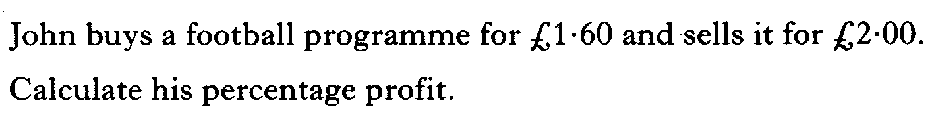
Starter Questions
S4
www.mathsrevision.com
Expand and simplify 4( 3 + 2x) – 3(x + 1)
12 Jul 2026
Created by Mr.Lafferty Maths Dept

Slide 8
Straight Line Graphs
S4
Learning Intention
Success Criteria
  To explain the keypoints of straight line graphs that pass through the origin and write down its equation.
  Understand the keypoints of straight line graph passing through the origin.
  Be able to write down equation of a straight line passing through the origin.
www.mathsrevision.com
12 Jul 2026
Created by Mr.Lafferty Maths Dept

Slide 9
Straight Line Graphs y = ax
y = x
y
10
x
y
y = 3x
9
0
2
6
8
0
2
6
x
y
0
1
2
7
6
0
3
6
5
4
3
2
1
x
-10
-9
-8
-7
-6
-5
-4
-3
-2
-1
0
1
2
3
4
5
6
7
8
9
10
y = 0.5x
-1
y = 2x
-2
x
y
0
4
8
-3
x
y
0
3
4
-4
0
2
4
-5
0
6
8
-6
-7
-8
-9
-10
12 Jul 2026
Created by Mr. Lafferty Maths Dept

Slide 10
Straight Line Graphs
S4
Now tryEx2
Ch6 (page 68)
www.mathsrevision.com
12 Jul 2026
Created by Mr.Lafferty Maths Dept

Slide 11
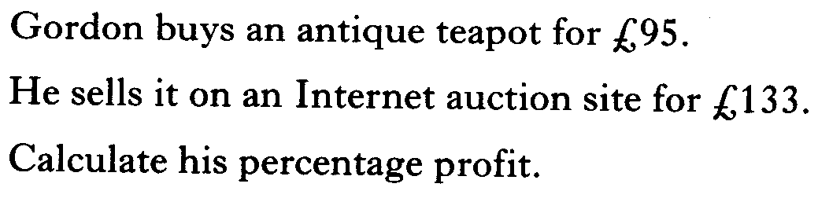
Starter Questions
S4
Q1. Calculate 40 – 30x2
www.mathsrevision.com
12 Jul 2026
Created by Mr.Lafferty Maths Dept

Slide 12
The Straight Line Equation
S4
Learning Intention
Success Criteria
  To explain the connection between the straight line equation and the gradient.
  Understand the term standard form.
  2. Identity the gradient m from the standard form.
www.mathsrevision.com
12 Jul 2026
Created by Mr.Lafferty Maths Dept

Slide 13
Straight Line Graphs
S4
Key Points
Make a table
Calculate and plot 3 coordinates
3. Draw a line through points
www.mathsrevision.com
12 Jul 2026
Created by Mr.Lafferty Maths Dept

Slide 14
Drawing Straight Line Graphs y = ax
y = x
y
10
x
y
y = 3x
9
0
2
6
8
0
2
6
x
y
0
1
2
7
6
0
3
6
5
4
3
2
1
x
-10
-9
-8
-7
-6
-5
-4
-3
-2
-1
0
1
2
3
4
5
6
7
8
9
10
y = 5x
-1
y = 2x
-2
x
y
0
1
2
-3
x
y
0
3
4
-4
0
5
10
-5
0
6
8
-6
-7
-8
-9
-10
12 Jul 2026
Created by Mr. Lafferty Maths Dept

Slide 15
The Gradient of a Line
S4
Now try Ex 3
Ch6 (page 70)
www.mathsrevision.com
12 Jul 2026
Created by Mr.Lafferty Maths Dept

Slide 16
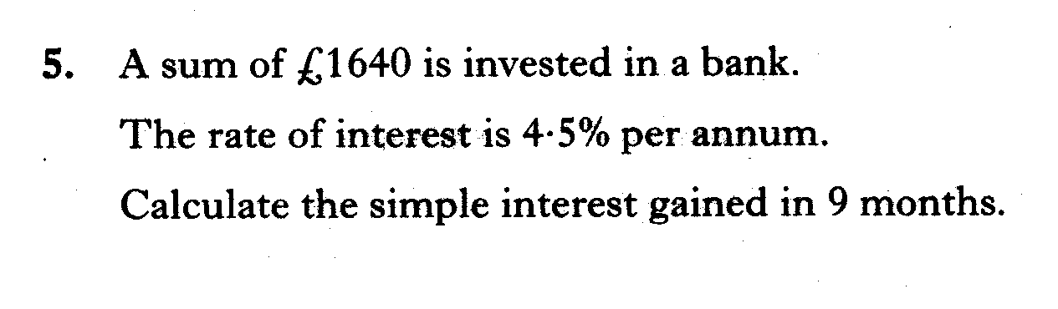
Starter Questions
S4
www.mathsrevision.com
Factorise 5x + 10
12 Jul 2026
Created by Mr.Lafferty Maths Dept

Slide 17
The Straight Line Equation
S4
Learning Intention
Success Criteria
  To explain the draw straight lines of the form y = ax + b.
  Be able to draw straight lines of the form y = ax + b
www.mathsrevision.com
12 Jul 2026
Created by Mr.Lafferty Maths Dept

Slide 18
Straight Line Graphs
S4
Key Points
Make a table
Calculate and plot 3 coordinates
3. Draw a line through points
www.mathsrevision.com
12 Jul 2026
Created by Mr.Lafferty Maths Dept

Slide 19
Drawing Straight Line Graphs y = ax + b
y = x
y
10
x
y
y = 3x+1
9
0
2
4
8
0
2
4
x
y
0
1
2
7
6
1
4
7
5
4
3
2
1
x
-10
-9
-8
-7
-6
-5
-4
-3
-2
-1
0
1
2
3
4
5
6
7
8
9
10
y = x - 3
-1
y = 2x + 3
-2
x
y
0
4
8
-3
x
y
0
1
2
-4
-3
1
5
-5
3
5
7
-6
-7
-8
-9
-10
12 Jul 2026
Created by Mr. Lafferty Maths Dept

Slide 20
Straight Line Equation
S4
y
All straight lines have
the equation of the form
10
lines are parallel if they have the same gradient
9
8
y = mx + c
7
6
5
4
www.mathsrevision.com
3
Where line
meets y-axis
2
Gradient
1
x
0
1
2
3
4
5
6
7
8
9
10
Find the equations of the following lines
y = x
y = x+4
y = 4x+2
y = -0.5x+2
12 Jul 2026
Created by Mr.Lafferty Maths Dept

Slide 21
Straight Line Equation
S4
Now try MIA
Ex 4
Ch6 (page 73)
www.mathsrevision.com
12 Jul 2026
Created by Mr.Lafferty Maths Dept

