Slide 1



Mathematical Similarity
S4
www.mathsrevision.com
Similar Figures & Scale Factor
Similar Triangles

Slide 2

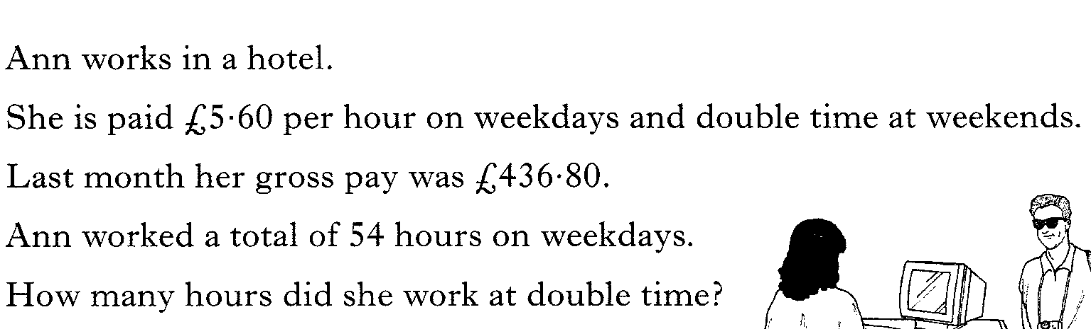

Starter Questions
S4
www.mathsrevision.com
Sunday, 12 July 2026

Slide 3

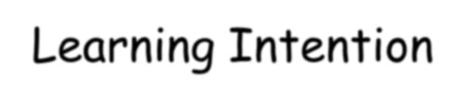
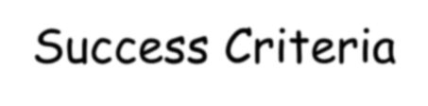
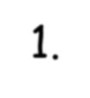
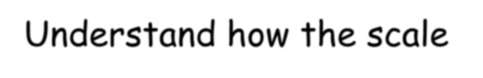
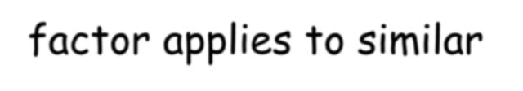
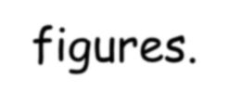
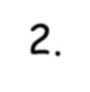
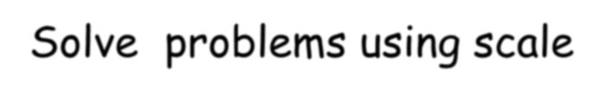
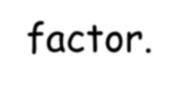





Similar Figures
S4
www.mathsrevision.com
Learning Intention
Success Criteria
1. To explain how the scale factor applies to similar figures.
1. Understand how the scale factor applies to similar figures.
2. Solve problems using scale factor.
12-Jul-26
Created by Mr. Lafferty Maths Dept.

Slide 4
Conditions for similarity
Two shapes are similar only when:
Corresponding sides are in proportion and
Corresponding angles are equal
All rectangles are not similar to one another since only condition 2 is true.

Slide 5


If two objects are similar then one is an enlargement of the other
The rectangles below are similar:
Find the scale factor of enlargement that maps A to B
8 cm
Not to scale!
5 cm
A
16 cm
Scale factor = x2
Note that B to A would be x ½
10 cm
B

Slide 6
If two objects are similar then one is an enlargement of the other
The rectangles below are similar:
Find the scale factor of enlargement that maps A to B
8 cm
Not to scale!
5 cm
A
12 cm
Scale factor = x1½
Note that B to A would be x 2/3
7½ cm
B

Slide 7



If we are told that two objects are similar and we can find the scale factor of enlargement then we can calculate the value of an unknown side.
13½ cm
The 3 rectangles are similar. Find the
unknown sides
Not to scale!
x cm
3 cm
y cm
24 cm
C
B
A
8 cm
Comparing corresponding sides in A and B: 24/8 = 3 so x = 3 x 3 = 9 cm
Comparing corresponding sides in A and C: 13½ /3 = 4½ so y = 4 ½ x 8 = 36 cm

Slide 8



If we are told that two objects are similar and we can find the scale factor of enlargement then we can calculate the value of an unknown side.
y cm
The 3 rectangles are similar. Find the
unknown sides
Not to scale!
7.14 cm
2.1 cm
26.88
cm
C
B
x cm
A
5.6 cm
Comparing corresponding sides in A and B: 7.14/2.1 = 3.4 so x = 3.4 x 5.6 = 19.04 cm
Comparing corresponding sides in A and C: 26.88/5.6 = 4.8 so y = 4.8 x 2.1 = 10.08 cm

Slide 9









Scale Factor applies to ANY SHAPES that are mathematically similar.
1.4 cm 7 cm
2cm
z
y
3 cm
15 cm
6 cm
Given the shapes are similar, find the values y and z ?
Scale factor = ESF = ¹⁵ = 5 Scale factor = RSF = ¹ = 0.2
3 5
y is 2 x 5 = 10 z is 6 x 0.2 = 1.2

Slide 10










Scale Factor applies to ANY SHAPES that are mathematically similar.
b
a
3 cm
7.5 cm
4 cm
8 cm
2cm
10 cm
Given the shapes are similar, find the values a and b ?
Scale factor = RSF = ⁴ = 0.4 Scale factor = ESF = ¹⁰ = 2.5
10 4
a is 8 x 0.4 = 3.2 b is 2 x 2.5 = 5

Slide 11


Similar Figures
S4
www.mathsrevision.com
Now try Ex 1
Ch 9 (page 103)
12-Jul-26
Created by Mr. Lafferty Maths Dept.

Slide 12
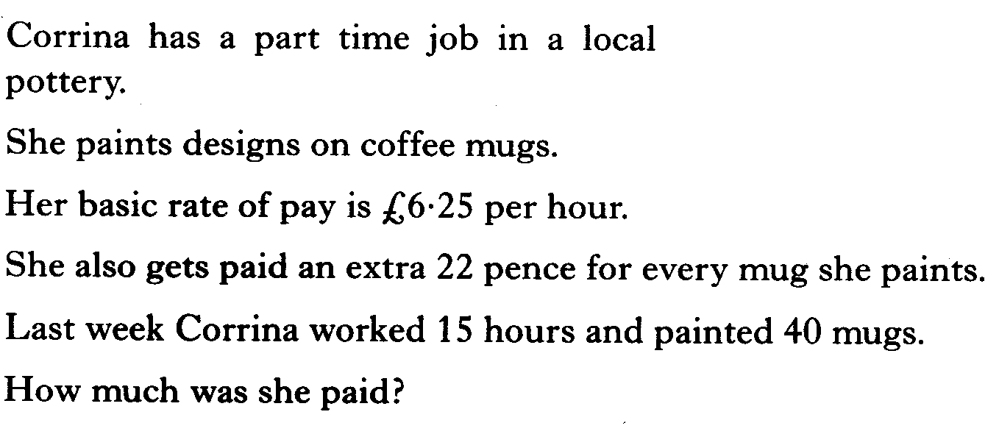
Starter Questions
S4
www.mathsrevision.com
Sunday, 12 July 2026

Slide 13

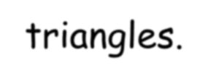
Similar Triangles
S4
www.mathsrevision.com
Learning Intention
Success Criteria
1. To explain how the scale factor applies to similar triangles.
1. Understand how the scale factor applies to similar triangles.
2. Solve problems using scale factor.
12-Jul-26
Created by Mr. Lafferty Maths Dept.

Slide 14



Scale factors
S4
Enlargement Scale factor?
www.mathsrevision.com
₌ 3
ESF =
8 m
2
12cm
Reduction Scale factor?
5cm
₌ 2
RSF =
3
7.5cm
Can you see the relationship between the two scale factors?

Slide 15
Scale factors
S4
Find a given ESF = 3
www.mathsrevision.com
ESF = 3 = ª
9cm
9
By finding the RSF Find the value of b.
27cma
5bcm
_{RSF =} 1 ₌ b ₌ 5
3 15 15
15cm

Slide 16
Finding Unknown sides (1)
b
20 cm
c
6 cm
18 cm
12 cm
Since the triangles are equiangular they are similar.
So comparing corresponding sides.
b ₌ 18
6 12
c ₌ 12
20 18
b = ^{6x 18} = 9 cm
c = ^{20x 12} = 13.3 cm
12
18

Slide 17
Similar Triangles
S4
Now try Ex 2 Ch 9 (page 107)
www.mathsrevision.com
12-Jul-26
Created by Mr. Lafferty Maths Dept.

