Slide 1


Pythagoras Theorem
S4
Finding the length of the smaller side
Length of line using Pythagoras Theorem
www.mathsrevision.com
Solving Real – Life Problems
12 Jul 2026
Compiled by Mr. Lafferty Maths Dept.

Slide 2
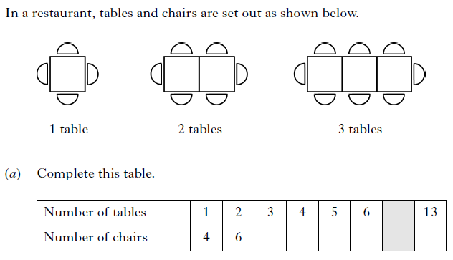
S4 Starter Questions
ALWAYS comes up in exam !!
S4
www.mathsrevision.com

Slide 3
Length of the smaller side
S4
Learning Intention
Success Criteria
1. To show how Pythagoras Theorem can be used to find the length of the smaller side.
  Use Pythagoras Theorem to find the length of smaller side.
www.mathsrevision.com
  2. Show all working.
12 Jul 2026
Compiled by Mr. Lafferty Maths Dept.

Slide 4
Pythagoras Revisited
S4
Two key points when dealing with
right-angled triangles
The longest side in a right-angled triangle is called
The HYPOTENUSE
The HYPOTENUSE is ALWAYS opposite the right angle
www.mathsrevision.com
c² = a² + b²
(xz)² = (xy)² + (yz)²
c
b
x
a
12 Jul 2026
Compiled by Mr. Lafferty Maths Dept.
y
z

Slide 5
Calculating the Hypotenuse
Example 1
Q2. Calculate the longest length of the right- angled triangle below.
c
8
www.mathsrevision.com
12
12 Jul 2026
Compiled by Mr. Lafferty Maths Dept.

Slide 6

Calculating the Hypotenuse
Example 2
Q1. An aeroplane is preparing to land at Glasgow Airport. It is over Lennoxtown at present which is 15km from the airport. It is at a height of 8km.
How far away is the plane from the airport?
Aeroplane
www.mathsrevision.com
c
b = 8
Airport
a = 15
Lennoxtown
12 Jul 2026
Compiled by Mr. Lafferty Maths Dept.

Slide 7
Calculating Hypotenuse
Now try the Review
on page 52
www.mathsrevision.com
12 Jul 2026
Compiled by Mr. Lafferty Maths Dept.

Slide 8
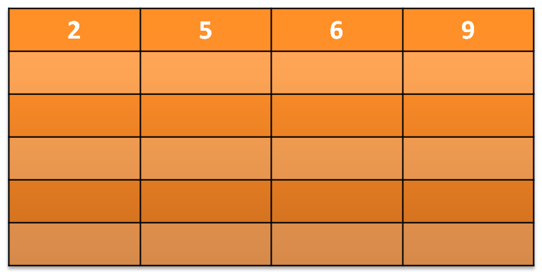
S4 Starter Questions
S4
To get money from a cash machine, you need an appropriate card and a four-digit Personal Identification Number (PIN).
Gary knows:
  His PIN contains the digits 2, 5, 6 and 9
  2 is the first digit
www.mathsrevision.com
One possible PIN is shown in the table.
Copy and complete the table with all possible PINs.

Slide 9
Length of the smaller side
S4
To find the length of the smaller side
of a right-angled triangle
we simply rearrange Pythagoras Theorem.
Example : Find the length of side a ?
Check answer ! Always smaller than hypotenuse
www.mathsrevision.com
20cm
12cm
a cm
12 Jul 2026
Compiled by Mr. Lafferty Maths Dept.

Slide 10
Length of the smaller side
S4
Example : Find the length of side b ?
10cm
b cm
www.mathsrevision.com
Check answer ! Always smaller than hypotenuse
8 cm
12 Jul 2026
Compiled by Mr. Lafferty Maths Dept.

Slide 11

Length of smaller side
S4
Now try
Ch5 Ex1 (Page 54)
www.mathsrevision.com
12 Jul 2026
Compiled by Mr. Lafferty Maths Dept.

Slide 12
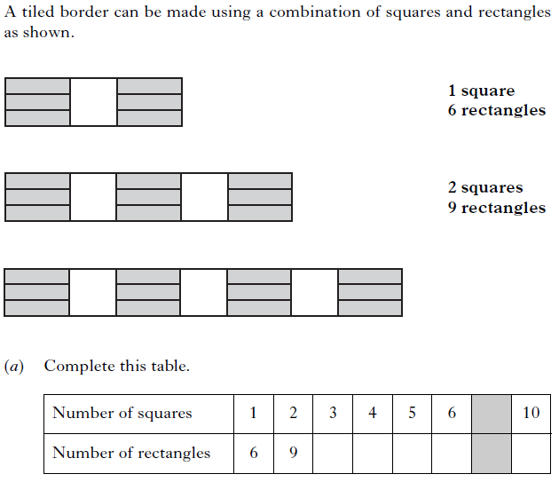
S4 Starter Questions
S4
www.mathsrevision.com
12 Jul 2026
Compiled by Mr. Lafferty Maths Dept.

Slide 13
Finding the
Length of a Line
S4
Learning Intention
Success Criteria
1. To show how Pythagoras Theorem can be used to find the length of a line.
  Apply Pythagoras Theorem to find length of a line.
www.mathsrevision.com
  2. Show all working.
12 Jul 2026
Compiled by Mr. Lafferty Maths Dept.

Slide 14
Using the coordinate grid, can you draw a right-angled triangle containing the line we want to find the length of?.
12 Jul 2026
Created by Mr. Lafferty Maths Dept.
Finding the
Length of a Line
8
(7,7)
7
6
3
5
5
4
(2,4)
www.mathsrevision.com
3
2
1
0
1
2
3
4
5
6
7
8
9
10

Slide 15
12 Jul 2026
Created by Mr. Lafferty Maths Dept.
Pythagoras Theorem to find the length of a Line
8
7
(0,6)
6
5
4
5
www.mathsrevision.com
3
2
(9,1)
9
1
0
1
2
3
4
5
6
7
8
9
10

Slide 16
Pythagoras Theorem to find the length of a Line
S4
Now try Ex 2
Ch5 (page 56)
www.mathsrevision.com
12 Jul 2026
Compiled by Mr. Lafferty Maths Dept.

Slide 17
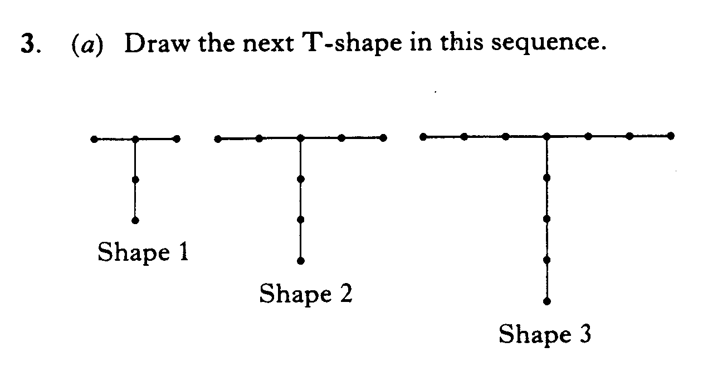
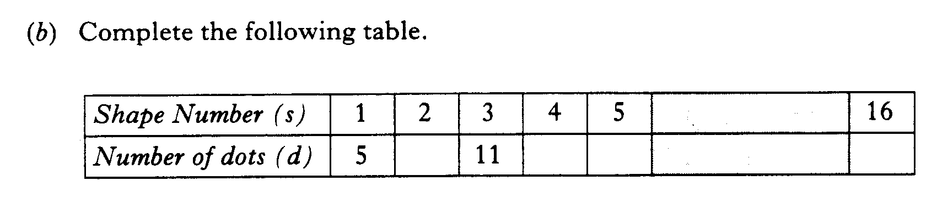
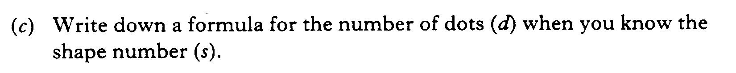
S4 Starter Questions
S4
www.mathsrevision.com
12 Jul 2026
Compiled by Mr. Lafferty Maths Dept.

Slide 18
Solving Real – Life Problems
Using Pythagoras Theorem
S4
Learning Intention
Success Criteria
1. To show how Pythagoras Theorem can be used to solve real-life problems.
  Apply Pythagoras Theorem to solve real-life problems.
www.mathsrevision.com
  2. Show all working.
12 Jul 2026
Compiled by Mr. Lafferty Maths Dept.

Slide 19
Solving Real-Life Problems
S4
When coming across a problem involving finding a missing side in a right-angled triangle, you should consider using Pythagoras’ Theorem to calculate its length.
Example : A steel rod is used to support a tree
which is in danger of falling down.
What is the height of the tree ?
www.mathsrevision.com
17m
a
c
rod
8m
b
12 Jul 2026
Compiled by Mr. Lafferty Maths Dept.

Slide 20
Solving Real-Life Problems
S4
Example 2
A garden has a fence around its perimeter and
along its diagonal as shown below.
What is the length of the fence from D to C.
A
B
www.mathsrevision.com
5m
13m
D
C
b m
12 Jul 2026
Compiled by Mr. Lafferty Maths Dept.

Slide 21
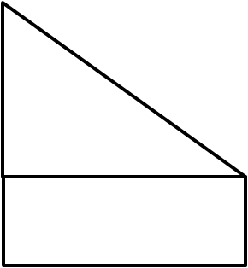
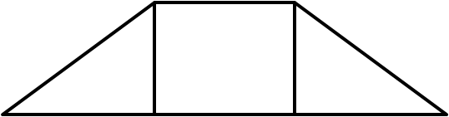
N
G
H
O
C
D
E
F
M
P
J
I
r
P(x,y)
K
L
A
C
o
Q
R
U
V
T
A
W
Z
S
B

Slide 22
Mixed Examples
S4
Now try Ex 3
Ch5 (page 58)
www.mathsrevision.com
12 Jul 2026
Compiled by Mr. Lafferty Maths Dept.

