Slide 1
Investigating the Tangent Ratio
The Tangent (Finding lengths)
The Tangent (Finding the Angle)
The Sine Ratio (Finding a length)
The Sine Ratio (Finding an angle)
The Cosine ( Finding a length)
The Cosine of an Angle
Mixed Problems

Slide 2


Starter Questions
National 4
REL 1.3a
REL 1.3b
Q1. Calculate
Q2. Convert 60% to fraction and simplify.
Q3. Convert
to a percentage.
www.mathsrevision.com
Q4. What is the time difference 09:28 and 10:50
Q5. The answer to the question is 90. What is the
question.
12 Jul 2026
Created by Mr.Lafferty Maths Dept

Slide 3
Angles & Triangles
National 4
REL 1.3a
REL 1.3b
Learning Intention
Success Criteria
  To identify the hypotenuse, opposite and adjacent sides in a right angled triangle.
  1. Understand the terms hypotenuse, opposite and adjacent in right angled triangle.
www.mathsrevision.com
  2. Work out Tan Ratio.
12 Jul 2026
Created by Mr. Lafferty Maths Dept.

Slide 4
Trigonometry means “triangle” and “measurement”.
We will be using right-angled triangles.
Opposite
hypotenuse
x°
Adjacent

Slide 5
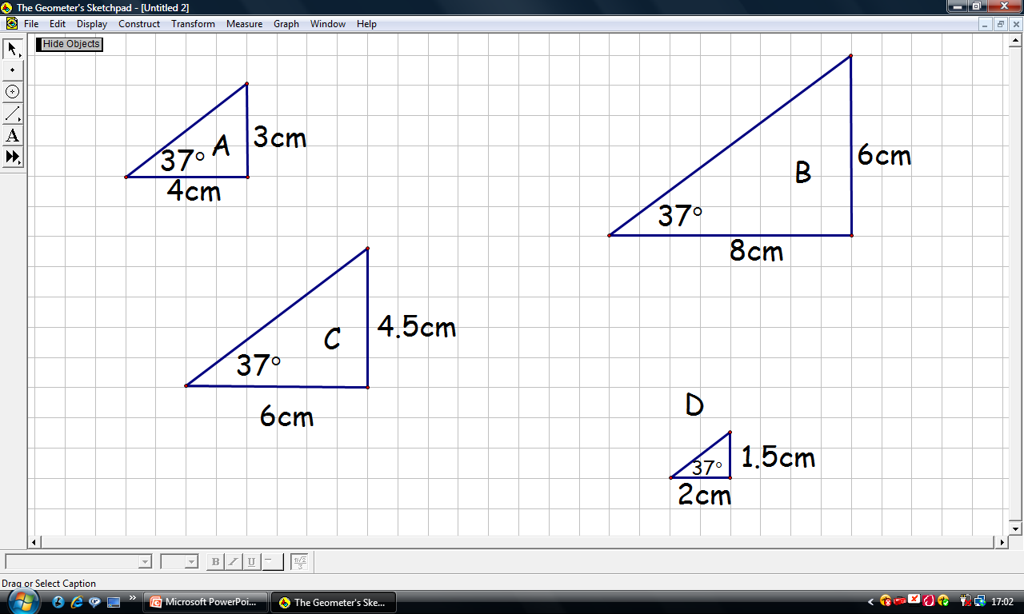
These triangles have 2 things in common
One is 37º
The other we will investigate

Slide 6
Triangle | A | B | C | D
Vertical side | 3cm | 6cm | 4cm
Horizontal side | 4cm | 8cm | 6cm
1.5cm
2cm
0.75
0.75

Slide 7
Right-Angled Triangle
Trigonometry
National 4
REL 1.3a
REL 1.3b
For the RAT with angle of 37º
the answer obtained by dividing vertical side
by horizontal side was
ALWAYS 0.75
tan37º
www.mathsrevision.com
The number has a special name
It is called the TANGENT of 37º
www.mathsrevision.com

Slide 8
Using a calculator to find tan ratio What Goes In The Box ?
National 4
REL 1.3a
REL 1.3b
Find the tan ratio to 3 decimal places.
tan 30º
tan 0º
tan 45º
= 0.577
= 0.000
= 1.000
tan 60º
tan 20º
tan 70º
= 1.732
= 0.364
= 2.747
www.mathsrevision.com

Slide 9
National 4
REL 1.3a
REL 1.3b
Opp
Tan x° =
Adj
Opposite
x°
Adjacent

Slide 10

Opposite
hypotenuse
Copy this!
60°
12 m
Adjacent

Slide 11
Opp
Tan x° =
Copy this!
Adj
Opp
Tan 60° =
12
12 x Tan 60°
= Opp
Opp =
12 x Tan 60°
= 20.8m (1 d.p.)

Slide 12

Tan Ratio Ex1
Ch16 Page 198

Slide 13
Starter Questions
National 4
REL 1.3a
REL 1.3b
xº
www.mathsrevision.com
www.mathsrevision.com

Slide 14
Angles & Triangles
National 4
REL 1.3a
REL 1.3b
Learning Intention
Success Criteria
  To use tan of the angle to solve REAL LIFE problems.
  1. Write down tan ratio.
www.mathsrevision.com
  2. Use tan of an angle to solve REAL LIFE problems.
12 Jul 2026
Created by Mr. Lafferty Maths Dept.

Slide 15
National 4
REL 1.3a
REL 1.3b
Opp
Tan x° =
Adj
Opposite
x°
Adjacent

Slide 16


Example
Find the height h
National 4 REL 1.3 a + 1.3b
S^{O}H C^{A}H T^{O}A
Opp
Hyp
Opp
h
Tan x° =
Adj
65°
h
Tan 65° =
8m
8
Adj
8 x Tan 65°
= h
h =
8 x Tan 65°
= 17.2m (1 d.p.)

Slide 17

Use the tan ratio to find the height h of the tree
to 2 decimal places.
S^{O}H C^{A}H T^{O}A
rod
47º
12 Jul 2026
Compiled by Mr. Lafferty Maths Dept.
8m

Slide 18

S^{O}H C^{A}H T^{O}A
Example 2
Q1. An aeroplane is preparing to land at Glasgow Airport. It is over Lennoxtown at present which is 15km from the airport. The angle of descent is 6º.
What is the height of the plane ?
Aeroplane
c
6º
Airport
a = 15
Lennoxtown
12 Jul 2026
Compiled by Mr. Lafferty Maths Dept.

Slide 19
Use the tan ratio to calculate how far the ladder is away from the building.
S^{O}H C^{A}H T^{O}A
ladder
12m
45º
12 Jul 2026
Compiled by Mr. Lafferty Maths Dept.
d m

Slide 20
Example 2
Q1. An aeroplane is preparing to land at Glasgow Airport. It is over Lennoxtown at present. It is at a height of 1.58 km above the ground. It ‘s angle of descent is 6º.
How far is it from the airport to Lennoxtown?
S^{O}H C^{A}H T^{O}A
Aeroplane
a = 1.58 km
6º
Airport
Lennoxtown
12 Jul 2026
Compiled by Mr. Lafferty Maths Dept.

Slide 21
Now try
Exercise 2
Ch16 (page 199)

Slide 22
Starter Questions
National 4
REL 1.3a
REL 1.3b
10cm
www.mathsrevision.com
Q
6cm
10cm
P
7cm
R
www.mathsrevision.com

Slide 23
Angles & Triangles
National 4
REL 1.3a
REL 1.3b
Learning Intention
Success Criteria
  To use tan of the angle to solve problems.
  1. Write down tan ratio.
www.mathsrevision.com
  2. Use tan of an angle to solve problems.
12 Jul 2026
Created by Mr. Lafferty Maths Dept.

Slide 24
Using Tan to calculate angles
National 4
REL 1.3a
REL 1.3b
www.mathsrevision.com
www.mathsrevision.com

Slide 25
Using a calculator to find angle given tan ratio
What Goes In The Box ?
National 4
REL 1.3a
REL 1.3b
Find the angle given the tan ratio to 1 decimal places.
tan⁻¹ 1
tan⁻¹ 0.5
tan⁻¹ 0.8
= 45.0º
= 26.6º
= 38.7º
tan⁻¹ 0.6
tan⁻¹ 2
tan⁻¹ 3
= 31.0º
= 64.4º
= 71.6º
www.mathsrevision.com

Slide 26
Example
Calculate the tan xº ratio
National 4
REL 1.3a
REL 1.3b
P
S^{O}H C^{A}H T^{O}A
Opp
Hyp
18m
Opp
Tan x° =
Adj
x°
Q
18
R
12m
Tan x° =
Adj
12
Tan x°
= 1.5

Slide 27


Calculate the size of
angle xº
Tan x°
= 1.5
How do we find x°?
We need to use Tan ⁻¹on the calculator.
Tan ⁻¹
Tan ⁻¹is written above
Tan
To get this press
2nd
Followed by
Tan

Slide 28
Tan x°
= 1.5
Tan ⁻¹
Press
2nd
Tan
Enter
1.5
=
x =
Tan ⁻¹1.5
= 56.3° (1 d.p.)

Slide 29
Process
1. Identify Hyp, Opp and Adj
2. Write down ratio Tan xº = Opp
Adj
Tan ⁻¹
3. Calculate xº
2nd
Tan

Slide 30
Use the tan ratio to calculate the angle that the support wire makes with the ground.
S^{O}H C^{A}H T^{O}A
11m
xº
12 Jul 2026
Compiled by Mr. Lafferty Maths Dept.
4 m

Slide 31
Now try
Exercise 3
Ch16 Page 202

Slide 32
Starter Questions
National 4
REL 1.3a
REL 1.3b
www.mathsrevision.com
12 Jul 2026
Created by Mr.Lafferty Maths Dept

Slide 33
Angles & Triangles
National 4
REL 1.3a
REL 1.3b
Learning Intention
Success Criteria
  Definite the sine ratio and show how to find an angle using this ratio.
  1. Write down sine ratio.
www.mathsrevision.com
  2. Use sine ratio to find an angle.
12 Jul 2026
Created by Mr. Lafferty Maths Dept.

Slide 34
The Sine Ratio
National 4
REL 1.3a
REL 1.3b
Opp
Sin x° =
Hyp
Opposite
hypotenuse
x°

Slide 35
Using a calculator to find sin ratio What Goes In The Box ?
National 4
REL 1.3a
REL 1.3b
Find the sin ratio to 3 decimal places.
sin 30º
sin 0º
sin 45º
= 0.500
= 0.000
= 0.707
sin 60º
sin 20º
sin 90º
= 0.866
= 0.342
= 1.000
www.mathsrevision.com

Slide 36
Example
Find the height h
National 4
REL 1.3a
REL 1.3b
11cm
Hyp
h
Opp
Opp
Sin x° =
Hyp
34°
h
Sin 34° =
11
S^{O}H C^{A}H T^{O}A
11 x Sin 34°
= h
h =
11 x Sin 34°
= 6.2cm (1 d.p.)

Slide 37
The support rope is 11.7m long. The angle between the rope and ground is 70º. Use the sine ratio to calculate the height of the flag pole.
S^{O}H C^{A}H T^{O}A
11.7m
h
70º
12 Jul 2026
Compiled by Mr. Lafferty Maths Dept.

Slide 38
Example
National 4
REL 1.3a
REL 1.3b
S^{O}H C^{A}H T^{O}A
A road AB is right angled at B.
The road BC is 5 km.
Calculate the length of
the new road AC.
Opp
Sin x° =
Hyp
B
A
5
Sin 72° =
72°
r
5km
r =
r
r =
C
5.3 km

Slide 39
Now try
Extension Booklet
Ex4E (page 83)

Slide 40
Starter Questions
National 4
REL 1.3a
REL 1.3b
www.mathsrevision.com
www.mathsrevision.com

Slide 41
Angles & Triangles
National 4
REL 1.3a
REL 1.3b
Learning Intention
Success Criteria
  To show how to use the sine ratio to find angle in
  REAL-LIFE problems.
  1. Write down sine ratio.
www.mathsrevision.com
  Use sine ratio to find angle
  REAL-LIFE problems.
12 Jul 2026
Created by Mr. Lafferty Maths Dept.

Slide 42
Using Sin to calculate angles
National 4
REL 1.3a
REL 1.3b
www.mathsrevision.com
www.mathsrevision.com

Slide 43
Using a calculator to find angle given sin ratio
What Goes In The Box ?
National 4
REL 1.3a
REL 1.3b
Find the angle given the sin ratio to 1 decimal places.
sin⁻¹ 1
sin⁻¹ 0.5
sin⁻¹ 0.8
= 90.0º
= 30.0º
= 53.1º
sin⁻¹ 0.6
sin⁻¹ 0.1
sin⁻¹ 0.9
= 36.9º
= 5.7º
= 64.2º
www.mathsrevision.com

Slide 44
Example
Find the xº
National 4
REL 1.3a
REL 1.3b
9m
Hyp
6m
Opp
x°
Opp
Sin x° =
Hyp
S^{O}H C^{A}H T^{O}A
6
Sin x° =
9
Sin x°
= 0.667 (3 d.p.)

Slide 45
Sin x°
=0.667 (3 d.p.)
How do we find x°?
We need to use Sin ⁻¹on the calculator.
Sin ⁻¹
Sin ⁻¹is written above
Sin
To get this press
2nd
Followed by
Sin

Slide 46
Sin x°
= 0.667 (3 d.p.)
Sin ⁻¹
Press
2nd
Sin
Enter
0.667
=
x =
Sin ⁻¹0.667
= 41.8° (1 d.p.)

Slide 47

Use the sine ratio to find the angle of the ramp.
S^{O}H C^{A}H T^{O}A
20 m
10m
xº
12 Jul 2026
Compiled by Mr. Lafferty Maths Dept.

Slide 48
Now try
Extension Booklet
Ex5E (page 85)

Slide 49
Starter Questions
National 4
REL 1.3a
REL 1.3b
www.mathsrevision.com
www.mathsrevision.com

Slide 50
Angles & Triangles
National 4
REL 1.3a
REL 1.3b
Learning Intention
Success Criteria
  Definite the cosine ratio and show how to find an length or angle using this ratio.
  1. Write down cosine ratio.
www.mathsrevision.com
  2. Use cosine ratio to find a length or angle.
12 Jul 2026
Created by Mr. Lafferty Maths Dept.

Slide 51
Using a calculator to find cos ratio What Goes In The Box ?
National 4
REL 1.3a
REL 1.3b
Find the cos ratio to 3 decimal places.
cos 30º
cos 0º
cos 45º
= 0.866
= 1.000
= 0.707
cos 60º
cos 20º
cos 90º
= 0.500
= 0.940
= 0.000
www.mathsrevision.com

Slide 52
The Cosine Ratio
National 4
REL 1.3a
REL 1.3b
Adj
Cos x° =
Hyp
hypotenuse
x°
Adjacent

Slide 53
Example
Find the adjacent length b
National 4
REL 1.3a
REL 1.3b
b
Adj
40°
Adj
Cos x° =
Opp
Hyp
Hyp
35mm
b
Cos 40° =
35
S^{O}H C^{A}H T^{O}A
35 x Cos 40°
= b
b =
35 x Cos 40°
= 26.8mm (1 d.p.)

Slide 54
Now try
Extension Booklet
Ex6E (page 88 Q1 to Q5)

Slide 55
Starter Questions
National 4
REL 1.3a
REL 1.3b
www.mathsrevision.com
12 Jul 2026
Created by Mr.Lafferty Maths Dept

Slide 56
Angles & Triangles
National 4
REL 1.3a
REL 1.3b
Learning Intention
Success Criteria
  Definite the cosine ratio and show how to find an length or angle using this ratio.
  1. Write down cosine ratio.
www.mathsrevision.com
  2. Use cosine ratio to find a length or angle.
12 Jul 2026
Created by Mr. Lafferty Maths Dept.

Slide 57
Using Cos to calculate angles
National 4
REL 1.3a
REL 1.3b
www.mathsrevision.com
www.mathsrevision.com

Slide 58
Using a calculator to find angle given cos ratio
What Goes In The Box ?
National 4
REL 1.3a
REL 1.3b
Find the angle given the cos ratio to 1 decimal places.
cos⁻¹ 1
cos⁻¹ 0
cos⁻¹ 0.8
= 0.0º
= 90.0º
= 36.9º
cos⁻¹ 0.6
cos⁻¹ 0.1
cos⁻¹ 0.9
= 53.1º
= 84.3º
= 25.8º
www.mathsrevision.com

Slide 59

Example
Find the angle xº
National 4
REL 1.3a
REL 1.3b
34cm
Adj
Adj
x°
Cos x° =
Hyp
Opp
Hyp
45cm
34
Cos x° =
45
S^{O}H C^{A}H T^{O}A
Cos x°
= 0.756 (3 d.p.)
x =
Cos ⁻¹0.756
=41°

Slide 60
Now try
Extension Booklet
Ex6E (page 89 Q6 to Q8)

Slide 61
Starter Questions
National 4
REL 1.3a
REL 1.3b
www.mathsrevision.com
xº
10
6
www.mathsrevision.com
8

Slide 62







The Three Ratios
National 4
REL 1.3a
REL 1.3b
opposite
adjacent
Cosine
Tangent
Sine
hypotenuse
Sine
adjacent
adjacent
Cosine
www.mathsrevision.com
Cosine
Tangent
hypotenuse
opposite
opposite
Sine
Sine
www.mathsrevision.com
hypotenuse

Slide 63
National 4
REL 1.3a
REL 1.3b
Opp
Adj
Opp
Sin x° =
Cos x° =
Tan x° =
Hyp
Hyp
Adj
S^{O}H
C^{A}H
T^{O}A

Slide 64


National 4
REL 1.3a
REL 1.3b
Process
1. Write down
S^{O}H C^{A}H T^{O}A
2.
Identify what you want to find
3.
what you know
Copy this!

Slide 65
Past Paper Type Questions
National 4
REL 1.3a
REL 1.3b
S^{O}H C^{A}H T^{O}A

Slide 66
Past Paper Type Questions
National 4
REL 1.3a
REL 1.3b
S^{O}H C^{A}H T^{O}A
(4 marks)

Slide 67
Past Paper Type Questions
National 4
REL 1.3a
REL 1.3b
S^{O}H C^{A}H T^{O}A

Slide 68
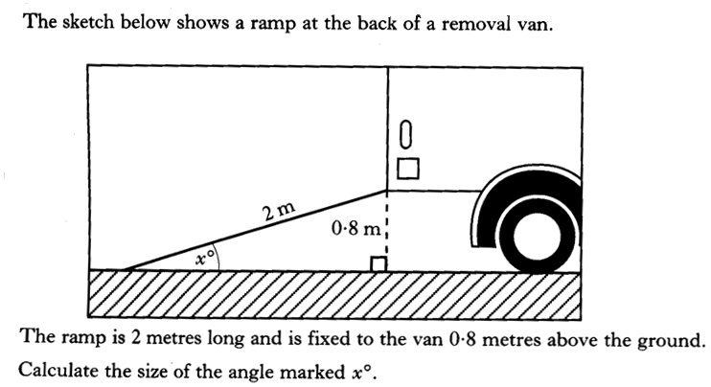
Past Paper Type Questions
National 4
REL 1.3a
REL 1.3b
S^{O}H C^{A}H T^{O}A
4 marks

Slide 69
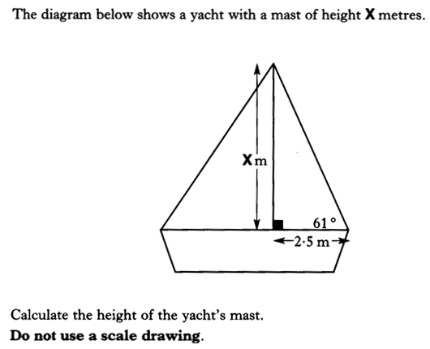
Past Paper Type Questions
National 4
REL 1.3a
REL 1.3b
S^{O}H C^{A}H T^{O}A

Slide 70
Past Paper Type Questions
National 4
REL 1.3a
REL 1.3b
S^{O}H C^{A}H T^{O}A
(4marks)

Slide 71
Past Paper Type Questions
National 4
REL 1.3a
REL 1.3b
S^{O}H C^{A}H T^{O}A

Slide 72
Past Paper Type Questions
National 4
REL 1.3a
REL 1.3b
S^{O}H C^{A}H T^{O}A
(4marks)

Slide 73
Now try
Extension Booklet
Ex7E (page 91)

