Slide 1


Statistics
National 4
EF 1.3e
Probability Line
Calculating Simple Probability
www.mathsrevision.com
12 Jul 2026
Created by Mr. Lafferty
<number>

Slide 2
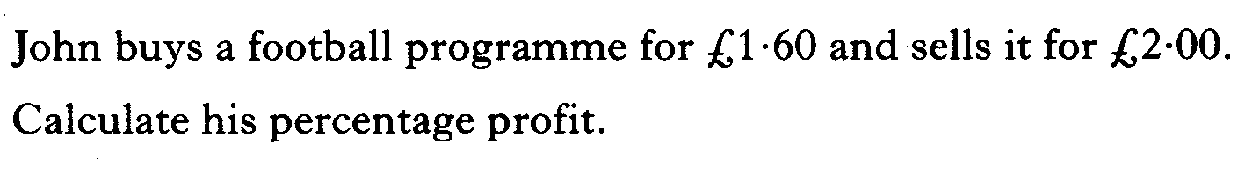
Starter Questions
National 4
EF 1.3e
www.mathsrevision.com
Expand and simplify 4( 3 + 2x) – 3(x + 1)
12 Jul 2026
Created by Mr.Lafferty Maths Dept

Slide 3
Probability
National 4
EF 1.3e
Learning Intention
Success Criteria
  To understand probability in terms of the number line.
  Understand the probability line.
www.mathsrevision.com
Calculate simply probabilities.
12 Jul 2026
Created by Mr Lafferty Maths Dept

Slide 4
Probability
Likelihood Line
National 4
EF 1.3e
0
0.5
1
Impossible
Evens
Certain
Not very
likely
Very
likely
www.mathsrevision.com
Seeing
a butterfly
In July
School
Holidays
Winning the
Lottery
Baby Born
A Boy
Go back
in time
12 Jul 2026
Created by Mr Lafferty Maths Dept

Slide 5
Probability
Likelihood Line
National 4
EF 1.3e
0
0.5
1
Impossible
Evens
Certain
Not very
likely
Very
likely
www.mathsrevision.com
It will
Snow in winter
Homework
Every week
Everyone getting
100 % in test
Toss a coin
That land
Heads
Going without
Food
for a year.
12 Jul 2026
Created by Mr Lafferty Maths Dept

Slide 6

Probability
National 4
EF 1.3e
Now try Ex Intro.
Ch18 (page 214)
www.mathsrevision.com
12 Jul 2026
Created by Mr. Lafferty Maths Dept.

Slide 7
Starter Questions
National 4
EF 1.3e
Q1. Calculate 7 – 5 x 2
Q2. Calculate
www.mathsrevision.com
Q3. Is this triangle right angled ?
Explain
9
8
5
12 Jul 2026
Created by Mr.Lafferty Maths Dept

Slide 8
Probability
National 4
EF 1.3e
Learning Intention
Success Criteria
  To understand probability calculate simple probabilities.
  Calculate simply probabilities.
www.mathsrevision.com
12 Jul 2026
Created by Mr Lafferty Maths Dept

Slide 9
Probability
National 4
EF 1.3e
We can normally attach a value
to the probability of an event happening.
To work out a probability
www.mathsrevision.com
P(A) =
Probability is ALWAYS in the range 0 to 1
12 Jul 2026
Created by Mr Lafferty Maths Dept

Slide 10

Probability
Number Likelihood Line
National 4
EF 1.3e
1
2
3
4
5
6
7
8
0
0.5
1
0.1
0.2
0.3
0.4
0.6
0.7
0.8
0.9
Impossible
Evens
Certain
www.mathsrevision.com
8
Q. What is the chance of picking a number between 1 – 8 ?
P =
= 1
8
Q. What is the chance of picking a number that is even ?
4
P(E) =
= 0.5
8
Q. What is the chance of picking the number 1 ?
1
P(1) =
= 0.125
12 Jul 2026
Created by Mr Lafferty Maths Dept
8

Slide 11
Probability
Likelihood Line
National 4
EF 1.3e
52 cards in a pack of cards
0
0.5
1
0.1
0.2
0.3
0.4
0.6
0.7
0.8
0.9
Impossible
Evens
Certain
Not very
likely
Very
likely
www.mathsrevision.com
26
Q. What is the chance of picking a red card ?
P (Red) =
= 0.5
52
Q. What is the chance of picking a diamond ?
13
P (D) =
= 0.25
52
Q. What is the chance of picking ace ?
4
P (Ace) =
= 0.08
52
12 Jul 2026
Created by Mr Lafferty Maths Dept

Slide 12
Probability
National 4
EF 1.3e
Now try Ex 1
Ch18 (page 215)
www.mathsrevision.com
12 Jul 2026
Created by Mr. Lafferty Maths Dept.

