Slide 1


Pythagoras Theorem
Squaring a Number and Square Roots
Investigating Pythagoras Theorem
Calculating the Hypotenuse
Solving real-life problems
www.mathsrevision.com
Finding the length of the smaller side
Distance between two points
Mixed problems
12 Jul 2026
Compiled by Mr. Lafferty Maths Dept.

Slide 2
Starter Questions
www.mathsrevision.com
12 Jul 2026
Compiled by Mr. Lafferty Maths Dept.

Slide 3
Squaring a Number
Learning Intention
Success Criteria
  To understand the term
  ‘squaring a number’.
  To understand what is meant by the term
  ‘squaring a number’
Be able to calculate squares both mentally and using the calculator.
www.mathsrevision.com
12 Jul 2026
Compiled by Mr. Lafferty Maths Dept.

Slide 4
Squaring a Number
To square a number means to :
“Multiply it by itself”
Example :
means 9 x 9 = 81
www.mathsrevision.com
means 10 x 10 = 100
12 Jul 2026
Compiled by Mr. Lafferty Maths Dept.

Slide 5

Squaring a Number
Now try Exercise 1
Ch13 (page 151)
www.mathsrevision.com
12 Jul 2026
Compiled by Mr. Lafferty Maths Dept.

Slide 6
Square Root of a number
You now know how to find :
9² = 9 x 9 = 81
We can ‘undo’ this by asking
“which number, times itself, gives 81”
www.mathsrevision.com
From the top line, the answer is 9
This is expressed as : “the SQUARE ROOT of 81 is 9”
or in symbols we write :
12 Jul 2026
Compiled by Mr. Lafferty Maths Dept.

Slide 7
Square Root of a Number
Now try Exercise 2
Ch13 (page 153)
www.mathsrevision.com
12 Jul 2026
Compiled by Mr. Lafferty Maths Dept.

Slide 8
Starter Questions
Q1. Are the missing angles
65º, 40º and 65º
115º
Q2. Calculate
www.mathsrevision.com
Q3. The cost of a new computer is £1000 +vat. If the vat is charged at 12% what is the total cost.
Q4. The cost of a bag of sugar is £1.12. How much 50 bags cost.
NON-CALCULATOR
12 Jul 2026
Compiled by Mr. Lafferty Maths Dept.

Slide 9
Right – Angle Triangles
Aim of today's Lesson
‘To investigate the right-angle triangle and to come up with a relationship between the lengths of its two shorter sides and the longest side which is called the hypotenuse. ‘
www.mathsrevision.com
12 Jul 2026
Compiled by Mr. Lafferty Maths Dept.

Slide 10
Right – Angle Triangles
What is the length of a ?
3
What is the length of b ?
4
www.mathsrevision.com
Copy the triangle into your jotter
and measure the length of c
5
12 Jul 2026
Compiled by Mr. Lafferty Maths Dept.

Slide 11
Right – Angle Triangles
What is the length of a ?
6
What is the length of b ?
8
www.mathsrevision.com
Copy the triangle into your jotter
and measure the length of c
10
12 Jul 2026
Compiled by Mr. Lafferty Maths Dept.

Slide 12
Right – Angle Triangles
What is the length of a ?
5
What is the length of b ?
12
www.mathsrevision.com
Copy the triangle into your jotter
and measure the length of c
13
12 Jul 2026
Compiled by Mr. Lafferty Maths Dept.

Slide 13
Right – Angle Triangles
Copy the table below and fill in the values that are missing
a | b | c | a² | b² | c²
3 | 4 | 5
5 | 12 | 13
6 | 8 | 10
www.mathsrevision.com
12 Jul 2026
Compiled by Mr. Lafferty Maths Dept.

Slide 14
Right – Angle Triangles
Can anyone spot a relationship between
a², b², c².
a | b | c | a² | b² | c²
3 | 4 | 5 | 9 | 16 | 25
5 | 12 | 13 | 25 | 144 | 169
6 | 8 | 10 | 36 | 64 | 100
www.mathsrevision.com
12 Jul 2026
Compiled by Mr. Lafferty Maths Dept.

Slide 15
Pythagoras’s Theorem
c
b
www.mathsrevision.com
a
12 Jul 2026
Compiled by Mr. Lafferty Maths Dept.

Slide 16
Summary of
Pythagoras’s Theorem
www.mathsrevision.com
Note: The equation is ONLY valid for right-angled triangles.
12 Jul 2026
Compiled by Mr. Lafferty Maths Dept.

Slide 17
Pythagoras Theorem
Now try Exercise 3
Ch13 (page 154)
www.mathsrevision.com
12 Jul 2026
Compiled by Mr. Lafferty Maths Dept.

Slide 18
Starter Questions
www.mathsrevision.com
12 Jul 2026
Compiled by Mr. Lafferty Maths Dept.

Slide 19
Calculating Hypotenuse
Learning Intention
Success Criteria
  Use Pythagoras Theorem to calculate the length of the hypotenuse
  “the longest side”
  Know the term hypotenuse “ the longest side”
Use Pythagoras Theorem to calculate the hypotenuse.
www.mathsrevision.com
12 Jul 2026
Compiled by Mr. Lafferty Maths Dept.

Slide 20
Calculating the Hypotenuse
Example 1
Q2. Calculate the longest length of the right- angled triangle below.
c
8
www.mathsrevision.com
12
12 Jul 2026
Compiled by Mr. Lafferty Maths Dept.

Slide 21

Calculating the Hypotenuse
Example 2
Q1. An aeroplane is preparing to land at Glasgow Airport. It is over Lennoxtown at present which is 15km from the airport. It is at a height of 8km.
How far away is the plane from the airport?
Aeroplane
www.mathsrevision.com
c
b = 8
Airport
a = 15
Lennoxtown
12 Jul 2026
Compiled by Mr. Lafferty Maths Dept.

Slide 22
Calculating Hypotenuse
Now try Exercise 4
Ch13 (page 156)
www.mathsrevision.com
12 Jul 2026
Compiled by Mr. Lafferty Maths Dept.

Slide 23
Starter Questions
www.mathsrevision.com
12 Jul 2026
Compiled by Mr. Lafferty Maths Dept.

Slide 24
Solving Real-Life Problems
Learning Intention
Success Criteria
1. To show how Pythagoras Theorem can be used to solve real-life problems.
  Solve real-life problems using Pythagoras Theorem.
www.mathsrevision.com
12 Jul 2026
Compiled by Mr. Lafferty Maths Dept.

Slide 25
Solving Real-Life Problems
When coming across a problem involving finding a missing side in a right-angled triangle, you should consider using Pythagoras’ Theorem to calculate its length.
Example : A steel rod is used to support a tree
which is in danger of falling down.
What is the length of the rod?
www.mathsrevision.com
15m
rod
8m
12 Jul 2026
Compiled by Mr. Lafferty Maths Dept.

Slide 26
Solving Real-Life Problems
Example 2
A garden is rectangular in shape. A fence is to be put along the diagonal as shown below.
What is the length of the fence.
www.mathsrevision.com
10m
15m
12 Jul 2026
Compiled by Mr. Lafferty Maths Dept.

Slide 27
Solving Real-Life Problems
Now try Exercise 5
Ch13 (page 159)
www.mathsrevision.com
12 Jul 2026
Compiled by Mr. Lafferty Maths Dept.

Slide 28
Starter Questions
www.mathsrevision.com
12 Jul 2026
Compiled by Mr. Lafferty Maths Dept.

Slide 29
Length of the smaller side
Learning Intention
Success Criteria
1. To show how Pythagoras Theorem can be used to find the length of the smaller side.
  Use Pythagoras Theorem to find the length of smaller side.
www.mathsrevision.com
12 Jul 2026
Compiled by Mr. Lafferty Maths Dept.

Slide 30
Length of the smaller side
To find the length of the smaller side of a right- angled
triangle we simply rearrange Pythagoras Theorem.
Example : Find the length of side a ?
Check answer ! Always smaller than hypotenuse
www.mathsrevision.com
20cm
12cm
a cm
12 Jul 2026
Compiled by Mr. Lafferty Maths Dept.

Slide 31
Length of the smaller side
Example : Find the length of side b ?
10cm
b cm
Check answer ! Always smaller than hypotenuse
www.mathsrevision.com
8 cm
12 Jul 2026
Compiled by Mr. Lafferty Maths Dept.

Slide 32
Length of smaller side
Now try Exercise 6
Ch13 (page 161)
www.mathsrevision.com
12 Jul 2026
Compiled by Mr. Lafferty Maths Dept.

Slide 33
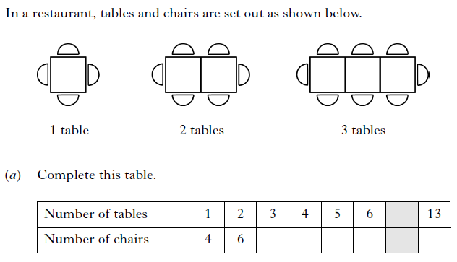
Starter Questions
ALWAYS comes up in exam !!
www.mathsrevision.com

Slide 34
Finding the
Length of a Line
Learning Intention
Success Criteria
1. To show how Pythagoras Theorem can be used to find the length of a line.
  Apply Pythagoras Theorem to find length of a line.
www.mathsrevision.com
  2. Show all working.
12 Jul 2026
Compiled by Mr. Lafferty Maths Dept.

Slide 35
Discuss with your partner how we might find the length of the line.
12 Jul 2026
Created by Mr. Lafferty Maths Dept.
Finding the
Length of a Line
National 4
REL 1.2a
8
(7,7)
7
6
3
5
5
4
(2,4)
www.mathsrevision.com
3
2
1
0
1
2
3
4
5
6
7
8
9
10

Slide 36
12 Jul 2026
Created by Mr. Lafferty Maths Dept.
Pythagoras Theorem to find the length of a Line
National 4
REL 1.2a
8
7
(0,6)
6
5
4
5
www.mathsrevision.com
3
2
(9,1)
9
1
0
1
2
3
4
5
6
7
8
9
10

Slide 37
Pythagoras Theorem to find the length of a Line
Now try
Extension Booklet
www.mathsrevision.com
12 Jul 2026
Compiled by Mr. Lafferty Maths Dept.

Slide 38
Starter Questions
www.mathsrevision.com
12 Jul 2026
Compiled by Mr. Lafferty Maths Dept.

Slide 39
Pythagoras Theorem
Learning Intention
Success Criteria
1. To use knowledge already gained on Pythagoras Theorem to solve mixed problems using appropriate version of Theorem.
  Use the appropriate form Pythagoras Theorem to solving problems.
www.mathsrevision.com
12 Jul 2026
Compiled by Mr. Lafferty Maths Dept.

Slide 40
Pythagoras Theorem
Finding hypotenuse c
Finding
shorter side b
c
b
www.mathsrevision.com
a
Finding shorter side a
12 Jul 2026
Compiled by Mr. Lafferty Maths Dept.

Slide 41
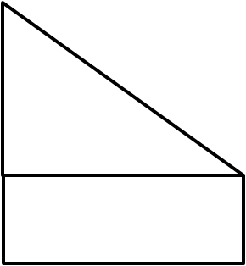
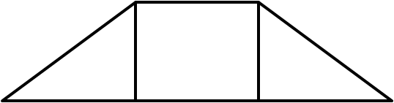
N
G
H
O
C
D
E
F
M
P
J
I
r
P(x,y)
K
L
A
C
o
Q
R
U
V
T
A
W
Z
S
B

Slide 42
Pythagoras Theorem
Now try
Extension Booklet
www.mathsrevision.com
12 Jul 2026
Compiled by Mr. Lafferty Maths Dept.

