Slide 1


Statistics
Nat 4
Interpreting Graphs.
Scattergraphs & Codes
Stem and Leaf Diagram
Drawing Graphs
Mean, Median, Mode and Range of a Data Set
www.mathsrevision.com
Line of best fit
Constructing Frequency Tables (Tally Tables)
Range Mode & Median from Frequency Table
Mean from a Frequency Table
12 Jul 2026
Created by Mr. Lafferty Maths Dept.

Slide 2
Starter Questions
Nat 4
www.mathsrevision.com
12 Jul 2026
Created by Mr.Lafferty Maths Dept

Slide 3
Interpreting Graphs
Nat 4
Learning Intention
Success Criteria
  To explain how to interpret various graphs.
  1. Understand key information on various graphs.
  2. Solve problems involving graphs.
www.mathsrevision.com
12 Jul 2026
Created by Mr. Lafferty Maths Dept.

Slide 4
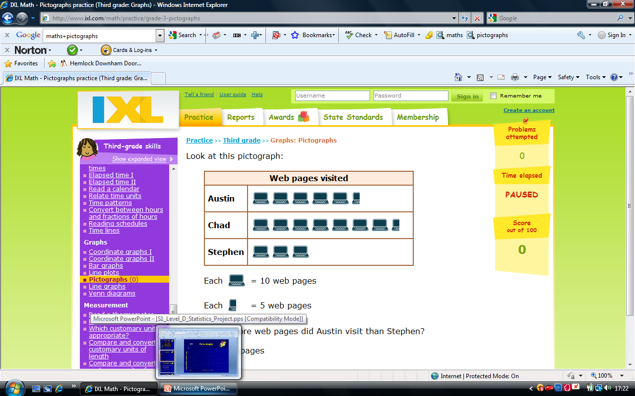
What does
1 computer represent
You have 1 minute to come up with a question
Interpreting Graphs
Nat 4
www.mathsrevision.com

Slide 5

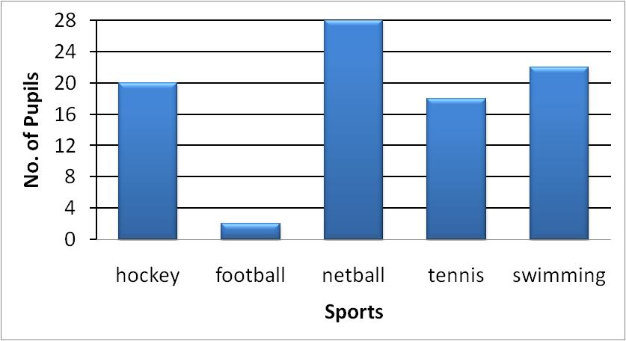
Interpreting Graphs
Nat 4
www.mathsrevision.com
12 Jul 2026
Created by Mr.Lafferty Maths Dept

Slide 6
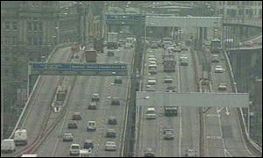
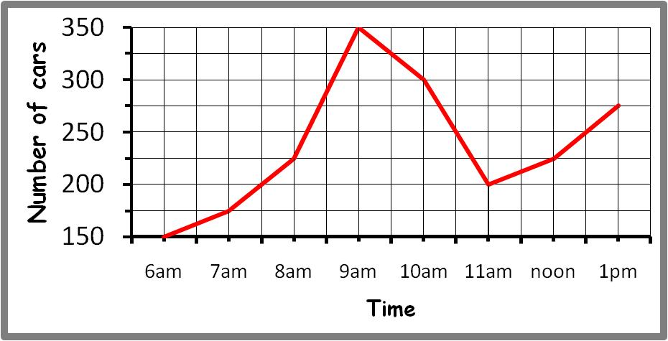
Interpreting Graphs
Nat 4
www.mathsrevision.com
12 Jul 2026
Created by Mr.Lafferty Maths Dept

Slide 7
Drawing Pie Charts
Favourite Sport
In a survey, 300 people were asked to indicate which one of five sports they liked best. Using the graph calculate the number people who liked each sport.
Rugby
75
Football
90
Cricket
45
Ice Hockey
60
Squash
30
Total
300
Football
Rugby
90º
108º
36º
54º
72º
Squash
Cricket
Ice Hockey
12 Jul 2026
Created by Mr. Lafferty Maths Dept.

Slide 8

Interpreting Graphs
Now try Exercise 1
Ch12 (page 132)
www.mathsrevision.com
12 Jul 2026
Created by Mr. Lafferty Maths Dept.

Slide 9
Starter Questions
www.mathsrevision.com
12 Jul 2026
Created by Mr.Lafferty Maths Dept

Slide 10
Scattergraphs
Nat 4
Learning Intention
Success Criteria
  To explain how to interpret a scattergraph and codes.
  1. Understand how to interpret a scattergraph and codes.
  2. Solve problems involving scattergraphs and codes.
www.mathsrevision.com
12 Jul 2026
Created by Mr. Lafferty Maths Dept.

Slide 11
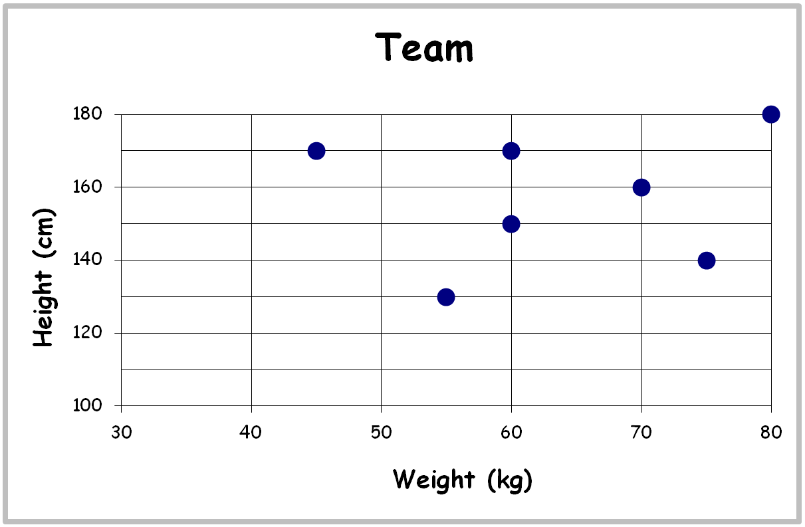
This scattergraph shows the heights and weights of a sevens football team
Write down the height and weight of each player.
Scattergraphs
Nat 4
Bob
Tim
Sam
Joe
Gary
Dave
www.mathsrevision.com
Jim
12 Jul 2026
Created by Mr. Lafferty Maths Dept.

Slide 12


Break the Code
Nat 4
www.mathsrevision.com
Write down the sentence with the code
13 1 20 8 19 9 19 6 21 14
M A T H S I S F U N
12 Jul 2026
Created by Mr. Lafferty Maths Dept.

Slide 13
Break the Code
Nat 4
Write down the sentence with the code
(4,3)
R
I
G
H
T
W
A
Y
y - axis
(-3,3)
4
W
(3,-2)
I
O
3
R
(-2,1)
A
W
E
2
(-2,-4)
www.mathsrevision.com
H
1
Y
-3
-2
-1
0
-4
1
2
3
4
x - axis
-1
G
-2
N
G
R
R
-3
(2,2)
A
T
-4
(-4,-4)
12 Jul 2026
Created by Mr. Lafferty Maths Dept
(1,1)

Slide 14
Scattergraph & Codes
Nat 4
Now try Exercise 2
Ch12 (page 137)
www.mathsrevision.com
12 Jul 2026
Created by Mr. Lafferty Maths Dept.

Slide 15
Starter Questions
Nat 4
6cm
www.mathsrevision.com
8cm
10cm
2cm
12 Jul 2026
Created by Mr. Lafferty Maths Dept.

Slide 16
Stem Leaf Diagrams
Nat 4
Learning Intention
Success Criteria
  To explain how to interpret a stem leaf diagrams.
  1. Understand how to interpret a stem leaf diagram.
  2. Solve problems involving stem leaf diagrams.
www.mathsrevision.com
12 Jul 2026
Created by Mr. Lafferty Maths Dept.

Slide 17
You have 1 minute to come up with another question for stem leaf.
Stem Leaf Graphs
Nat 4
A Stem – Leaf graph is another way of displaying information :
Ages
This stem and leaf graph shows
the ages of people waiting in a
queue at a post office
2
4
6
8
3
0
1
3
4
4
4
5
6
7
9
How many people in the queue?
20
5
0
3
4
9
www.mathsrevision.com
6
1
4
5
6
How many people in their forties?
6
stem
leaves
n = 20 Key : 2 4 means 24
12 Jul 2026
Created by Mr. Lafferty Maths Dept.

Slide 18
Stem Leaf Graphs
Nat 4
Back to Back Stem – Leaf Graphs
Rugby Team 1
Heights
Rugby Team 2
Heights
A back to back stem-leaf
helps us to compare two
sets of data.
4
2
1
14
0
2
6
7
8
7
6
15
3
4
8
5
0
16
0
1
6
Write down a question that can be answered easily from the graph.
6
4
3
3
1
17
1
6
www.mathsrevision.com
7
0
18
1
4
4
n = 15
n = 15
14 | 1 represents 141cm
12 Jul 2026
Created by Mr. Lafferty Maths Dept.

Slide 19
Stem Leaf Diagram
Nat 4
Now try Exercise 3 Ch12 (page 140)
www.mathsrevision.com
12 Jul 2026
Created by Mr. Lafferty Maths Dept.

Slide 20
Starter Questions
Nat 4
www.mathsrevision.com
12 Jul 2026
Created by Mr. Lafferty Maths Dept.

Slide 21
Constructing Graphs
Nat 4
Learning Intention
Success Criteria
  1. To construct various graphs accurately.
  Understand how to construct various graphs from given information.
www.mathsrevision.com
12 Jul 2026
Created by Mr. Lafferty Maths Dept.

Slide 22
Pictographs
Nat 4
The table below shows the number of
internet pages viewed by three pupils.
Pupil | Pages viewed
Austin | 55
Chad | 75
Stephen | 30
www.mathsrevision.com
Construct a pictograph to represent this data.
Use the following pictures

Slide 23
Pictographs
Nat 4
c
www.mathsrevision.com

Slide 24
Bar Graphs
Nat 4
A survey of S1 pupils asked
what their favourite pet was.
The results are shown below
www.mathsrevision.com
Lets construct a Bar graph for the following table
Remember graph has to be labelled and neat !
12 Jul 2026
Created by Mr.Lafferty Maths Dept

Slide 25
What labels should we use for the Bar Chart
Title, Scale, Labels and Units where appropriate
Favourite Pets
12
10
8
Number of Pupils
6
4
2
0
Cat
Dog
Rabbit
Hamster
Snake
Pets

Slide 26
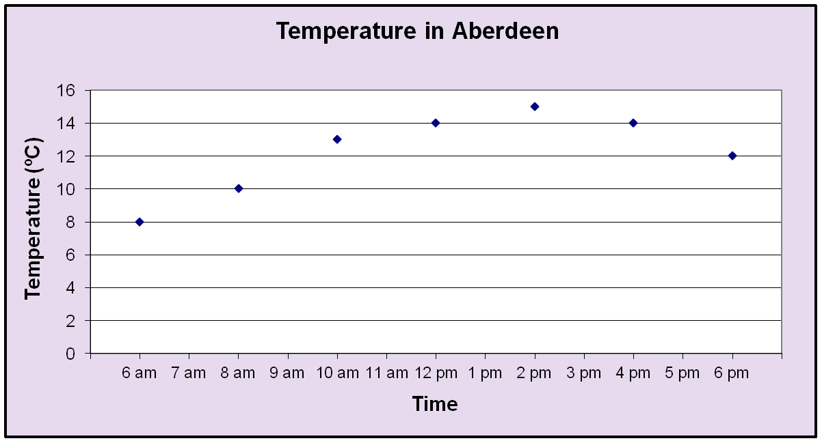
Line graphs
Line graphs are most often used to show trends over time.
If the temperature in Aberdeen, in ºC, over a 12-hour period is plotted, the line graph shows the temperature trend.
12 Jul 2026
Created by Mr. Lafferty
<number>

Slide 27

A hospital nurse recorded a patient’s temperature every hour
Time (Hour) | 6 am | 7 am | 8 am | 9 am | 10 am | 11 am
Temperature ºC | 101 | 102 | 102.5 | 103 | 101 | 100.5
Temperature against Time
Title
Labels
Units
Reasonable Scale
103
102
Temperature C
101
100
6
7
8
9
10
11
12 Jul 2026
Time (Hours AM)
<number>

Slide 28
Scattergraphs
Nat 4
Construction of Scattergraph
Price
(£1000)
Age
1
9
1
8
2
8
3
7
www.mathsrevision.com
3
6
3
5
4
5
4
4
5
2
12 Jul 2026
Created by Mr. Lafferty Maths Dept.

Slide 29
Stem Leaf Graphs
Nat 4
Construction of Stem and Leaf
Example : Construct a stem and leaf graphs for the following
weights in (kgs) :
Weight (kgs)
1
2
2
3
5
5
12 | 12 | 13 | 15 | 15
21 | 23 | 29 | 32 | 32
40 | 40 | 41 | 41 | 51
54 | 55 | 55 | 55 | 57
12 | 40 | 57 | 54 | 55
13 | 55 | 15 | 32 | 55
32 | 15 | 41 | 21 | 40
23 | 41 | 29 | 51 | 12
2
1
3
9
3
2
2
4
0
0
1
1
www.mathsrevision.com
5
1
4
5
5
5
7
stem
leaves
n = 20 Key : 2 3 means 23
12 Jul 2026
Created by Mr. Lafferty Maths Dept.

Slide 30
Constructing Graphs
Nat 4
Now try Exercise 4
Ch12 (page 142)
www.mathsrevision.com
12 Jul 2026
Created by Mr. Lafferty Maths Dept.

Slide 31
Starter Questions
Nat 4
4cm
www.mathsrevision.com
5cm
8cm
2cm
12 Jul 2026
Created by Mr. Lafferty Maths Dept.

Slide 32
Different Averages
Nat 4
Learning Intention
Success Criteria
  To define the terms Mean Median, Mode and Range for a set of data.
  1. Know the terms Mean, Median, Mode and Range.
  2. Work out values of Mean, Median, Mode and Range.
www.mathsrevision.com
12 Jul 2026
Created by Mr. Lafferty Maths Dept.

Slide 33
Mean (Average)
Nat 4
Find the mean of the set of data 1, 1, 1, 1, 2, 3, 26
www.mathsrevision.com
Can you see that this is not the most suitable of averages since
five out of the six numbers are all below the mean of 5
12 Jul 2026
Created by Mr. Lafferty Maths Dept.

Slide 34
Different Averages
Nat 4
An average should indicate a
“measure of central tendency”
but should also indicate
what the distribution of data looks like.
This is why we have 3 different types of averages to consider
www.mathsrevision.com
The Mean
The Median (put the data in order then find the MIDDLE value)
3. The Mode (the number that appears the most)
For the above data the Median or Mode is a better average = 1
12 Jul 2026
Created by Mr. Lafferty Maths Dept.

Slide 35
Different Averages
Nat 4
Example :
Find the mean, median, mode and range for the set of data.
Range = Highest number – Lowest Number
10, 2, 14, 1, 14, 7
www.mathsrevision.com
12 Jul 2026
Created by Mr. Lafferty Maths Dept.

Slide 36
Different Averages
Nat 4
Now try Exercise 5
Ch12 (page 144)
www.mathsrevision.com
12 Jul 2026
Created by Mr. Lafferty Maths Dept.

Slide 37
Starter Questions
Nat 4
www.mathsrevision.com
12 Jul 2026
Created by Mr. Lafferty Maths Dept.

Slide 38
Scattergraphs
Nat 4
Construction of Scattergraphs
Learning Intention
Success Criteria
Construct and understand the Key-Points of a scattergraph.
  To construct a scattergraph and answer questions based on it.
www.mathsrevision.com
2. Know the term positive and negative correlation.
12 Jul 2026
Created by Mr. Lafferty Maths Dept.

Slide 39
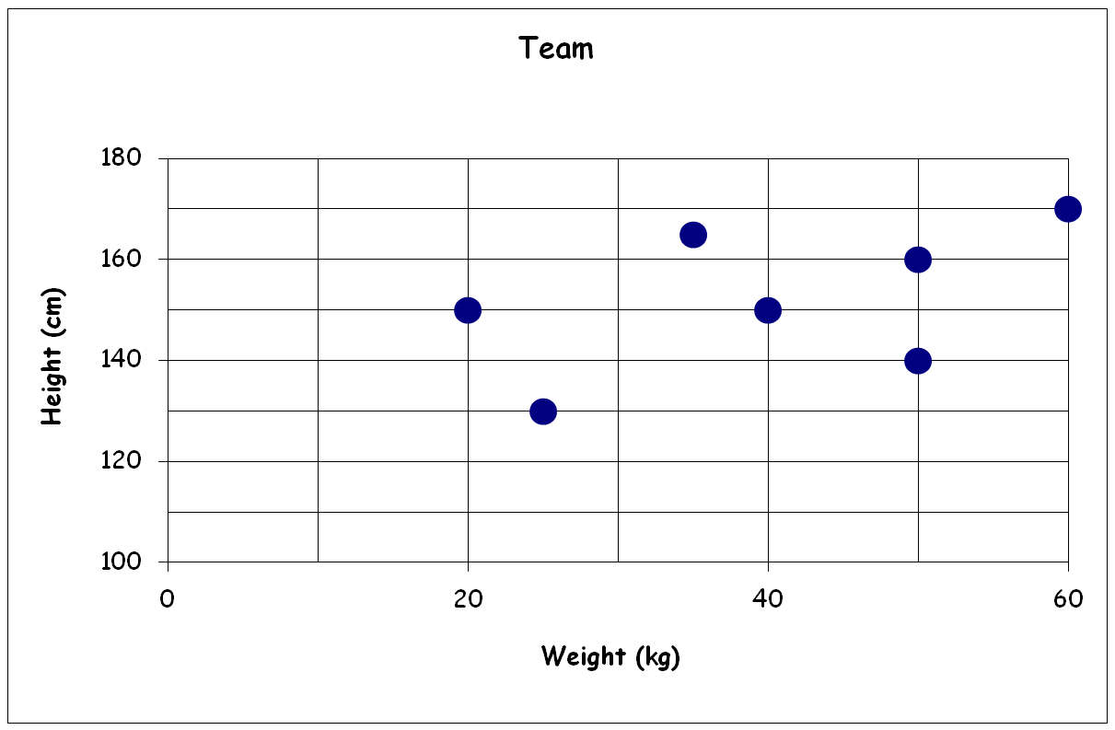
This scattergraph shows the heights and weights of a sevens football team
Scattergraphs
Write down height and weight of each player.
Nat 4
Construction of Scattergraph
Bob
Tim
Joe
Sam
Gary
Dave
www.mathsrevision.com
Jim
12 Jul 2026
Created by Mr. Lafferty Maths Dept.

Slide 40
Scattergraphs
Nat 4
Construction of Scattergraph
When two quantities are strongly connected we say there is a
strong correlation between them.
Best fit line
x
x
x
x
x
x
x
x
x
x
x
x
www.mathsrevision.com
Best fit line
Strong positive
correlation
Strong negative
correlation
12 Jul 2026
Created by Mr. Lafferty Maths Dept.

Slide 41
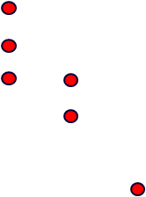
Draw in the best fit line
Scattergraphs
Nat 4
Construction of Scattergraph
Is there
a correlation?
If yes, what kind?
Price
(£1000)
Age
1
9
1
8
Strong negative correlation
2
8
3
7
www.mathsrevision.com
3
6
3
5
4
5
4
4
5
2
12 Jul 2026
Created by Mr. Lafferty Maths Dept.

Slide 42
Scattergraphs
Nat 4
Construction of Scattergraphs
Now try Extension Booklet
2E (page 53)
www.mathsrevision.com
12 Jul 2026
Created by Mr. Lafferty Maths Dept.

Slide 43
Lesson Starter
Nat 4
Q1.
Q2. How long between 8:40am to 1.20pm
Q3. 36.9 x 6
www.mathsrevision.com
Q4. 34.7 x 100
Q5. Put these numbers in order
52, 55, 62, 51, 59, 62, 52, 59, 61, 55
12 Jul 2026
Created by Mr. Lafferty
<number>

Slide 44
Aims of the Lesson
Nat 4
1. Understand the term Frequency Table.
2. Construct a Frequency Table.
3. Interpret information from Frequency Tables.
www.mathsrevision.com
12 Jul 2026
Created by Mr. Lafferty
<number>

Slide 45
Frequency tables
Raw data can often appear untidy and difficult to understand. Organising such data into frequency tables can make it much easier to make sense of (interpret) the data.
Data | Tally | Frequency
llll
represents a tally of 5
12 Jul 2026
Sum of Tally is the Frequency
<number>

Slide 46
Frequency tables
Example 1. A tomato grower ideally wants his tomatoes to have diameters of 60mm, but a diameter ranging from 58mm to 62mm will be acceptable. Organise the diameters given below into a frequency table.
58
56
59
57
60
56
62
62
58
56
58
59
56
59
56
59
57
58
60
62
61
58
59
62
60
58
60
59
56
59
60
61
56
60
62
59
61
58
60
61
62
58
57
62
59
61
58
60
Lowest number
56
Highest number
62
12 Jul 2026
Created by Mr. Lafferty
<number>

Slide 47
Frequency tables
X
X
X
X
X
X
58
56
59
57
60
56
62
60
58
60
58
59
57
59
56
59
57
58
60
59
61
58
59
62
60
58
60
59
59
60
59
61
59
60
62
59
61
58
60
61
59
58
57
62
59
61
58
60
Diameter | Tally | Frequency
56
57
58
59
60
61
62
l
l
l
l
l
l
12 Jul 2026
Created by Mr. Lafferty
<number>

Slide 48
Frequency tables
X
X
X
X
X
X
X
X
X
X
X
X
58
56
59
57
60
56
62
60
58
60
58
59
X
X
X
X
X
X
X
X
X
X
X
X
57
59
56
59
57
58
60
59
61
58
59
62
X
X
X
X
X
X
X
X
X
X
X
X
60
58
60
59
59
60
59
61
59
60
62
59
X
X
X
X
X
X
X
X
X
X
X
X
61
58
60
61
59
58
57
62
59
61
58
60
Diameter | Tally | Frequency
56
57
58
59
60
61
62
lll
3
llll
4
llll
llll
9
llll
llll
lll
13
llll
llll
10
llll
5
llll
4
12 Jul 2026
Created by Mr. Lafferty
<number>

Slide 49
Frequency Tables
Nat 4
Now try
Extension Booklet
5E (page 57)
www.mathsrevision.com
12 Jul 2026
Created by Mr. Lafferty
<number>

Slide 50
Starter Questions
Nat 4
www.mathsrevision.com
12 Jul 2026
Created by Mr. Lafferty Maths Dept.

Slide 51
Frequency Tables
Nat 4
Range, Mode & Median
Learning Intention
Success Criteria
  1. To explain how to work out the range , mode & median from a frequency table.
  Understand how to work out the range, mode and median from a frequency table.
www.mathsrevision.com
  2. Solve problems using a frequency Table.
12 Jul 2026
Created by Mr. Lafferty Maths Dept.

Slide 52
Frequency Tables
Nat 4
Range, Mode & Median
Reminder !
Range : The difference between highest and Lowest
values. It is a measure of spread.
Median : The middle value of a set of data.
When they are two middle values
the median is half way between them.
www.mathsrevision.com
Mode : The value that occurs the most in a set
of data. Can be more than one value.
12 Jul 2026
Created by Mr Lafferty Maths Dept

Slide 53
Different Averages
Example :
Find the median and mode for the set of data.
10, 2, 14, 1, 14, 7
www.mathsrevision.com
12 Jul 2026
Created by Mr. Lafferty Maths Dept.

Slide 54
Range Mode & Median from Frequency Table
Mode
value that occurs the most
= 0
High – Low
= 6 – 0
= 6
20 + 17 = 37
20 + 17 + 15 = 52
Here are the results of a sports survey carried out
among university students.
Nat 4
Numbers of sports played | Frequency
0 | 20
1 | 17
2 | 15
3 | 10
4 | 9
5 | 3
6 | 2
Range =
6
Mode =
0
Median harder to calculate
20 + 17 + 15 + 10 + 9 + 3 + 2 = 76
Middle value of 76
is between 38th and 39th values
38.5 lies in here
Median =
2
12 Jul 2026
Created by Mr Lafferty Maths Dept

Slide 55
Range Mode & Median from Frequency Table
Mode
value that occurs the most
= 5
High – Low
= 7 – 1
= 6
25 + 29 = 54
25 + 29 + 20 = 74
Here are the results of a S3 maths exam survey carried out
among St. Ninian’s High School students.
Nat 4
Grade scored in exam | Frequency
1 | 25
2 | 29
3 | 20
4 | 20
5 | 31
6 | 10
7 | 5
Range =
6
Mode =
5
Median harder to calculate
25 + 29 + 20 + 20 + 31 + 10 + 5 = 140
Middle value of 140
is between the 70th and 71th values
70.5 lies in here
Median =
3
12 Jul 2026
Created by Mr Lafferty Maths Dept

Slide 56
Frequency Tables
Nat 4
Range, Mode & Median
Now try
Extension Booklet
6E (page 60)
www.mathsrevision.com
12 Jul 2026
Created by Mr. Lafferty Maths Dept.

Slide 57
Starter Questions
Nat 4
www.mathsrevision.com
12 Jul 2026
Created by Mr. Lafferty Maths Dept.

Slide 58
Frequency Tables
Nat 4
Working Out the Mean
Learning Intention
Success Criteria
  1. To explain how to work out the mean by adding in a third column to a Frequency Table.
  Add a third column to a frequency table.
  2. Work out the mean from a frequency Table.
www.mathsrevision.com
12 Jul 2026
Created by Mr. Lafferty Maths Dept.

Slide 59
Frequency Tables
Nat 4
Working Out the Mean
Example : This table shows the number
of coins in the pockets of some children.
No of Coins (c) | Freq. (f)
f x C
Adding a third column to this table
will help us find the total number of
coins and the ‘Mean’.
1
5
5 x 1 =5
2
5
5 x 2 = 10
www.mathsrevision.com
3
1
1 x 3 = 3
4
3
3 x 4 = 12
5
2
2 x 5 = 10
Totals
16
40
12 Jul 2026
Created by Mr. Lafferty Maths Dept.

Slide 60
Frequency Tables
Nat 4
Working Out the Mean
Example : This table shows the number
of brothers and sisters of pupils in an
S2 class.
No of Siblings (S) | Freq. (f)
S x f
Adding a third column to this table
will help us find the total number of
siblings and the ‘Mean’.
0
9
0 x 9 =0
1
13
1 x 13 = 13
www.mathsrevision.com
2
6
2 x 6 = 12
3
1
3 x 1 = 3
5
1
5 x 1 = 5
Totals
30
33
12 Jul 2026
Created by Mr. Lafferty Maths Dept.

Slide 61
Frequency Tables
Nat 4
Working Out the Mean
Now try
Extension Booklet
7E (page 62)
www.mathsrevision.com
12 Jul 2026
Created by Mr. Lafferty Maths Dept.

