Slide 1

Higher Unit 2
What is a polynomials
Evaluating / Nested / Synthetic Method
Factor Theorem
Factorising higher Orders
Factors of the form (ax + b)
Finding Missing Coefficients
Finding Polynomials from its zeros
Credit Quadratic Theory
Completing the square
Discriminant
Condition for Tangency
Notes:
<number>

Slide 2
Polynomials
Definition
A polynomial is an expression with several terms.
These will usually be different powers of a particular letter.
The degree of the polynomial is the highest power that appears.
Examples
3x⁴ – 5x³ + 6x² – 7x - 4
Polynomial in x of degree 4.
7m⁸ – 5m⁵ – 9m² + 2
Polynomial in m of degree 8.
w¹³ – 6
Polynomial in w of degree 13.
NB: It is not essential to have all the powers from the highest down, however powers should be in descending order.

Slide 3
Disguised Polynomials
(x + 3)(x – 5)(x + 5)
= (x + 3)(x² – 25)
= x³ + 3x² – 25x - 75
So this is a polynomial in x of degree 3.
Coefficients
In the polynomial 3x⁴ – 5x³ + 6x² – 7x – 4 we say that
the coefficient of x⁴ is 3
the coefficient of x³ is -5
the coefficient of x² is 6
the coefficient of x is -7
and the coefficient of x⁰ is -4 (NB: x⁰ = 1)
In w¹³ – 6 , the coefficients of w¹², w¹¹, ….w², w are all zero.

Slide 4
Evaluating Polynomials
Suppose that g(x) = 2x³ - 4x² + 5x - 9
Substitution Method
g(2) = (2 X 2 X 2 X 2) – (4 X 2 X 2 ) + (5 X 2) - 9
= 16 – 16 + 10 - 9
= 1
NB: this requires 9 calculations.

Slide 5
Nested or Synthetic Method
This involves using the coefficients and requires fewer calculations so is more efficient.
It can also be carried out quite easily using a calculator.
g(x) = 2x³ - 4x² + 5x - 9
Coefficients are 2, -4, 5, -9
g(2) =
2 -4 5 -9
4
0
10
2
0
5
1
This requires only 6 calculations so is ¹/₃ more efficient.

Slide 6
Nested or Synthetic Method
Example
If f(x) = 2x³ - 8x
then the coefficients are 2 0 -8 0
and f(2) = 2
2 0 -8 0
4
8
0
2
4
0
0

Slide 7
Factor Theorem
If (x – a) is a factor of the polynomial f(x)
Then f(a) = 0.
Reason
Say f(x) = a₃x³ + a₂x² + a₁x + a₀ = (x – a)(x – b)(x – c)
polynomial form factorised form
Since (x – a), (x – b) and (x – c) are factors
then f(a) = f(b) = f(c ) = 0
Check
f(b) = (b – a)(b – b)(b – c) = (b – a) X 0 X (b – c) = 0

Slide 8
Factor Theorem
Now consider the polynomial
f(x) = x³ – 6x² – x + 30 = (x – 5)(x – 3)(x + 2)
So f(5) = f(3) = f(-2) = 0
The polynomial can be expressed in 3 other factorised forms
These can be checked by multiplying out the brackets !
A
f(x) = (x – 5)(x² – x – 6)
B
f(x) = (x – 3)(x² – 3x – 10)
C
f(x) = (x + 2)(x² – 8x + 15)
Keeping coefficients in mind an interesting thing occurs when we calculate f(5) , f(3) and f(-2) by the nested method.

Slide 9
Factor Theorem
A
f(5) = 5
1 -6 -1 30
5
-5
-30
1
-1
-6
0
Other factor is x² – x - 6
f(5) = 0 so (x – 5) a factor
= (x – 3)(x + 2)

Slide 10
Factor Theorem
B
f(3) = 3
1 -6 -1 30
3
-9
-30
1
-3
-10
0
Other factor is x² – 3x - 10
f(3) = 0 so (x – 3) a factor
= (x – 5)(x + 2)

Slide 11
Factor Theorem
C
f(-2) = -2
1 -6 -1 30
-2
16
-30
1
-8
15
0
Other factor is x² – 8x + 15
f(-2) = 0 so (x +2) a factor
= (x – 3)(x - 5)
This connection gives us a method of factorising polynomials that are more complicated then quadratics
ie cubics, quartics and others.

Slide 12
Factor Theorem
Example
Factorise x³ + 3x² – 10x - 24
We need some trial & error with factors of –24 ie +/-1, +/-2, +/-3 etc
f(-1) = -1
1 3 -10 -24
-1
-2
12
1
2
-12
-12
No good
f(1) = 1
1 3 -10 -24
1
4
-6
1
4
-6
-30
No good

Slide 13
Factor Theorem
f(-2) = -2
1 3 -10 -24
f(-2) = 0 so (x + 2) a factor
-2
-2
24
1
1
-12
0
Other factor is x² + x - 12
= (x + 4)(x – 3)
So x³ + 3x² – 10x – 24 = (x + 4)(x + 2)(x – 3)
Roots/Zeros
The roots or zeros of a polynomial tell us where it cuts the X-axis. ie where f(x) = 0.
If a cubic polynomial has zeros a, b & c then it has factors (x – a), (x – b) and (x – c).

Slide 14
We need some trial & error with factors of –9 ie +/-1, +/-3 etc
Factorising Higher Orders
Example
Solve x⁴ + 2x³ - 8x² – 18x – 9 = 0
f(-1) = -1
1 2 -8 -18 -9
f(-1) = 0 so (x + 1) a factor
-1
-1
9
9
1
1
-9
-9
0
Other factor is x³ + x² – 9x - 9 which we can call g(x)
test +/-1, +/-3 etc

Slide 15
Factorising Higher Orders
g(-1) = -1
1 1 -9 -9
g(-1) = 0 so (x + 1) a factor
-1
0
9
1
0
-9
0
Other factor is x² – 9
= (x + 3)(x – 3)
if x⁴ + 2x³ - 8x² – 18x – 9 = 0
then (x + 3)(x + 1)(x + 1)(x – 3) = 0
So x = -3 or x = -1 or x = 3

Slide 16
Factorising Higher Orders
Summary
A cubic polynomial ie ax³ + bx² + cx + d
could be factorised into either
(i) Three linear factors of the form (x + a) or (ax + b)
or
(ii) A linear factor of the form (x + a) or (ax + b) and a quadratic factor (ax² + bx + c) which doesn’t factorise.
or
IT DIZNAE FACTORISE
(iii) It may be irreducible.

Slide 17
Linear Factors in the form (ax + b)
If (ax + b) is a factor of the polynomial f(x)
then f(^{-b}/_{a}) = 0
Reason
Suppose f(x) = (ax + b)(………..)
If f(x) = 0 then (ax + b)(………..) = 0
So (ax + b) = 0 or (…….) = 0
so ax = -b
so x = ^{-b}/_{a}
NB: When using such factors we need to take care with the other coefficients.

Slide 18
Linear Factors in the form (ax + b)
Example
Show that (3x + 1) is a factor of g(x) = 3x³ + 4x² – 59x – 20
and hence factorise the polynomial completely.
Since (3x + 1) is a factor then g(⁻¹/₃) should equal zero.
g(⁻¹/₃) = ⁻¹/₃
3 4 -59 -20
g(- ¹/₃) = 0
so (x + ¹/₃)
is a factor
-1
-1
20
3
3
-60
0
3x² + 3x - 60

Slide 19
Linear Factors in the form (ax + b)
Other factor is
3x² + 3x - 60
= 3(x² + x – 20)
= 3(x + 5)(x – 4)
NB: common factor
Hence g(x) = (x + ¹/₃) X 3(x + 5)(x – 4)
= (3x + 1)(x + 5)(x – 4)

Slide 20
Missing Coefficients
Example
Given that (x + 4) is a factor of the polynomial
f(x) = 2x³ + x² + ax – 16 find the value of a
and hence factorise f(x) .
Since (x + 4) a factor then f(-4) = 0 .
f(-4) = -4
2 1 a -16
-8
28
(-4a – 112)
2
-7
(a + 28)
(-4a – 128)

Slide 21
Missing Coefficients
Since -4a – 128 = 0
then 4a = -128
so a = -32
If a = -32
then the other factor is 2x² – 7x - 4
= (2x + 1)(x – 4)
So f(x) = (2x + 1)(x + 4)(x – 4)

Slide 22
Missing Coefficients
Example
(x – 4) is a factor of f(x) = x³ + ax² + bx – 48
while f(-2) = -12.
Find a and b and hence factorise f(x) completely.
(x – 4) a factor so f(4) = 0
f(4) = 4
1 a b -48
4
(4a + 16)
(16a + 4b + 64)
1
(a + 4)
(4a + b + 16)
(16a + 4b + 16)
16a + 4b + 16 = 0
(÷4)
4a + b + 4 = 0
4a + b = -4

Slide 23
Missing Coefficients
f(-2) = -12 so
f(-2) = -2
1 a b -48
-2
(-2a + 4)
(4a - 2b - 8)
1
(a - 2)
(-2a + b + 4)
(4a - 2b - 56)
4a - 2b - 56 = -12
(÷2)
2a - b - 28 = -6
2a - b = 22
We now use simultaneous equations ….

Slide 24
Missing Coefficients
4a + b = -4
2a - b = 22
Using 4a + b = -4
add
6a = 18
12 + b = -4
a = 3
b = -16
When (x – 4) is a factor the quadratic factor is
x² + (a + 4)x + (4a + b + 16) =
x² + 7x + 12 =
(x + 4)(x + 3)
So f(x) = (x - 4)(x + 3)(x + 4)

Slide 25
Finding a Polynomial From Its Zeros
Caution
Suppose that
f(x) = x² + 4x - 12
and g(x) = -3x² - 12x + 36
f(x) = 0
g(x) = 0
x² + 4x – 12 = 0
-3x² - 12x + 36 = 0
(x + 6)(x – 2) = 0
-3(x² + 4x – 12) = 0
x = -6 or x = 2
-3(x + 6)(x – 2) = 0
x = -6 or x = 2
Although f(x) and g(x) have identical roots/zeros they are clearly different functions and we need to keep this in mind when working backwards from the roots.

Slide 26
Finding a Polynomial From Its Zeros
If a polynomial f(x) has roots/zeros at a, b and c
then it has factors (x – a), (x – b) and (x – c)
And can be written as f(x) = k(x – a)(x – b)(x – c).
NB: In the two previous examples
k = 1 and k = -3 respectively.

Slide 27
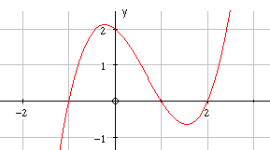
Finding a Polynomial From Its Zeros
Example
y = f(x)
30
-2
1
5

Slide 28
Finding a Polynomial From Its Zeros
f(x) has zeros at x = -2, x = 1 and x = 5,
so it has factors (x +2), (x – 1) and (x – 5)
so f(x) = k (x +2)(x – 1)(x – 5)
f(x) also passes through (0,30) so replacing x by 0
and f(x) by 30 the equation becomes
30 = k X 2 X (-1) X (-5)
ie 10k = 30
ie k = 3

Slide 29
Finding a Polynomial From Its Zeros
Formula is f(x) = 3(x + 2)(x – 1)(x – 5)
f(x) = (3x + 6)(x² – 6x + 5)
f(x) = 3x³ – 12x² – 21x + 30

Slide 30
Roots
f(x) = x² + 4x + 3
f(-2) =(-2)² + 4x(-2) + 3
= -1
(0, )
a > 0
Mini. Point
Max. Point
x=
Line of Symmetry
half way
between roots
Evaluating
(0, )
Graphs
a < 0
Quadratic Functions
y = ax² + bx + c
Decimal places
x=
Line of Symmetry
half way
between roots
c
c
Cannot Factorise
Factorisation
ax² + bx + c = 0
SAC
e.g. (x+1)(x-2)=0
Roots
x = -1 and x = 2
Roots
x = -1.2 and x = 0.7

Slide 31
Completing the Square
This is a method for changing the format
of a quadratic equation
so we can easily sketch or read off key information
Completing the square format looks like
f(x) = a(x + b)² + c
Warning ! The a,b and c values are different
from the a ,b and c in the general quadratic function

Slide 32
Completing the Square
Complete the square for x² + 2x + 3
and hence sketch function.
f(x) = a(x + b)² + c
x² + 2x + 3
Half the x term and square the coefficient.
x² + 2x + 3
Compensate
a = 1
b = 1
c = 2
Tidy up !
-1
(x² + 2x + 1) + 3
(x + 1)² + 2

Slide 33
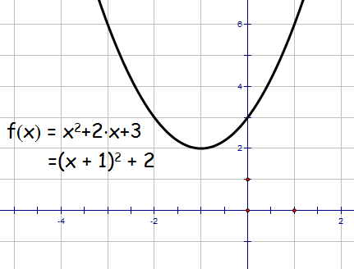
Completing the Square
sketch function.
f(x) = a(x + b)² + c
= (x + 1)² + 2
(0,3)
Mini. Pt. ( -1, 2)
(-1,2)

Slide 34
Completing the Square
Complete the square for 2x² - 8x + 9
and hence sketch function.
f(x) = a(x + b)² + c
2x² - 8x + 9
Half the x term and square the coefficient.
2x² - 8x + 9
Take out coefficient of x² term.
2(x² - 4x) + 9
Tidy up
a = 2
b = 2
c = 1
Compensate !
2(x² – 4x + 4) + 9
- 8
2(x - 2)² + 1

Slide 35
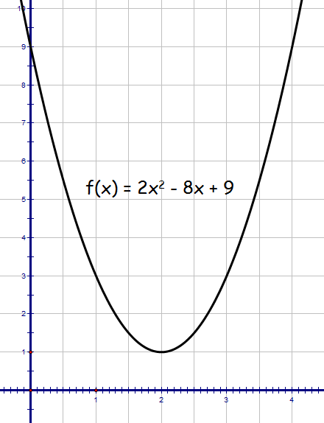
Completing the Square
sketch function.
(0,9)
f(x) = a(x + b)² + c
= 2(x - 2)² + 1
Mini. Pt. ( 2, 1)
(2,1)

Slide 36
Completing the Square
Complete the square for 7 + 6x – x²
and hence sketch function.
f(x) = a(x + b)² + c
-x² + 6x + 7
Half the x term and square the coefficient
-x² + 6x + 7
Take out coefficient of x²
-(x² - 6x) + 7
Tidy up
a = -1
b = 3
c = 16
compensate
+ 9
-(x² – 6x + 9) + 7
-(x - 3)² + 16

Slide 37
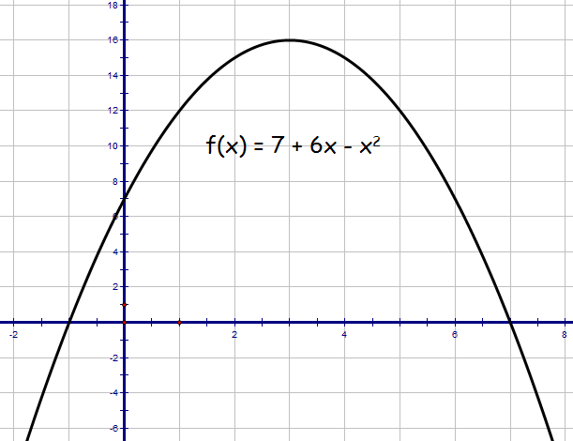
Completing the Square
sketch function.
f(x) = a(x + b)² + c
(3,16)
= -(x - 3)² + 16
(0,7)
Mini. Pt. ( 3, 16)

Slide 38
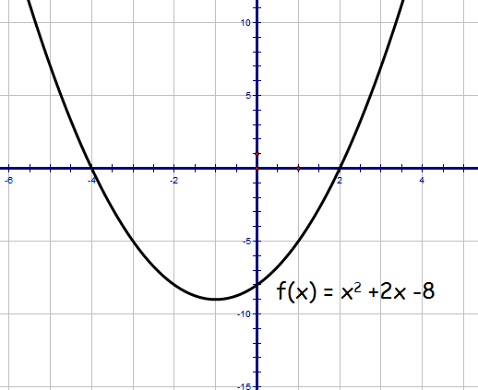
Quadratic Theory Higher
Given , express in the form
Hence sketch function.
(0,-8)
(-1,9)

Slide 39
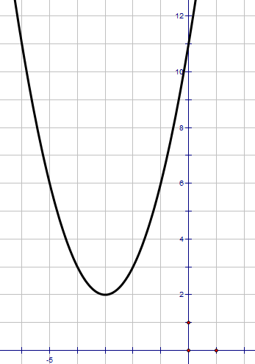
Quadratic Theory Higher
a) Write in the form
b) Hence or otherwise sketch the graph of
(0,11)
a)
(-3,2)
b)
For the graph of
moved 3 places to left and 2 units up.
minimum t.p. at (-3, 2)
y-intercept at (0, 11)

Slide 40
Using Discriminants
Given the general form for a quadratic function.
f(x) = ax² + bx + c
We can calculate the value of the discriminant
b² – 4ac
This gives us valuable information
about the roots of the quadratic function

Slide 41
Roots of a quadratic Function
There are 3 possible scenarios
2 real and
distinct roots
2 equal real roots
No real roots
discriminant
discriminant
discriminant
(b²- 4ac > 0)
(b²- 4ac = 0)
(b²- 4ac < 0)
To determine whether a quadratic function has 2 real roots,
2 equal real roots or no real roots we calculate the discriminant.
Notes:
<number>

Slide 42
Discriminant
Find the value p given that 2x² + 4x + p = 0 has real roots
a = 2 b = 4 c = p
For real roots b² – 4ac ≥ 0
16 – 8p ≥ 0
-8p ≥ -16
p ≤ 2
The equation has real roots when p ≤ 2.

Slide 43
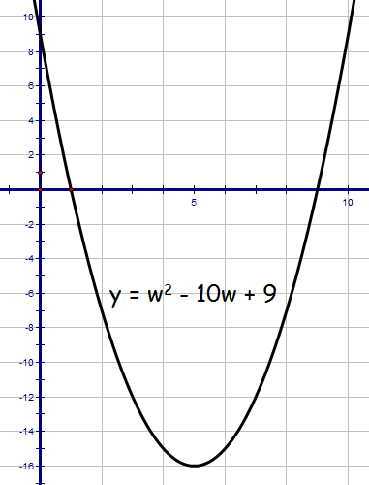
Discriminant
Find w given that x² + (w – 3)x + w = 0 has non-real roots
a = 1 b = (w – 3) c = w
For non-real roots b² – 4ac < 0
(w – 3)² – 4w < 0
w² – 6w +9 - 4w < 0
w² – 10w + 9 < 0
(w – 9)(w – 1) < 0
From graph non-real roots when 1 < w < 9

Slide 44
Discriminant
Show that the roots of
(k - 2)x² – (3k - 2)x + 2k = 0
Are always real
a = (k – 2) b = – (3k – 2) c = 2k
b² – 4ac = [– (3k – 2) ]² – 4(k – 2)(2k)
= 9k² – 12k + 4 - 8k² + 16k
= k² + 4k + 4
= (k + 2)²
Since square term b² – 4ac ≥ 0 and roots ALWAYS real.

Slide 45
Quadratic Theory Higher
Show that the equation
has real roots for all integer values of k
Use discriminant
Consider when this is greater than or equal to zero
Sketch graph
cuts x axis at
Hence equation has real roots for all integer k

Slide 46
Quadratic Theory Higher
For what value of k does the equation have equal roots?
Discriminant
For equal roots
discriminant = 0

Slide 47
Condition for Tangency
2 real and
distinct roots
2 equal real roots
No real roots
discriminant
discriminant
discriminant
(b²- 4ac > 0)
(b²- 4ac = 0)
(b²- 4ac < 0)
If the discriminant
b² – 4ac = 0 then 2 equal real roots
and therefore a point of tangency exists.

Slide 48
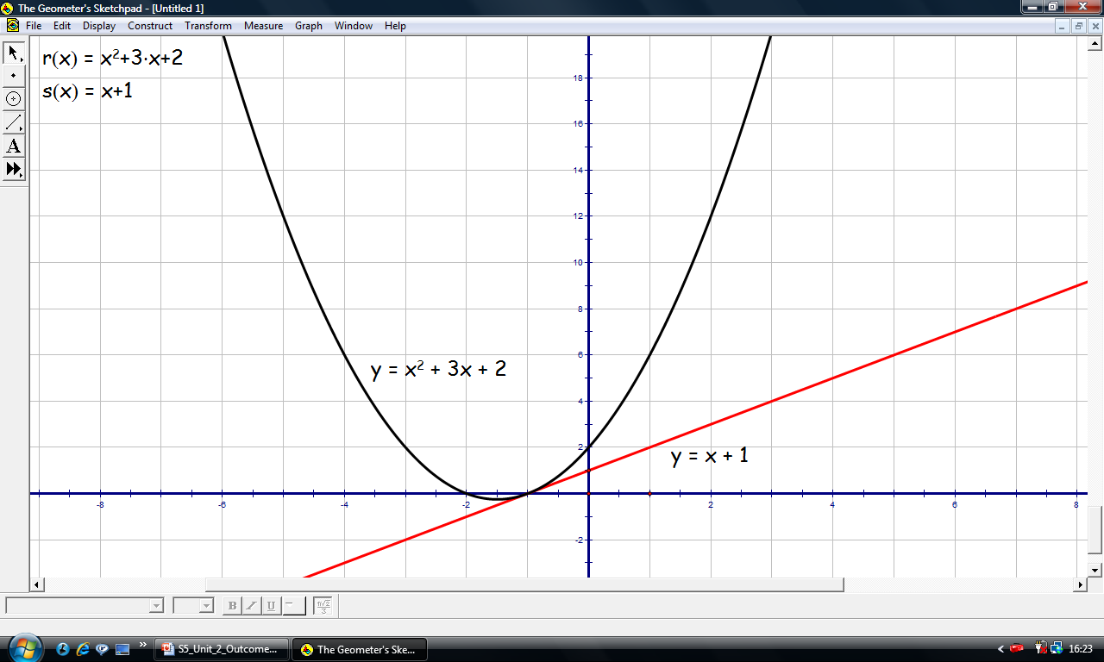
Examples to prove Tangency
Prove that the line is a tangent to the curve.
Make the two functions equal to each other.
x² + 3x + 2 = x + 1
x² + 3x + 2 – x - 1 = 0
x² + 2x + 1 = 0
b² – 4ac = (2)² – 4(1)(1)
= 0
Since 2 equal real roots line is tangent to curve.

Slide 49
Examples to prove Tangency
Prove that y = 2x - 1 is a tangent to the curve y = x²
and find the intersection point
x² = 2x - 1
Since 2 equal real root hence tangent
x² - 2x + 1 = 0
b² - 4ac
= (-2)² -4(1)(1)
= 0 hence tangent
(x – 1)² = 0
x = 1
For x = 1 then y = (1)² = 1 so intersection point is (1,1)
Or x = 1 then y = 2x1 - 1 = 1 so intersection point is (1,1)

Slide 50
Examples to prove Tangency
Tangent line has equation of the form y = 2x + k
Find the equation of the tangent to y = x² + 1
that has gradient 2.
x² + 1 = 2x + k
Since 2 equal real root hence tangent
x² - 2x + (1 – k) = 0
a = 1 b = – 2 c = (1 – k)
b² – 4ac = (– 2)² – 4(1 – k) = 0
4 – 4 + 4k = 0
k = 0
Tangent equation is y = 2x

Slide 51
Quadratic Theory Higher
Show that the line with equation
does not intersect the parabola
with equation
Put two equations equal
Use discriminant
Show discriminant < 0
No real roots

Slide 52
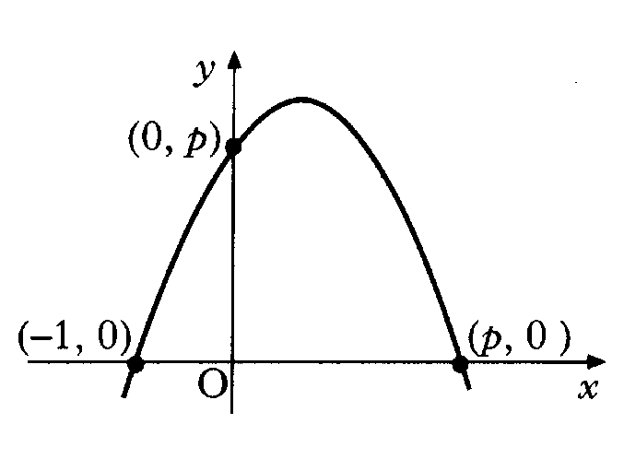
Quadratic Theory Higher
The diagram shows a sketch of a parabola
passing through (–1, 0), (0, p) and (p, 0).
a) Show that the equation of the parabola is
For what value of p will the line be a tangent to this curve?
a)
Use point (0, p) to find k
b)
Simultaneous equations
Discriminant = 0 for tangency

Slide 53
Are you on Target !
Update you log book
Make sure you complete and correct
ALL of the Polynomials questions in
the past paper booklet.

