Slide 1

Higher Maths
What is a set
Function in various formats
Graph Transformations
Exponential Graphs
Log Graphs
Composite Functions
Inverse function
Family of Curves
Mindmap
Exam
Question Type

Slide 2
Sets & Functions
Notation & Terminology
SETS: A set is a collection of items which have some common property.
These items are called the members or elements of the set.
Sets can be described or listed using “curly bracket” notation.

Slide 3
Sets & Functions
We can describe numbers by the following sets:
N = {natural numbers}
= {1, 2, 3, 4, ……….}
W = {whole numbers}
= {0, 1, 2, 3, ………..}
Z = {integers}
= {….-2, -1, 0, 1, 2, …..}
Q = {rational numbers}
This is the set of all numbers which can be written as fractions or ratios.
eg 5 = ⁵/₁ -7 = ⁻⁷/₁ 0.6 = ⁶/₁₀ = ³/₅
55% = ⁵⁵/₁₀₀ = ¹¹/₂₀ etc

Slide 4
Sets & Functions
R = {real numbers}
This is all possible numbers. If we plotted values on a number line then each of the previous sets would leave gaps but the set of real numbers would give us a solid line.
We should also note that
N “fits inside” W
W “fits inside” Z
Z “fits inside” Q
Q “fits inside” R

Slide 5
Sets & Functions
N
W
Z
Q
R
When one set can fit inside another we say
that it is a subset of the other.
The members of R which are not inside Q are called irrational numbers. These cannot be expressed as fractions and include π , √2, ³√5 etc

Slide 6
Sets & Functions
To show that a particular element/number belongs to a particular set we use the symbol ∈.
eg 3 ∈ W but 0.9 ∉ Z
Examples
{ x ∈ W: x < 5 }
= { 0, 1, 2, 3, 4 }
{ x ∈ Z: x ≥ -6 }
= { -6, -5, -4, -3, -2, …….. }
{ x ∈ R: x² = -4 }
= { } or Φ
This set has no elements and is called the empty set.

Slide 7
What are Functions ?
Functions describe how one quantity
relates to another
Car Parts
Cars
Assembly line
Defn: A function or mapping is a relationship between two sets in which each member of the first set is connected to exactly one member in the second set.

Slide 8
What are Functions ?
Functions describe how one quantity
relates to another
Dirty
Clean
Washing Machine
x
y
y = f(x)
Function
Input
Output
f(x)

Slide 9
Defining a Functions
A function can be thought of as the relationship between
Set A (INPUT - the x-coordinate)
and
SET B the y-coordinate (Output) .

Slide 10
Functions
A function can be though of as a black box
Function
Input
Output
f(x) = x²+ 3x - 1
x - Coordinate
y - Coordinate
Members (x - axis)
Members (y - axis)
Co-Domain
Domain
Image
Range

Slide 11
Finding the Function
Examples
Find the output or input values for the functions below :
4
12
6
7
8
36
49
64
f: 0
f: 1
f:2
-1
3
7
5
15
6
18
f(x) = x²
f(x) = 4x - 1
f(x) = 3x

Slide 12
Functions & Mapping
Functions can be illustrated in three ways:
1) by a formula.
2) by arrow diagram.
3) by a graph (ie co-ordinate diagram).
Example
Suppose that f: A → B is defined by
f(x) = x² + 3x where A = { -3, -2, -1, 0, 1}.
FORMULA
then f(-3) = 0 , f(-2) = -2 , f(-1) = -2 , f(0) = 0 , f(1) = 4
NB: B = {-2, 0, 4} = the range!

Slide 13
Functions
ARROW DIAGRAM
A B
f(x)
f(-3) = 0
f(-2) = -2
f(-1) = -2
f(0) = 0
f(1) = 4
-3
0
-2
-2
-1
-2
0
0
0
1
4

Slide 14
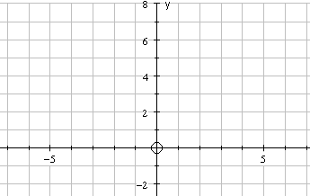
Functions
In a GRAPH we get :
NB: This graph consists of 5 separate points. It is not a solid curve.

Slide 15
Functions
Recognising Functions
A B
a b c d
e
f
g
A B
e
f
g
a bc d
YES
Not a function
two arrows leaving b!

Slide 16
Functions
A B
a b c d
Not a function - d unused!
e f g
A B
a bc d
e f g h
YES

Slide 17
Functions
Recognising Functions from Graphs
If we have a function f: R → R (R - real nos.) then every vertical line we could draw would cut the graph exactly once!
This basically means that every x-value has one, and only one, corresponding y-value!

Slide 18
Functions
Y
Function !!
x

Slide 19
Functions
Y
Not a function !!
Cuts graph
more than once !
x must map to
one value of y
x

Slide 20
Functions
Y
Not a function !!
Cuts graph
more than once!
X

Slide 21
Functions
Y
Function !!
X

Slide 22
Functions
No all functions work every numerical value.
Some restriction apply.
When a function involves division
the denominator CANNOT be equal to zero.
Can take square root of a NEGATIVE number.

Slide 23


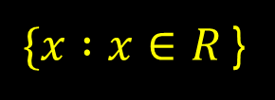


Functions
For each function below
What is the largest possible domain of f(x)

Slide 24
Functions
Ex 11.1
Page 132

Slide 25
Completing the Square
This is a method for changing the format
of a quadratic equation
so we can easily sketch or read off key information
Completing the square format looks like
f(x) = a(x + b)² + c
Warning ! The a,b and c values are different
from the a ,b and c in the general quadratic function

Slide 26
Completing the Square
Complete the square for x² + 2x + 3
and hence sketch function.
f(x) = a(x + b)² + c
x² + 2x + 3
Half the x term and square the coefficient.
x² + 2x + 3
Compensate
a = 1
b = 1
c = 2
Tidy up !
-1
(x² + 2x + 1) + 3
(x + 1)² + 2

Slide 27
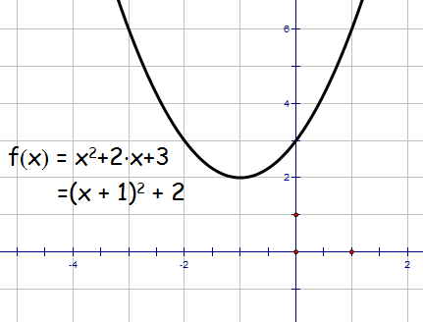
Completing the Square
sketch function.
f(x) = a(x + b)² + c
= (x + 1)² + 2
(0,3)
Mini. Pt. ( -1, 2)
(-1,2)

Slide 28
Completing the Square
Complete the square for 2x² - 8x + 9
and hence sketch function.
f(x) = a(x + b)² + c
2x² - 8x + 9
Half the x term and square the coefficient.
2x² - 8x + 9
Take out coefficient of x² term.
2(x² - 4x) + 9
Tidy up
a = 2
b = 2
c = 1
Compensate !
2(x² – 4x + 4) + 9
- 8
2(x - 2)² + 1

Slide 29
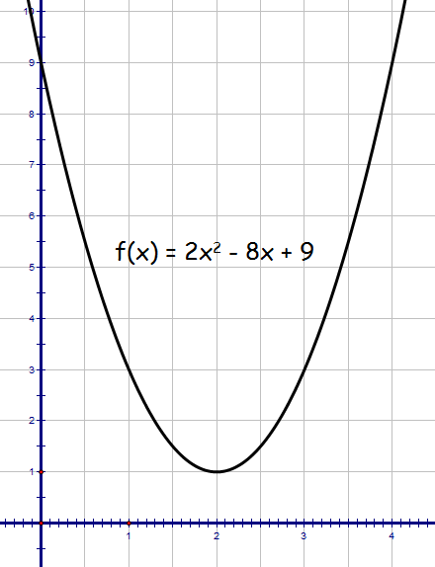
Completing the Square
sketch function.
(0,9)
f(x) = a(x + b)² + c
= 2(x - 2)² + 1
Mini. Pt. ( 2, 1)
(2,1)

Slide 30
Completing the Square
Complete the square for 7 + 6x – x²
and hence sketch function.
f(x) = a(x + b)² + c
-x² + 6x + 7
Half the x term and square the coefficient
-x² + 6x + 7
Take out coefficient of x²
-(x² - 6x) + 7
Tidy up
a = -1
b = 3
c = 16
compensate
+ 9
-(x² – 6x + 9) + 7
-(x - 3)² + 16

Slide 31
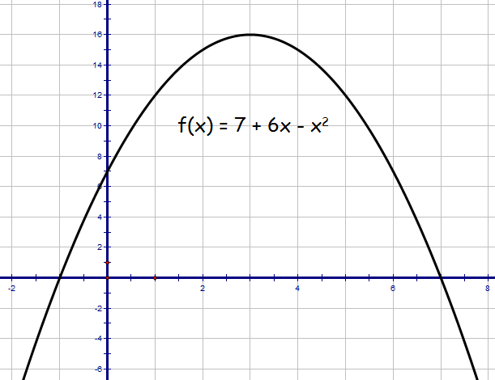
Completing the Square
sketch function.
f(x) = a(x + b)² + c
(3,16)
= -(x - 3)² + 16
(0,7)
Mini. Pt. ( 3, 16)

Slide 32
Completing the Square
By completing the square find the roots of
f(x) = x² +2x - 8
= (x + 1)² -9 = 0
(x + 1)² = 9
(x + 1) = ±3
x = ±3 - 1
x = -4 and 2

Slide 33
Completing the Square
By completing the square find the roots of
f(x) = 7 + 6x – x²
From previous slide
= -(x - 3)² + 16 = 0
(x - 3)² = 16
(x - 3) = ±4
x = ±4 + 3
x = 7 and -1

Slide 34
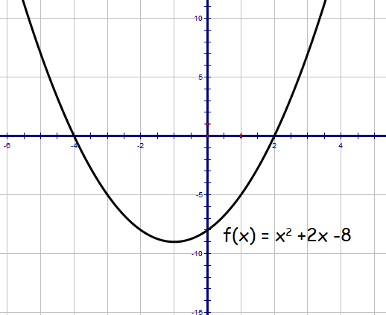
Quadratic Theory Higher
Given , express in the form
Hence sketch function.
(0,-8)
(-1,9)

Slide 35
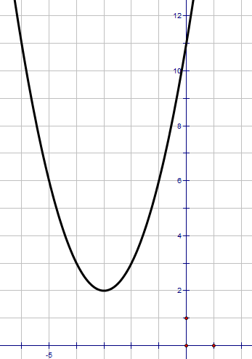
Quadratic Theory Higher
a) Write in the form
b) Hence or otherwise sketch the graph of
(0,11)
a)
(-3,2)
b)
For the graph of
moved 3 places to left and 2 units up.
minimum t.p. at (-3, 2)
y-intercept at (0, 11)

Slide 36
Functions
Ex 11.2
Page 133

Slide 37
Graph Transformations
We will investigate f(x) graphs of the form
1. f(x) ± k
f(x ± k)
-f(x)
f(-x)
kf(x)
f(kx)
Each moves the
Graph of f(x) in a certain way !

Slide 38
f(x) + 5
Transformation f(x) ± k
f(x) - 3
6
Mapping
(x , y) ⇨ (x , y ± k)
4
2
x
-6
-4
-2
0
2
4
6
8
-2
f(x)
f(x)
-4
-6

Slide 39
Transformation f(x) ± k
Keypoints
y = f(x) ± k
moves original f(x) graph vertically up or down
+ k ⇨ move up
- k ⇨ move down
Only y-coordinate changes
NOTE: Always state any coordinates given on f(x)
on f(x) ± k graph
Demo

Slide 40
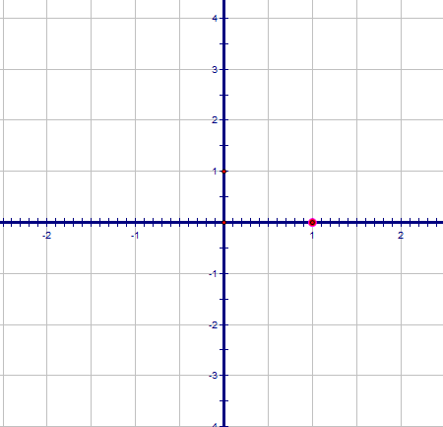
f(x) - 2
A(-1,-2)
B(1,-2)
C(0,-3)

Slide 41
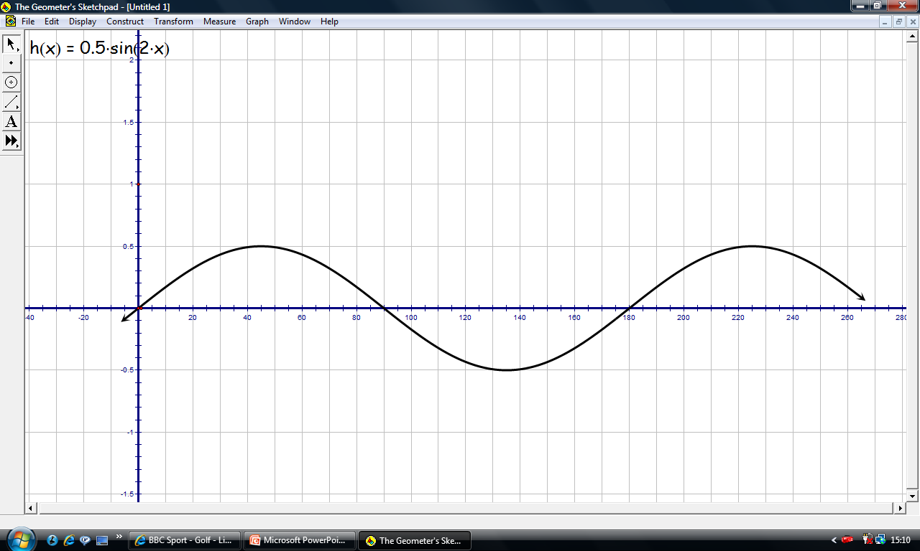
f(x) + 1
A(45º,1.5)
B(90º,1)
A(45º,0.5)
C(135º,0.5)
B(90º,0)
C(135º,-0.5)

Slide 42
f(x - 2)
Transformation f(x ± k)
f(x + 4)
6
Mapping
(x, y) ⇨ (x ± k , y)
4
2
x
-6
-4
-2
0
2
4
6
8
-2
f(x)
f(x)
-4
-6

Slide 43
Transformation f(x ± k)
Keypoints
y = f(x ± k)
moves original f(x) graph horizontally left or right
+ k ⇨ move left
- k ⇨ move right
Only x-coordinate changes
NOTE: Always state any coordinates given on f(x)
on f(x ± k) graph
Demo

Slide 44
Transformation -f(x)
6
Mapping
(x, y) ⇨ (x , -y)
4
Flip in
x-axis
2
Flip in
x-axis
x
-6
-4
-2
0
2
4
6
8
-2
f(x)
f(x)
-4
-6

Slide 45
Transformation -f(x)
Keypoints
y = -f(x)
Flips original f(x) graph in the x-axis
y-coordinate changes sign
NOTE: Always state any coordinates given on f(x)
on -f(x) graph
Demo

Slide 46
- f(x)
C(0,1)
A(-1,0)
B(1,0)

Slide 47
- f(x)
C(135º,0.5)
A(45º,0.5)
B(90º,0)
A(45º,-0.5)
C(135º,-0.5)

Slide 48
Transformation f(-x)
Flip in
y-axis
Mapping
6
(x, y) ⇨ (-x , y)
4
2
x
-6
-4
-2
0
2
4
6
8
-2
f(x)
f(x)
Flip in
y-axis
-4
-6

Slide 49
Transformation f(-x)
Keypoints
y = f(-x)
Flips original f(x) graph in the y-axis
x-coordinate changes sign
NOTE: Always state any coordinates given on f(x)
on f(-x) graph
Demo

Slide 50
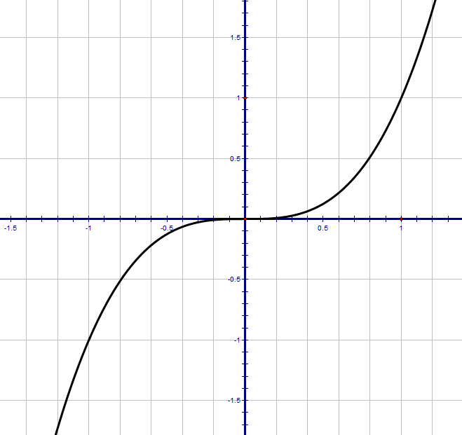
f(-x)
C (1,1)
C’(-1,1)
B(0,0)
A(-1,-1)
A’(1,-1)

Slide 51
2f(x)
Transformation kf(x)
0.5f(x)
Stretch in
y-axis
Mapping
6
(x, y) ⇨ (x , ky)
4
Compress in
y-axis
2
x
-6
-4
-2
0
2
4
6
8
-2
f(x)
f(x)
-4
-6

Slide 52
Transformation kf(x)
Keypoints
y = kf(x)
Stretch / Compress original f(x) graph in the
y-axis direction
y-coordinate changes by a factor of k
NOTE: Always state any coordinates given on f(x)
on kf(x) graph
Demo

Slide 53
f(2x)
Transformation f(kx)
f(0.5x)
Compress in
x-axis
6
Mapping
(x, y) ⇨ (1/kx , y)
4
2
x
-6
-4
-2
0
2
4
6
8
-2
f(x)
f(x)
Stretch in
x-axis
-4
-6

Slide 54
Transformation f(kx)
Keypoints
y = f(kx)
Stretch / Compress original f(x) graph in the
x-axis direction
x-coordinate changes by a factor of 1/k
NOTE: Always state any coordinates given on f(x)
on f(kx) graph
Demo

Slide 55
Combining Transformations
You need to be able to work with combinations
Demo

Slide 56
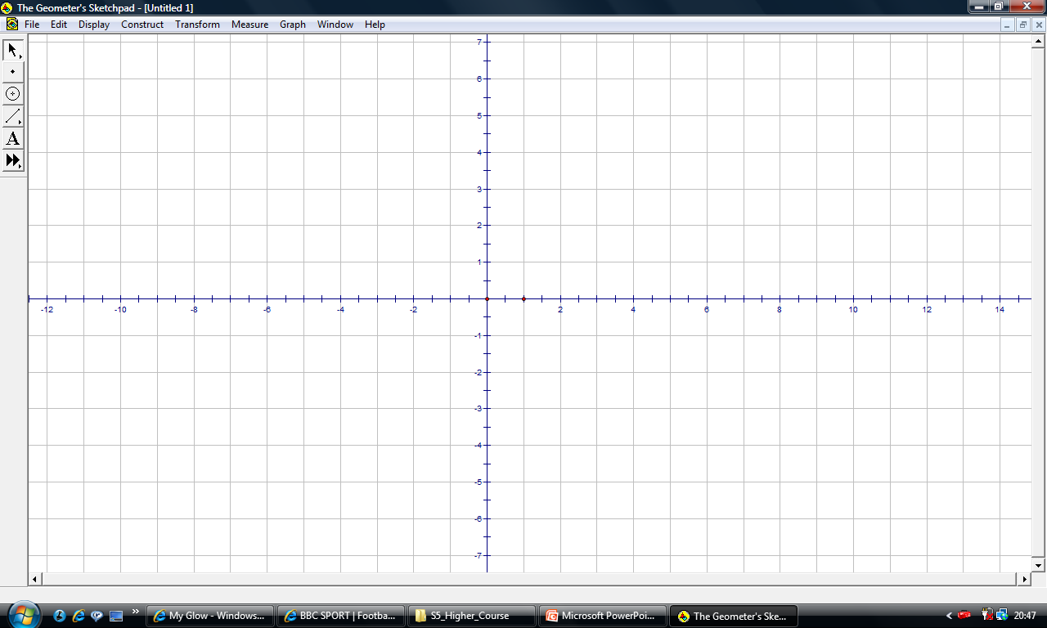
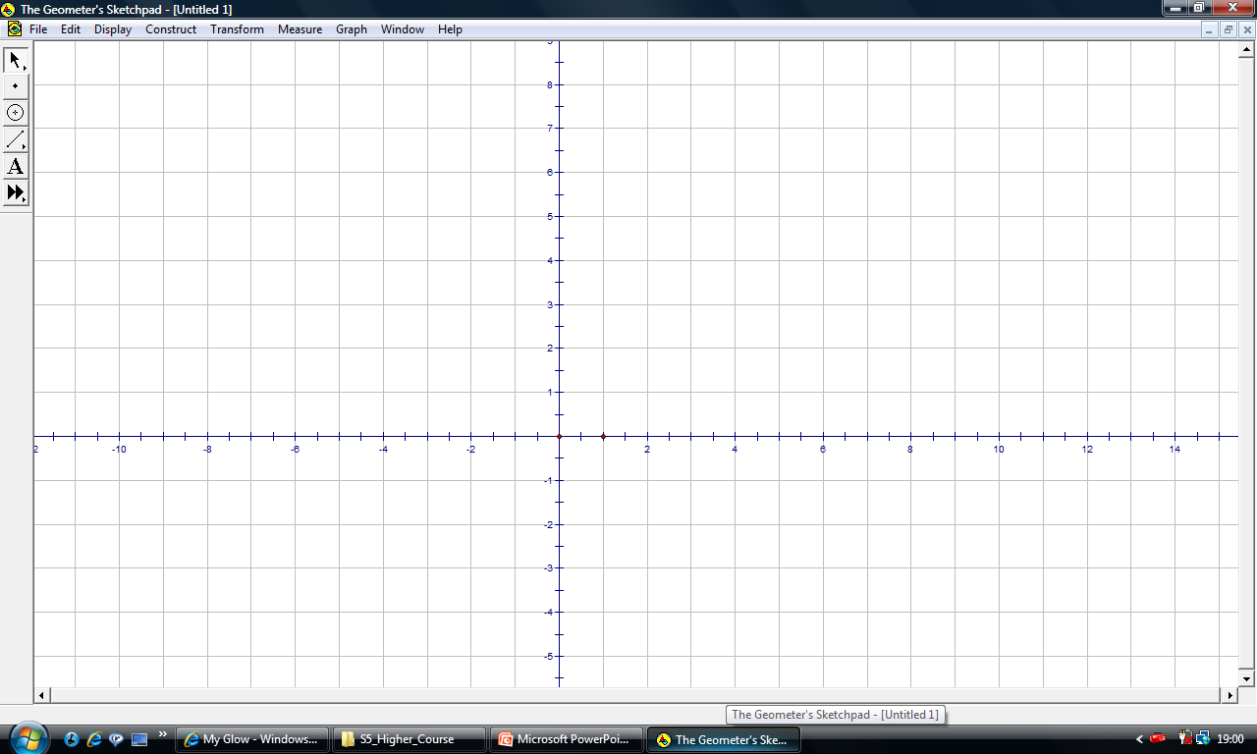
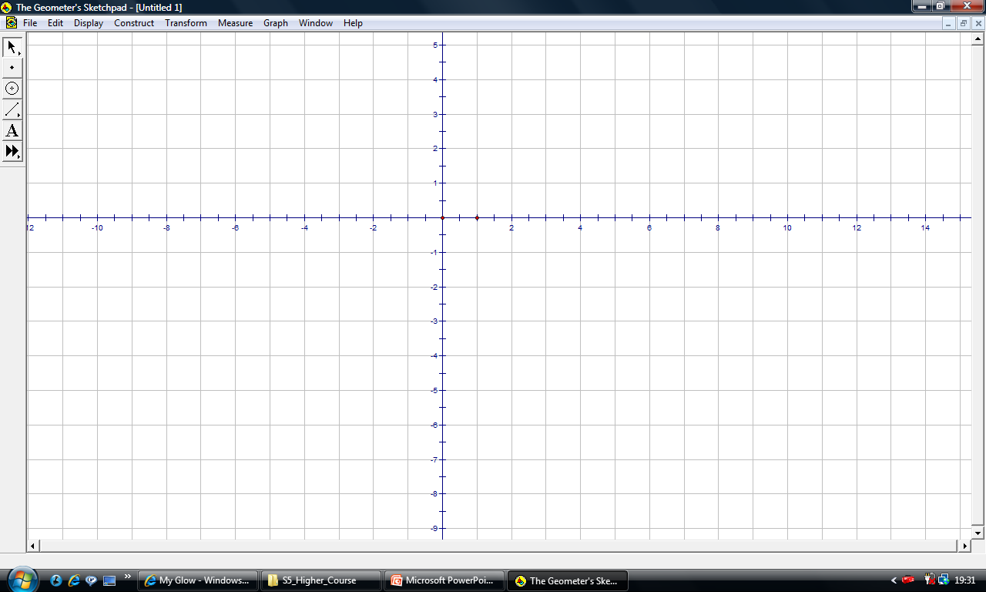
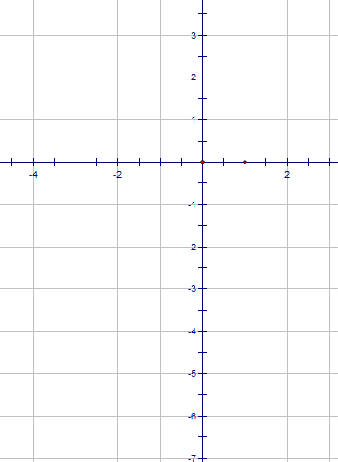

Explain the effect the following have
-f(x)
f(-x)
f(x) ± k
(1,3)
(1,3)
(-1,-3)
2f(x) + 1
f(x + 1) + 2
(-1,-3)
(1,3)
Name :
(1,3)
f(-x) + 1
(-1,-3)
-f(x) - 2
(-1,-3)
(1,3)
Explain the effect the following have
f(x ± k)
kf(x)
f(kx)
f(0.5x) - 1
(1,3)
-f(x + 1) - 3
(-1,-3)
(-1,-3)

Slide 57
(1,7)
Explain the effect the following have
-f(x) flip in x-axis
f(-x) flip in y-axis
f(x) ± k move up or down
(0,5)
(1,3)
(1,3)
(-2,-1)
(-1,-3)
(-1,-5)
2f(x) + 1
f(x + 1) + 2
(-1,-3)
(1,3)
(-1,4)
(-1,1)
Name :
(1,3)
f(-x) + 1
(-1,-3)
-f(x) - 2
(1,-2)
(1,-5)
(-1,-3)
(1,3)
Explain the effect the following have
f(x ± k) move left or right
kf(x) stretch / compress
in y direction
f(kx) stretch / compress
in x direction
f(0.5x) - 1
(1,3)
(-2,0)
(2,2)
-f(x + 1) - 3
(-1,-3)
(-1,-3)
(-2,-4)
(0,-6)

Slide 58
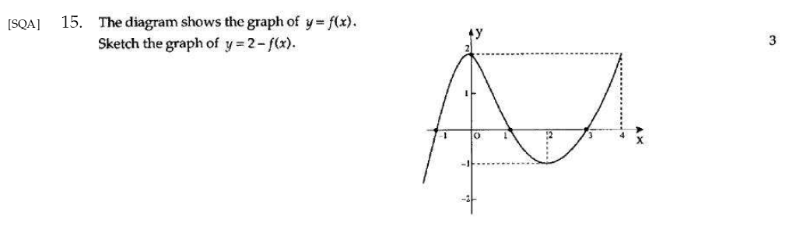
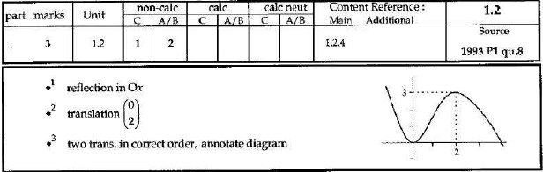

Slide 59
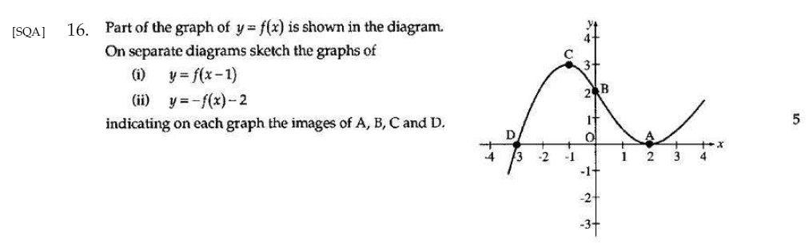
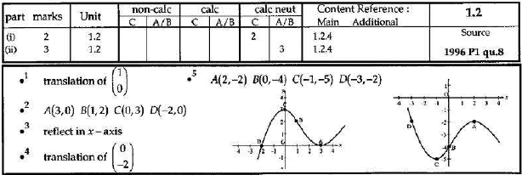

Slide 60
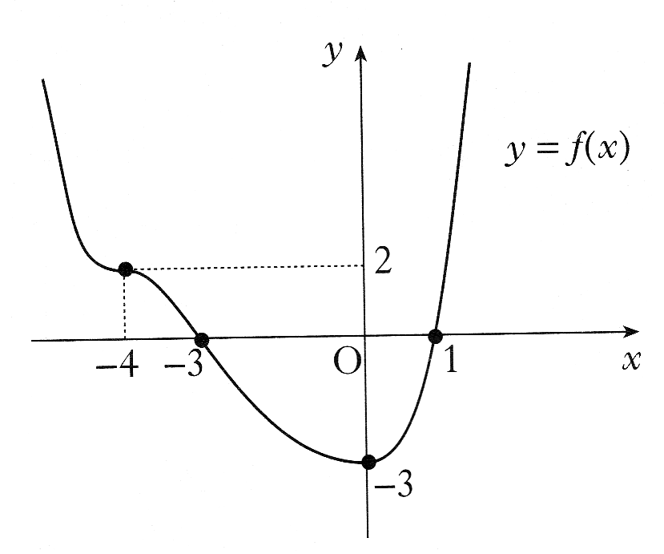
Graphs & Functions Higher
The diagram shows the graph of a function f.
f has a minimum turning point at (0, -3) and a
point of inflexion at (-4, 2).
a) sketch the graph of y = f(-x).
b) On the same diagram, sketch the graph of y = 2f(-x)
a)
Reflect across the y axis
b)
Now scale by 2 in the y direction

Slide 61
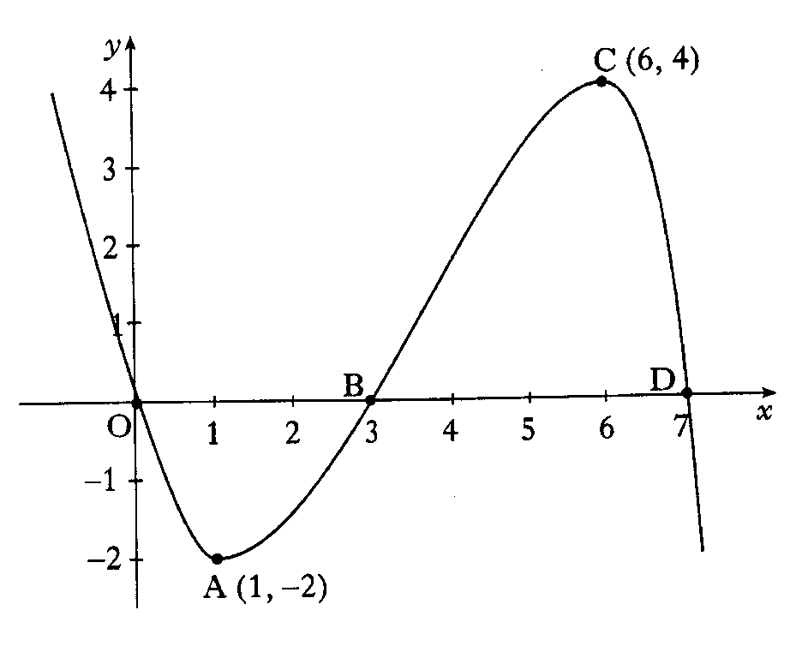
Graphs & Functions Higher
Part of the graph of is shown in the diagram.
On separate diagrams sketch the graph of
a) b)
Indicate on each graph the images of O, A, B, C, and D.
a)
graph moves to the left 1 unit
b)
graph is reflected in the x axis
graph is then scaled 2 units in the y direction

Slide 62
Graphs & Functions Higher
=
a) On the same diagram sketch
i) the graph of
ii) the graph of
b) Find the range of values of x for
which is positive
a)
b)
Solve:
10 - f(x) is positive for -1 < x < 5

Slide 63
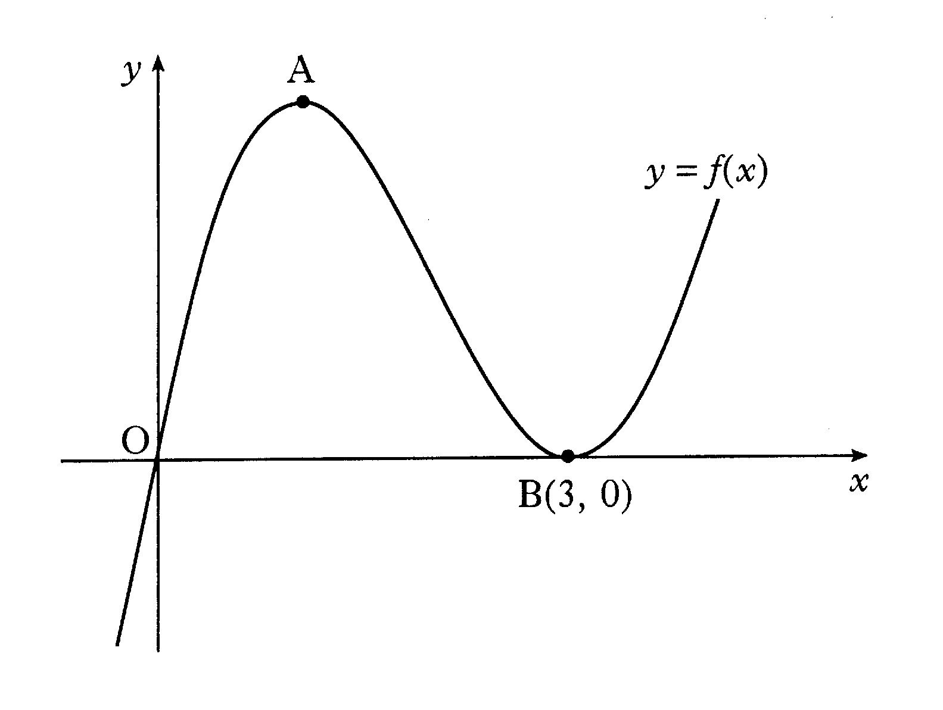
(-1,8)
Graphs & Functions Higher
A sketch of the graph of y = f(x) where is shown.
The graph has a maximum at A (1,4) and a minimum at B(3, 0)
.
Sketch the graph of
Indicate the co-ordinates of the turning points. There is no need to
calculate the co-ordinates of the points of intersection with the axes.
(1,4)
Graph is
moved 2 units to the left, and 4 units up
t.p.’s are:

Slide 64
Functions
Ex 11.3
Page 137

Slide 65
Exponential (to the power of)
Graphs
Exponential Functions
A function in the form f(x) = a^{x} where a > 0, a ≠ 1
is called an exponential function to base a .
Consider f(x) = 2^{x}
x -3 -2 -1 0 1 2 3
f(x)
¹ ¹/₈ ¼ ½ 1 2 4 8

Slide 66
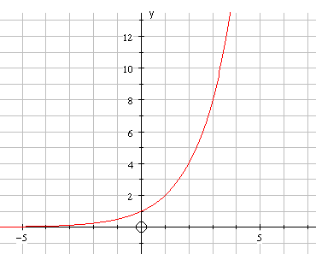
Graph
The graph of
y = 2^{x}
(1,2)
(0,1)
Major Points
(i) y = 2^{x} passes through the points (0,1) & (1,2)
(ii) As x ⇨∞ y ⇨∞ however as x ⇨-∞ y ⇨0 .
(iii) The graph shows a GROWTH function.

Slide 67
Exponential (to the power of)
Graphs
The graph of y = a^{x} always passes through (0,1) & (1,a)
It looks like ..
Y
y = a^{x}
(1,a)
(0,1)
x

Slide 68
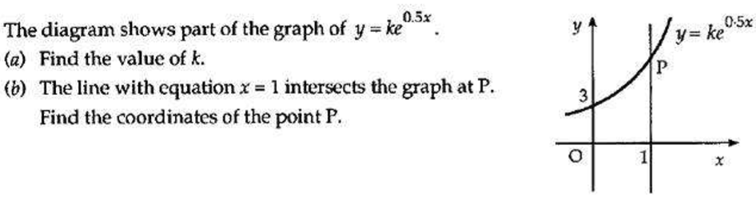

Slide 69
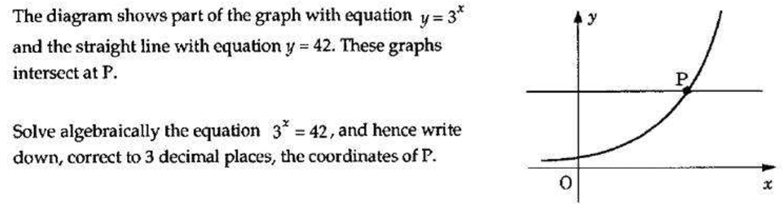

Slide 70
Functions
Ex 11.4
Page 139

Slide 71
Log Graphs
ie
x ¹/₈ ¼ ½ 1 2 4 8
y -3 -2 -1 0 1 2 3
To obtain y from x we must ask the question
“What power of 2 gives us…?”
This is not practical to write in a formula so we say
“the logarithm to base 2 of x”
y = log₂x
or “log base 2 of x”

Slide 72
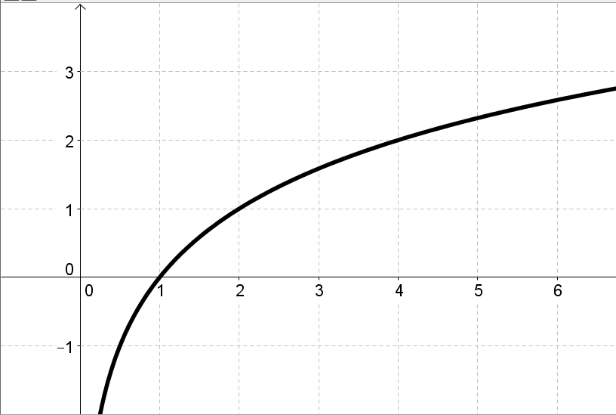
Graph
The graph of
(2,1)
y = log₂x
(1,0)
NB: x > 0
Major Points
(i) y = log₂x passes through the points (1,0) & (2,1) .
As x ⇨∞ y ⇨∞ but at a very slow rate and as x ⇨ 0 y ⇨ -∞ .

Slide 73
Log Graphs
The graph of y = log_{a}x always passes through (1,0) & (a,1)
Y
It looks like ..
(a,1)
(1,0)
x
y = log_{a}x

Slide 74
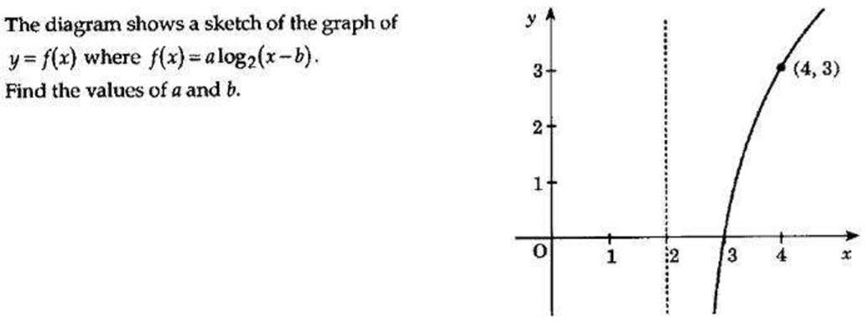

Slide 75
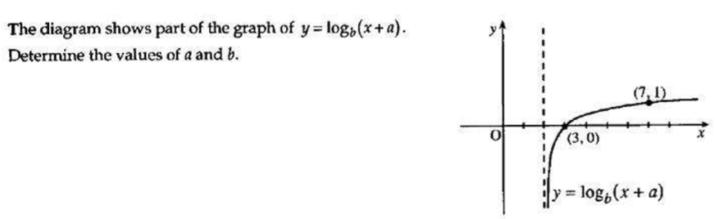

Slide 76
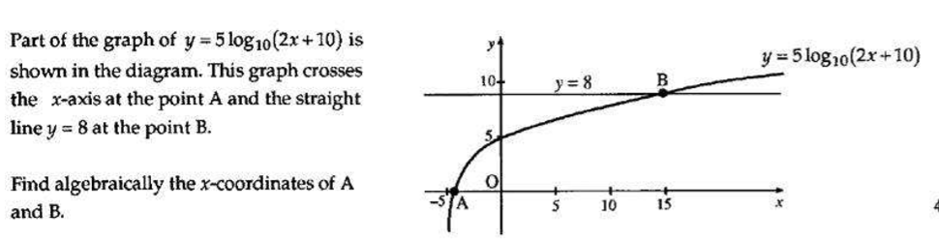

Slide 77
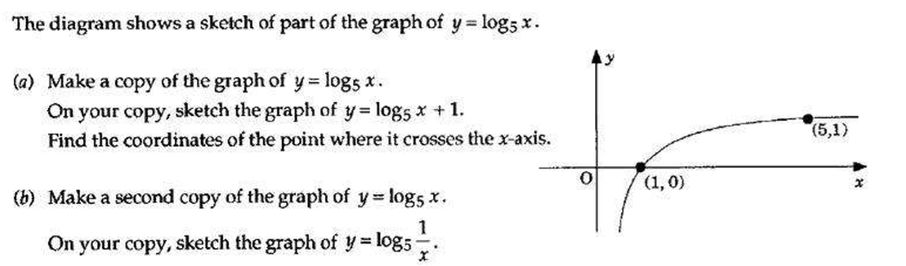

Slide 78
Functions
Ex 11.5
Page 141

Slide 79
Composite Functions
COMPOSITION OF FUNCTIONS
( or functions of functions )
Suppose that f and g are functions where
f:A → B and g:B → C
with f(x) = y and g(y) = z
where x∈ A, y∈ B and z∈ C.
Suppose that h is a third function where
h:A → C with h(x) = z .

Slide 80
Composite Functions
A B C
f
g
x
y
z
h
We can say that h(x) = g(f(x))
“function of a function”

Slide 81
f(2)=3x2 – 2 =4
g(4)=4² + 1 =17
Composite Functions
g(2)=2² + 1 =5
f(5)=5x3-2 =13
Example 1
f(1)=3x1 - 2 =1
f(1)=3x1 - 2 =1
Suppose that f(x) = 3x - 2 and g(x) = x² +1
(a) g( f(2) ) =
g(4)
= 17
g(5)=5² + 1 =26
g(26)=26² + 1 =677
(b) f( g (2) ) =
f(5)
= 13
(c) f( f(1) ) =
f(1)
= 1
(d) g( g(5) )
= g(26)
= 677

Slide 82
Composite Functions
Demo
3x - 2
x² +1
Suppose that f(x) = 3x - 2 and g(x) = x² +1
Find formulae for (a) g(f(x)) (b) f(g(x)).
(a) g(f(x)) =
( )² + 1
= 9x² - 12x + 5
(b) f(g(x)) =
3( ) - 2
= 3x² + 1
NB: g(f(x)) ≠ f(g(x)) in general.
CHECK
g(f(2)) =
9 x 2² - 12 x 2 + 5
= 36 - 24 + 5
= 17
f(g(2)) =
3 x 2² + 1
= 13

Slide 83
Composite Functions
x - 3
Let h(x) = x - 3 , g(x) = x² + 4 and k(x) = g(h(x)).
If k(x) = 8 then find the value(s) of x.
k(x) = g(h(x))
Put x² - 6x + 13 = 8
= ( )² + 4
then x² - 6x + 5 = 0
= x² - 6x + 13
or (x - 5)(x - 1) = 0
So x = 1 or x = 5

Slide 84
Composite Functions
Choosing a Suitable Domain
(i) Suppose f(x) = 1 . x² - 4
Clearly x² - 4 ≠ 0
So x² ≠ 4
So x ≠ -2 or 2
Hence domain = {x∈R: x ≠ -2 or 2 }

Slide 85
Composite Functions
Sketch graph
(ii) Suppose that g(x) = √(x² + 2x - 8)
We need (x² + 2x - 8) ≥ 0
Suppose (x² + 2x - 8) = 0
Then (x + 4)(x - 2) = 0
-4
2
So x = -4 or x = 2
So domain = { x∈R: x ≤ -4 or x ≥ 2 }

Slide 86
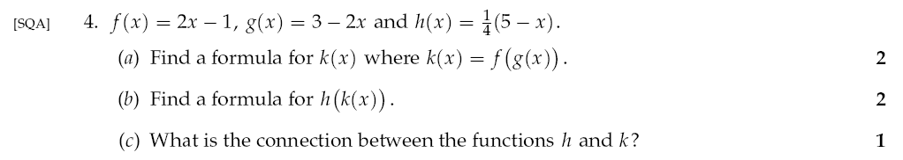

Slide 87
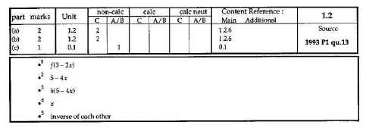

Slide 88
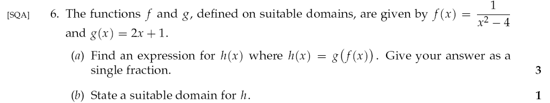

Slide 89
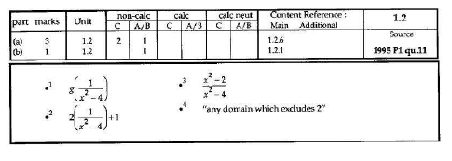

Slide 90
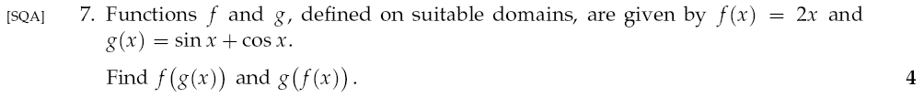

Slide 91
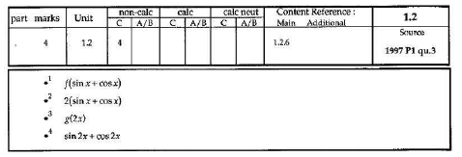

Slide 92
Graphs & Functions Higher
The functions f and g are defined on a suitable domain by
a) Find an expression for b) Factorise
a)
b)
Difference of 2 squares
Simplify

Slide 93
Graphs & Functions Higher
Functions and are defined on suitable domains.
a) Find an expression for h(x) where h(x) = f(g(x)).
b) Write down any restrictions on the domain of h.
a)
b)

Slide 94
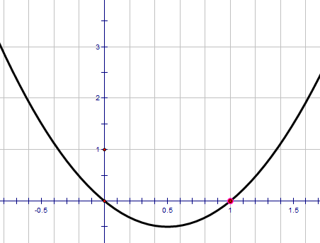
Graphs & Functions Higher
Functions f and g are defined on the set of real numbers by
a) Find formulae for
i) ii)
b) The function h is defined by
Show that and sketch the graph of h.
a)
b)

Slide 95
Graphs & Functions Higher
a) Find
b) If find in its simplest form.
a)
b)

Slide 96
Functions
Ex 11.6
Page 143

Slide 97
Inverse Functions
A Inverse function is simply a function in reverse
Function
Input
Output
f(x) = x²+ 3x - 1
f⁻¹(x) = ?
Output
Input

Slide 98
Inverse Function
Remember
f(x) is simply the
y-coordinate
Example
Find the inverse function given
Using Changing the subject rearrange into
x =
f(x) = 3x
Rewrite replacing y with x.
This is the inverse function
y = 3x
y
x =
3
x
f⁻¹(x) =
3

Slide 99
Inverse Function
Remember
f(x) is simply the
y-coordinate
Example
Find the inverse function given
Using Changing the subject rearrange into
x =
f(x) = x²
Rewrite replacing y with x.
This is the inverse function
y = x²
x =
√y
f⁻¹(x) =
√x

Slide 100
Inverse Function
Remember
f(x) is simply the
y-coordinate
Example
Find the inverse function given
Using Changing the subject rearrange into
x =
f(x) = 4x - 1
Rewrite replacing y with x.
This is the inverse function
y = 4x - 1
x =
y + 1
4
x + 1
f⁻¹(x) =
4

Slide 101
Functions
Ex 11.7
Page 146

Slide 102
Finding a Polynomial From Its Roots
Suppose that
f(x) = x² + 4x - 12
and g(x) = -3x² - 12x + 36
f(x) = 0
g(x) = 0
x² + 4x – 12 = 0
-3x² - 12x + 36 = 0
(x + 6)(x – 2) = 0
-3(x² + 4x – 12) = 0
x = -6 or x = 2
-3(x + 6)(x – 2) = 0
x = -6 or x = 2
Although f(x) and g(x) have identical roots/zeros they are clearly different functions and we need to keep this in mind when working backwards from the roots.

Slide 103
Finding a Polynomial From Its Roots
If a polynomial f(x) has roots/zeros at a, b and c
then it has factors (x – a), (x – b) and (x – c)
And can be written as f(x) = k(x – a)(x – b)(x – c).
NB: In the two previous examples
k = 1 and k = -3 respectively.

Slide 104
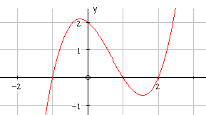
Finding a Polynomial From Its Roots
Example
y = f(x)
30
-2
1
5

Slide 105
Finding a Polynomial From Its Roots
f(x) has zeros at x = -2, x = 1 and x = 5,
so it has factors (x +2), (x – 1) and (x – 5)
so f(x) = k (x +2)(x – 1)(x – 5)
f(x) also passes through (0,30) so replacing x by 0
and f(x) by 30 the equation becomes
30 = k X 2 X (-1) X (-5)
ie 10k = 30
ie k = 3

Slide 106
Finding a Polynomial From Its Zeros
Formula is f(x) = 3(x + 2)(x – 1)(x – 5)
f(x) = (3x + 6)(x² – 6x + 5)
f(x) = 3x³ – 12x² – 21x + 30

Slide 107
Functions
Ex 11.8
Page 146

Slide 108
Are you on Target !
Update you log book
Make sure you complete and correct
MOST of the Composite Function
questions in the past paper booklet.
Make sure you complete and correct
SOME of the Trigonometry
questions in the past paper booklet.

Slide 109
0 < k < 1 compress
f(x)
+
k > 1 stretch
flip in
y-axis
Move vertically
up or downs
depending on k
f(x)
f(x)
-
Stretch or
compress
vertically
depending on k
y = f(x) ± k
y = f(-x)
Remember we can combine these together !!
y = kf(x)
Graphs & Functions
y = -f(x)
y = f(kx)
f(x)
y = f(x ± k)
f(x)
flip in
x-axis
-
Stretch or
compress
horizontally
depending on k
f(x)
+
Move horizontally
left or right
depending on k
0 < k < 1 stretch
k > 1 compress

Slide 110
1
g(f(x)) =
f(x) = x² - 4
g(x) =
g(f(x))
x
Write down g(x)
with brackets for x
1
x
x² - 4
x² - 4
1
g(x) =
( )
Domain
x-axis values
Input
inside bracket put f(x)
Range
y-axis values
Output
g(f(x)) =
1
A complex function made up of 2 or more simpler functions
Similar to composite Area
x² - 4
Restriction
x² - 4 ≠ 0
Composite Functions
(x – 2)(x + 2) ≠ 0
=
+
x ≠ 2
x ≠ -2
1
f(g(x)) =
g(x) =
f(x) = x² - 4
f(g(x))
x
Write down f(x)
with brackets for x
1
1
x
- 4
f(x) =
( )² - 4
x
x²
inside bracket put g(x)
1
²
1
Domain
x-axis values
Input
Range
y-axis values
Output
f(g(x)) =
- 4 =
- 4
x
x²
Restriction
x² ≠ 0

Slide 111
You need to learn
basic movements
Steps :
Outside function stays
the same EXCEPT replace
x terms with a ( )
2. Put inner function in bracket
Exam questions
normally involve
two movements
Composite
Functions
Remember order
BODMAS
Sketching
Graphs
Restrictions :
Denominator NOT ALLOWED
to be zero
CANNOT take the square root
of a negative number
Functions & Graphs
TYPE questions
(Sometimes Quadratics)

