Slide 1

Higher Maths
Connection between Radians / degrees
& Exact values
Solving Basic Trig Equations
Solving Harder Trig Equations
Solving Trig Equation by Substitution
Solving Wave Function
www.mathsrevision.com

Slide 2
Radians
Radian measure is an alternative to degrees and is based upon the ratio of
arc Length radius
L
θ
r
θ- theta
(angle at the centre)
So, full circle 360º ⇨2π radians

Slide 3
Radians
Demo
Copy Table
360º ⇨ 2π
180º ⇨ π
π
3π
90º ⇨
270º ⇨
2
2
π
2π
4π
5π
60º ⇨
120º ⇨
240º ⇨
300º ⇨
3
3
3
3
π
3π
5π
7π
45º ⇨
135º ⇨
225º ⇨
315º ⇨
4
4
4
4
π
5π
7π
11π
30º ⇨
150º ⇨
210º ⇨
330º ⇨
6
6
6
6

Slide 4
Converting
For any values
then X π
÷180
degrees
radians
÷ π
then x 180

Slide 5
Converting
Ex1 72º =
⁷²/₁₈₀ X π =
2π /₅
Ex2 330º =
³³⁰/₁₈₀ X π =
11 π /₆
Ex3 2π /₉ =
2π /₉ ÷ π x 180º =
²/₉ X 180º =
40º
Ex4 23π/₁₈ =
23π /₁₈ ÷ π x 180º =
²³/₁₈ X 180º =
230º

Slide 6
Exact Values
Some special values of Sin, Cos and Tan are useful left as fractions, We call these exact values
60º
2
30º
2
2
√3
60º
60º
60º
2
1
This triangle will provide exact values for
sin, cos and tan 30º and 60º

Slide 7
Exact Values
x | 0º | 30º | 45º | 60º | 90º
Sin xº
Cos xº
Tan xº |  |  |  |  | ∞
½
√3
2
0
1
1
√3
2
½
0
0
√3

Slide 8
Exact Values
Consider the square with sides 1 unit
45º
√2
1
1
45º
1
1
We are now in a position to calculate
exact values for sin, cos and tan of 45º

Slide 9
Exact Values
x | 0º | 30º | 45º | 60º | 90º
Sin xº
Cos xº
Tan xº |  |  |  |  | Undefined
½
1 √2
√3
2
0
1
1
√3
2
1 √2
½
0
0
1
√3

Slide 10
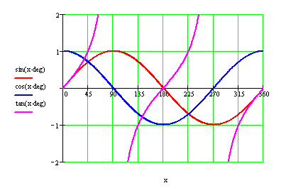
Solving Trig Equations
Sin +ve
All +ve
180º - xº
180º + xº
360º - xº
Tan +ve
Cos +ve
1
2
3
4
created by Mr. Lafferty

Slide 11


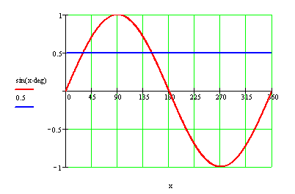
Solving Trig Equations
Graphically what are we trying to solve
90º
S
A
180º
0º
Example 1 Type 1:
Solving the equation sin xº = 0.5 in the range 0º to 360º
C
T
270º
sin xº = (0.5)
xº = sin⁻¹(0.5)
1st Q xº = 30º
2nd Q xº = 150º
1
2
3
4
(180º – 30º = 150º)
created by Mr. Lafferty
Notes:
<number>

Slide 12
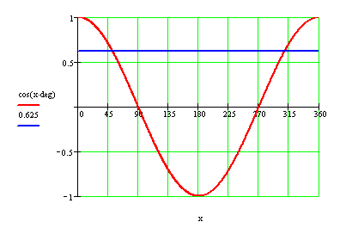
Solving Trig Equations
Graphically what are we trying to solve
90º
S
A
180º
0º
Example 2 :
Solving the equation cos xº - 0.625 = 0 in the range 0º to 360º
T
C
270º
cos xº = 0.625
xº = cos ⁻¹ (0.625)
1st Q xº = 51.3º
2nd Q xº = 308.7º
(360º - 53.1º = 308.7º)
1
2
3
4
created by Mr. Lafferty

Slide 13
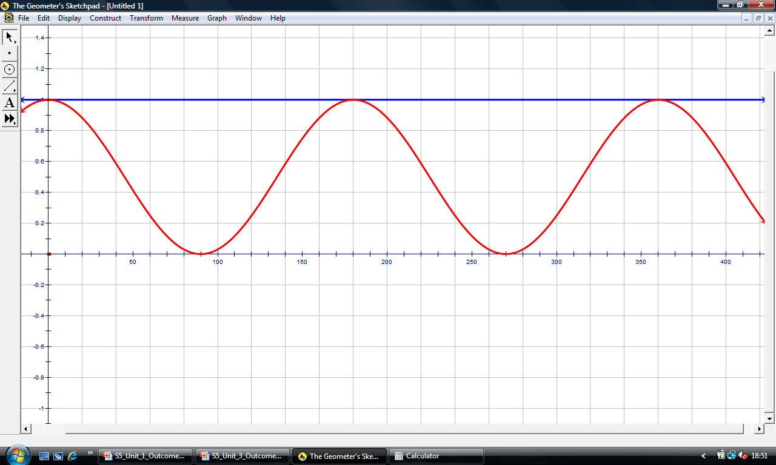
Solving Trig Equations
Graphically what are we trying to solve
90º
S
A
180º
0º
Example 6 Type 2 :
Solving the equation cos²x = 1 in the range 0º to 360º
T
C
270º
cos² xº = 1
cos xº = ± 1
cos xº = 1
xº = 0º and 360º
cos xº = -1
created by Mr. Lafferty
xº = 180º
Notes:
<number>

Slide 14




Maths4Scotland Higher
Find the exact solutions of 4sin² x = 1, 0 ≤ x ≤ 2π
Rearrange
Take square roots
Find acute x
Determine quadrants for sin x
+ and – from the square root requires all 4 quadrants
S
A
T
C
Hint
Previous
Quit
Quit
Next
Table of exact values

Slide 15
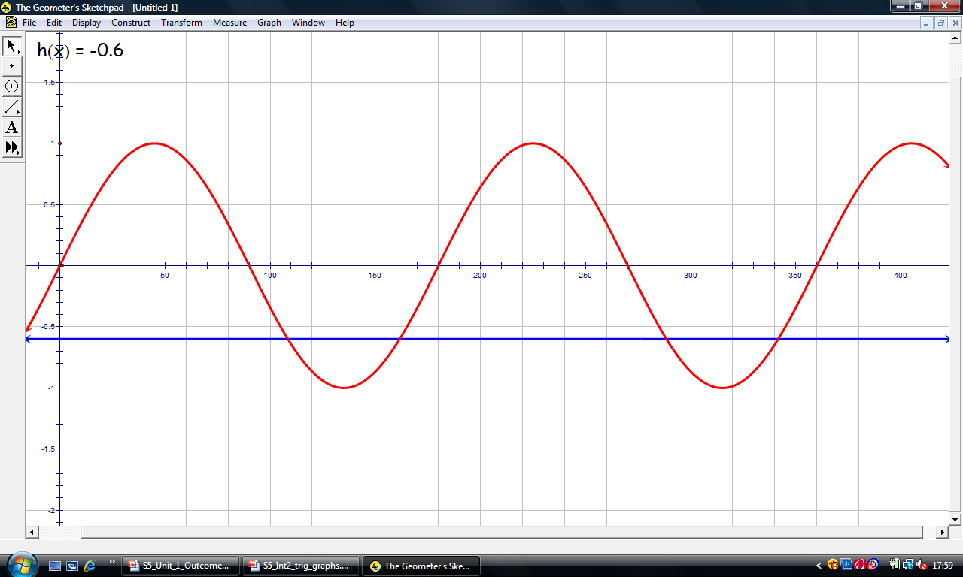
Solving Trig Equations
Graphically what are we trying to solve
90º
S
A
180º
0º
Example 4 Type 3 :
Solving the equation sin 2xº + 0.6 = 0 in the range 0º to 360º
T
C
270º
sin 2xº = (-0.6)
2xº = sin⁻¹(0.6)
2xº = 37º ( always 1st Q First)
2xº = 217º , 323º
577º , 683º ......
÷2
xº = 108.5º , 161.5º
288.5º , 341.5º
created by Mr. Lafferty
Notes:
<number>

Slide 16
Solving Trigonometric Equations
Example:
Step 2: consider what solutions
are expected
Step 1: Re-Arrange
90º
S
A
180º
0º
T
C
270º

Slide 17
3x means
3 rows
Solving Trigonometric Equations
Step 3: Solve the equation
1st Q 3x = 60º
4th Q 300º
x = 20º
100º
420º 660º
780º 1020º
140º
220º
260º
340º
Notes:
<number>

Slide 18
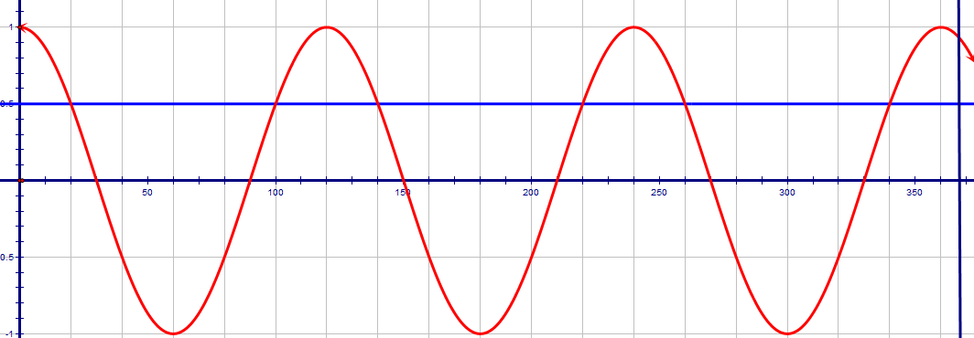
Solving Trigonometric Equations
Graphical solution for

Slide 19
Solving Trigonometric Equations
Example:
Step 2: consider what solutions
are expected
Step 1: Re-Arrange
90º
sin 6t is negative so solutions in the third and fourth quadrants
S
A
180º
0º
T
C
x 6
x 6
270º

Slide 20
6x means 6 rows
but only over 180º so 3 rows
Solving Trigonometric Equations
Step 3: Solve the equation
3rd Q 6t = 225º
4th Q = 315º
x = 37.5º
52.5º
585º 675º
945º 1035º
97.5º
112.5º
157.5º
172.5º
Notes:
<number>

Slide 21
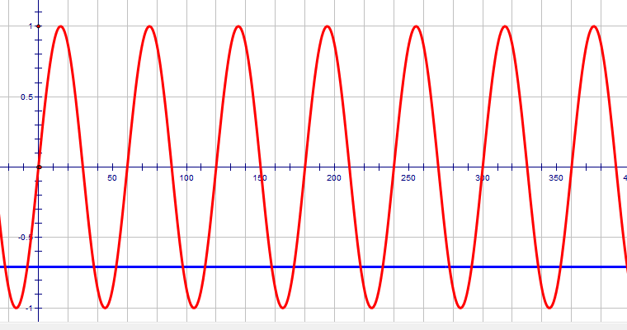
Solving Trigonometric Equations
Graphical solution for

Slide 22
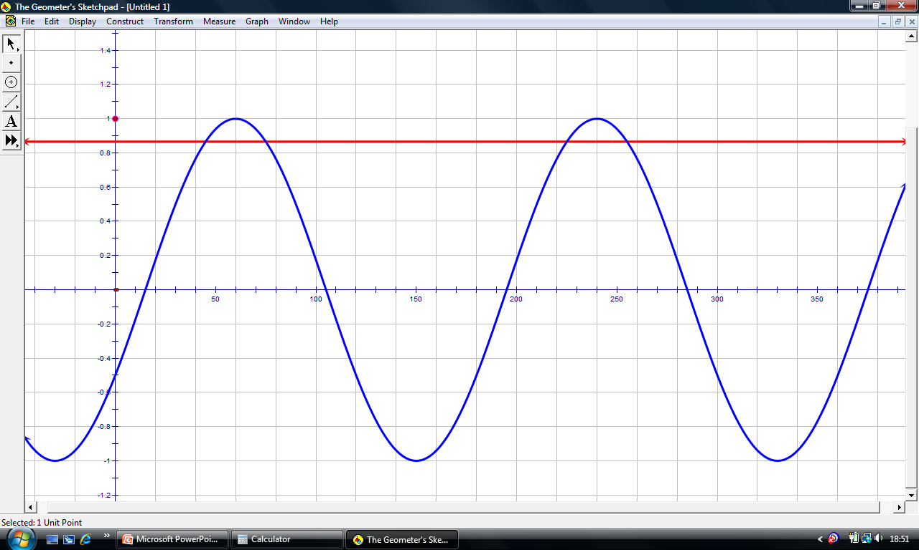
Solving Trig Equations
Graphically what are we trying to solve
90º
S
A
180º
0º
Example 5 Type 3 :
Solving the equation 2sin (2xº - 30º) - √3 = 0 in the range 0º to 360º
T
C
270º
2sin (2x - 30º) = √3
sin (2x - 30º) = √3 ÷ 2
(2x - 30º) = sin⁻¹(√3 ÷ 2)
(2xº - 30º) = 60º 120º
420º 480º
2xº = 90º 150º
450º 510º
÷2
xº = 45º 75º
225º 255º
created by Mr. Lafferty
Notes:
<number>

Slide 23
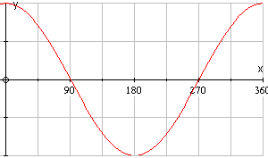
Trig Equations
Example
Find the value of x that minimises the expression
cosx°cos32° + sinx°sin32°
Using rule 2(b) we get
cosx°cos32° + sinx°sin32° = cos(x – 32)°
cos graph is roller-coaster
min value is -1 when angle = 180°
ie x – 32º = 180º
ie x = 212º

Slide 24
ALWAYS work out Quad 1 first
Trig Equations
Example 5
Solve sinx°cos30° + cosx°sin30° = -0.966
where 0º < x < 360º
By rule 1a sinx°cos30° + cosx°sin30° =
sin(x + 30)°
sin(x + 30)° = -0.966
S
A
180-xº
xº
180+xº
360-xº
1st Q sin⁻¹ (0.966) = 75°
T
C
3rd Q
4th Q
(x + 30º) = 255º
x + 30º = 285º
x = 225º
x = 255º

Slide 25
The solution is to be in radians – but work in degrees and convert at the end.
Solving Trigonometric Equations
Example:
Step 2: consider what solutions are expected
Step 1: Re-Arrange
90º
(2x – 60º ) = sin⁻¹(1/2)
S
A
180º
0º
T
C
270º

Slide 26
Solving Trigonometric Equations
Step 3: Solve the equation
1st Q 30º 2nd Q 150°
2x - 60° = 30º
150º
x = 45º
105º
390º 510º
225º
285º
2x = 90º 210º
450º 570º
Notes:
<number>

Slide 27
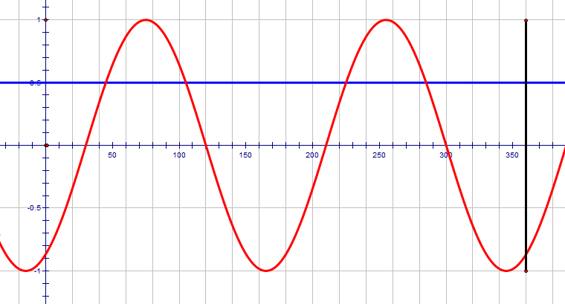
Solving Trigonometric Equations
Graphical solution for

Slide 28
Solving Trig Equations
90º
90º
S
A
S
A
180º
0º
180º
0º
Example 7 Type 5 :
Solving the equation
3sin²x + 2sin x - 1 = 0 in the range 0º to 360º
T
C
T
C
270º
270º
Let p = sin x
We have 3p² + 2p - 1 = 0
Factorise
(3p – 1)(p + 1) = 0
3p – 1 = 0
p + 1 = 0
p = 1/3
p = - 1
sin x = 1/3
sin x = -1
xº = 19.5º and 160.5º
xº = 270º
Notes:
<number>

Slide 29
Solving Trigonometric Equations
Harder Example:
Step 2: Consider what solutions
are expected
Step 1: Re-Arrange
90º
S
A
180º
0º
T
C
Two solutions
One solution
270º

Slide 30
Solving Trigonometric Equations
Step 3: Solve the equation
1st Q x = 19.5º
x = 90º
2nd Q x = 160.5º
Overall solution x = 19.5º , 90º and 160.5º
Notes:
<number>

Slide 31
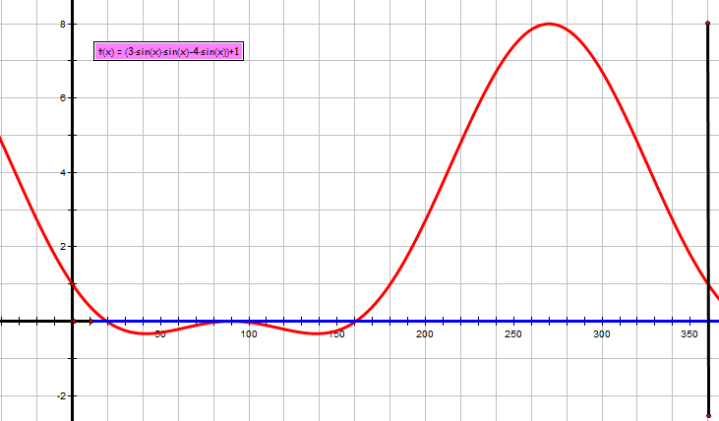
Solving Trigonometric Equations
Graphical solution for

Slide 32
cos(2x – 10º) – 0.5 = 0
2sin²xº + 3sinxº +1 = 0
Range : 0 ≤ x ≤ 2π
Range : 0 ≤ x ≤ 360º
Higher Trig.
tanxº – 0.5 = 0
Range : 0 ≤ x ≤ 2π
Range : 0 ≤ x ≤ 180º
Range : 0 ≤ x ≤ 2π
sin²xº – 0.5 = 0
6cos2xº + 3 = 0
Name :

Slide 33
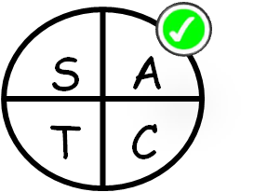
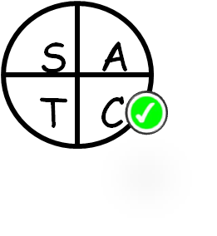



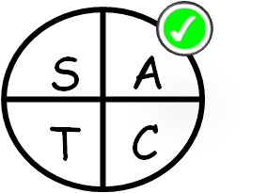


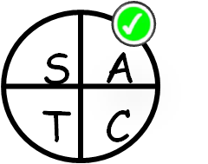




cos(2x – 10º) – 0.5 = 0
Range : 0 ≤ x ≤ 2π
2sin²xº + 3sinxº + 1 = 0
Range : 0 ≤ x ≤ 360º
cos(2xº – 10º) = 0.5
Let p = sinxº
2xº – 10 º = cos ⁻¹ (0.5)
2p² + 3p + 1 = 0
(2p + 1 )(p + 1) = 0
(2sinxº + 1 ) = 0
(sinxº + 1 ) = 0
sinxº = -0.5
sinxº = -1
xº = 210º , 330º
xº = 270º
Higher Trig.
tanxº – 0.5 = 0
sin²xº – 0.5 = 0
Range : 0 ≤ x ≤ 2π
Range : 0 ≤ x ≤ 180º
6cos2xº + 3 = 0
Range : 0 ≤ x ≤ 2π
1st Quad
xº =
1st Quad
xº =
sin ² xº = 0.5
tanxº = 0.5
cos2xº = -0.5
sinxº = ±1/√2
xº = tan ⁻¹ (0.5)
2xº = cos ⁻¹ (0.5)
xº = 26.5º , 206.5º
sinxº = 1 /√2
sinxº = - 1/√2
Name :

Slide 34
Trigonometric Equations
Double angle formulae (like cos2A or sin2A) often occur in trig equations. We can solve these equations by substituting the expressions derived in the previous sections.
Rules for solving equations
sin2A = 2sinAcosA when replacing sin2Aequation
cos2A = 2cos²A – 1 if cosA is also in the equation
cos2A = 1 – 2sin²A if sinA is also in the equation

Slide 35
Trigonometric Equations
cos2x and sin x,
so substitute 1-2sin²x

Slide 36
Trigonometric Equations
cos 2x and cos x,
so substitute 2cos² -1
90º
S
A
180º
0º
T
C
270º

Slide 37
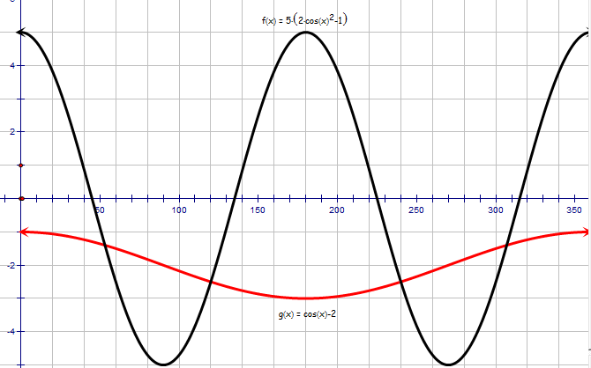
Trigonometric Equations

Slide 38
The solution is to be in radians – but work in degrees and convert at the end.
Solving Trigonometric Equations
Harder Example:
Step 2: Consider what solutions
are expected
Step 1: Re-Arrange
Remember this !
90º
S
A
180º
0º
T
C
270º
Two solutions
One solution

Slide 39
Solving Trigonometric Equations
Step 3: Solve the equation
1st Q x = 53.1º
x = 180º
4th Q x = 306.9º
Overall solution in radians x = 0.93 , π and 5.35
Notes:
<number>

Slide 40
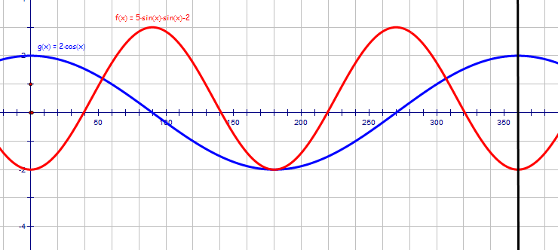
Solving Trigonometric Equations
Graphical solution for

Slide 41
Maths4Scotland Higher
Solve the equation for 0 ≤ x ≤ π correct to 2 decimal places
Replace cos 2x with
Determine quadrants
Substitute
S
A
Simplify
Factorise
T
C
Hence
Discard
Find acute x
Hint
Previous
Quit
Quit
Next

Slide 42
Maths4Scotland Higher
Functions f and g are defined on suitable domains by f(x) = sin (x) and g(x) = 2x
a) Find expressions for:
i) f(g(x)) ii) g(f(x))
b) Solve 2 f(g(x)) = g(f(x)) for 0 ≤ x ≤ 360°
Determine x
1st expression
2nd expression
S
A
Determine
quadrants
Form equation
Replace sin 2x
T
C
Rearrange
Common factor
Hint
Hence
Previous
Quit
Quit
Next
Table of exact values

Slide 43
Maths4Scotland Higher
Functions are defined on a suitable set of real numbers
Find expressions for i) f(h(x)) ii) g(h(x))
i) Show that ii) Find a similar expression for g(h(x))
iii) Hence solve the equation
1st expression
Simplifies to
2nd expression
Rearrange:
Simplify 1st expr.
acute x
Use exact values
S
A
Determine
quadrants
Similarly for 2nd expr.
T
C
Form Eqn.
Hint
Previous
Quit
Quit
Next
Table of exact values

Slide 44
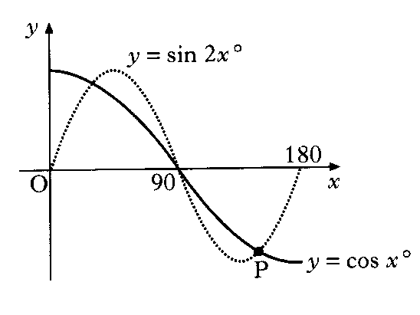
Maths4Scotland Higher
a) Solve the equation sin 2x - cos x = 0 in the interval 0 ≤ x ≤ 180°
b) The diagram shows parts of two trigonometric graphs,
y = sin 2x and y = cos x. Use your solutions in (a) to
write down the co-ordinates of the point P.
Replace sin 2x
Solutions for where graphs cross
Common factor
Hence
By inspection (P)
Determine x
Find y value
S
A
Coords, P
Determine quadrants
for sin x
Hint
T
C
Previous
Quit
Quit
Next
Table of exact values

Slide 45
Maths4Scotland Higher
Solve the equation for 0 ≤ x ≤ 360°
Replace cos 2x with
Determine quadrants
Substitute
Simplify
S
A
S
A
Factorise
Hence
T
C
T
C
Find acute x
Solutions are: x= 60°, 132°, 228° and 300°
Hint
Previous
Quit
Quit
Next
Table of exact values

Slide 46
Maths4Scotland Higher
Solve the equation for 0 ≤ x ≤ 2π
Rearrange
Find acute x
Note range
S
A
Determine quadrants
Solutions are:
T
C
Hint
Previous
Quit
Quit
Next
Table of exact values

Slide 47
Maths4Scotland Higher
a) Write the equation cos 2θ + 8 cos θ + 9 = 0 in terms of cos θ
and show that for cos θ it has equal roots.
b) Show that there are no real roots for θ
Replace cos 2θ with
Try to solve:
Rearrange
Divide by 2
No solution
Hence there are no real solutions for θ
Factorise
Deduction
Equal roots for cos θ
Hint
Previous
Quit
Quit
Next

Slide 48
Maths4Scotland Higher
Solve algebraically, the equation sin 2x + sin x = 0, 0 ≤ x ≤ 360
Replace sin 2x
Determine quadrants
for cos x
Common factor
S
A
Hence
T
C
Determine x
x = 0°, 120°, 240°, 360°
Hint
Previous
Quit
Quit
Next
Table of exact values

Slide 49
Maths4Scotland Higher
Solve the equation for 0 ≤ x ≤ 360°
Replace cos 2x with
Determine quadrants
Substitute
Simplify
S
A
Factorise
Hence
T
C
Find acute x
Solutions are: x= 60°, 180° and 300°
Hint
Previous
Quit
Quit
Next
Table of exact values

Slide 50
Maths4Scotland Higher
Solve algebraically, the equation for 0 ≤ x ≤ 360°
Replace cos 2x with
Determine quadrants
Substitute
Simplify
S
A
Factorise
Hence
T
C
Find acute x
Discard above
Solutions are: x= 60° and 300°
Hint
Previous
Quit
Quit
Next
Table of exact values

Slide 51
Maths4Scotland Higher
a) Express f (x) in the form
b) Hence solve algebraically
Expand kcos(x - a):
Equate coefficients:
Square and add
a is in 1st quadrant
(sin and cos are both + )
Dividing:
Put together:
Solve equation.
Cosine +, so 1st & 4th quadrants
Hint
Previous
Quit
Quit
Next

Slide 52
Maths4Scotland Higher
Solve the equation in the interval 0 ≤ x ≤ 360.
Use R cos(x - a):
Equate coefficients:
Square and add
a is in 2nd quadrant
(sin + and cos - )
Dividing:
Put together:
Solve equation.
Cosine +, so 1st & 4th quadrants
Hint
Previous
Quit
Quit
Next

Slide 53
Maths4Scotland Higher
Solve the simultaneous equations
where k > 0 and 0 ≤ x ≤ 360
Use tan A = sin A / cos A
Divide
Find acute angle
Determine quadrant(s)
Sine and cosine are both + in original equations
Solution must be in 1st quadrant
State solution
Hint
Previous
Quit
Quit
Next

Slide 54

Expand and equate coefficients
Solving Trig Equations
Example
Find tan ratio note: sin(-) and cos(-)
90º
Square and add
S
A
180º
0º
T
C
270º

Slide 55
Solving Trig Equations
368.8º - 360º = 8.8º
2x = 229.8º 377.6º
589.8º 737.6º
2x – 213.7 = 16.1º 163.9º
376.1º 523.9º
x = 114.9º , 188.8º, 294.9º, 368.8º

Slide 56


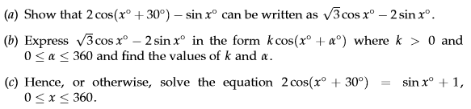
Range : 0 ≤ x ≤ π
Range : 0 ≤ x ≤ 360º
Solving Trig. Equations
Range : 0 ≤ x ≤ 2π
Name :

Slide 57
Are you on Target !
Update you log book
Make sure you complete and correct
MOST of the Trigonometry
questions in the past paper booklet.

