Slide 1

Higher Unit 3
Vectors and Scalars
3D Vectors
Properties of vectors
Properties 3D
Adding / Sub of vectors
Section formula
Multiplication by a Scalar
Scalar Product
Unit Vector
Component Form
Position Vector
Angle between vectors
Collinearity
Section Formula
Perpendicular
Properties of Scalar Product
Exam Type Questions
www.mathsrevision.com
Notes:
<number>

Slide 2
Vectors & Scalars
A vector is a quantity with
BOTH magnitude (length) and direction.
Examples : Gravity
Velocity
Force

Slide 3
Vectors & Scalars
A scalar is a quantity that has
magnitude ONLY.
Examples : Time
Speed
Mass

Slide 4
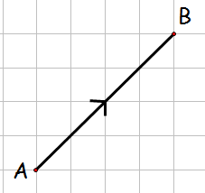
Vectors & Scalars
A vector is named using the letters at the end of the directed line segment
or
using a lowercase bold / underlined letter
This vector is named
u
or
u
u
or
u

Slide 5
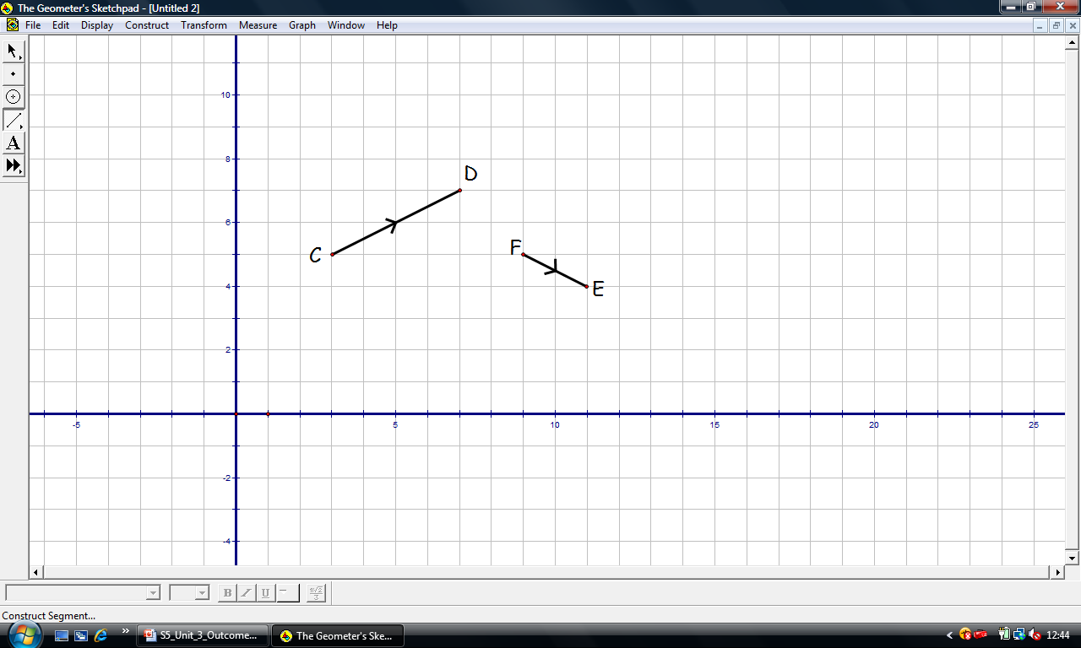
Also known as column vector
Vectors & Scalars
A vector may also be
represented in component form.
w
z

Slide 6
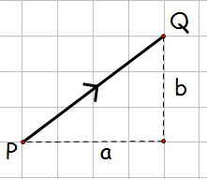
Magnitude of a Vector
A vector’s magnitude (length) is represented by
A vector’s magnitude is calculated using Pythagoras Theorem.
u

Slide 7
Vectors & Scalars
Calculate the magnitude of the vector.
w

Slide 8
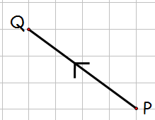
Vectors & Scalars
Calculate the magnitude of the vector.

Slide 9
Equal Vectors
Vectors are equal only if they both have
the same magnitude ( length ) and direction.
Vectors are equal if they have
equal components.
For vectors

Slide 10
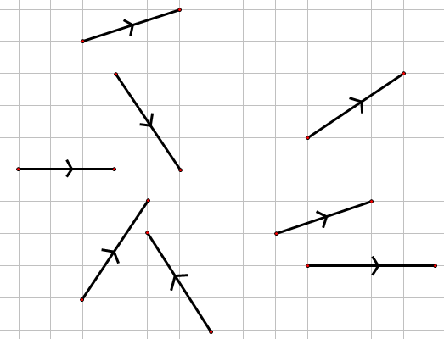
Equal Vectors
By working out the components of each of the vectors determine which are equal.
a
a
b
c
d
g
g
e
f
h

Slide 11
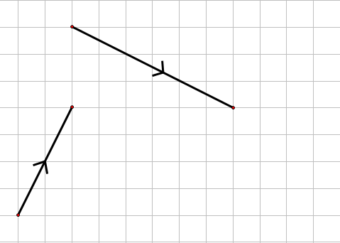
Addition of Vectors
Any two vectors can be added in this way
Arrows must be nose to tail
b
b
a
a + b

Slide 12
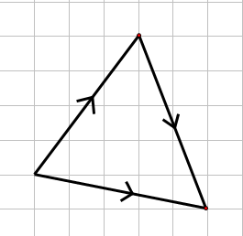
Addition of Vectors
Addition of vectors
B
A
C

Slide 13
Addition of Vectors
In general we have
For vectors u and v

Slide 14
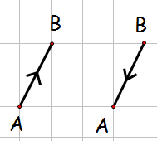
Zero Vector
The zero vector

Slide 15
Negative Vector
Negative vector
For any vector u

Slide 16
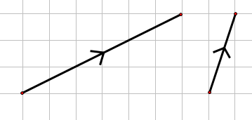
Subtraction of Vectors
Any two vectors can be subtracted in this way
u
Notice arrows nose to nose
v
v
u - v

Slide 17
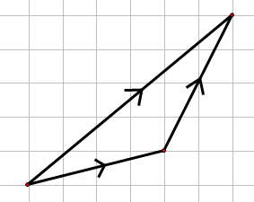
Subtraction of Vectors
Subtraction of vectors
Notice arrows nose to nose
a
b
a - b

Slide 18
Subtraction of Vectors
In general we have
For vectors u and v

Slide 19
Multiplication by a Scalar
Multiplication by a scalar ( a number)
Hence if u = kv then u is parallel to v
Conversely if u is parallel to v then u = kv

Slide 20
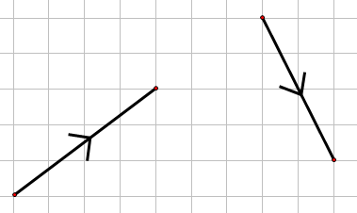
Multiplication by a Scalar
Multiplication by a scalar
Write down a vector
parallel to a
b
Write down a vector
parallel to b
a

Slide 21
Multiplication by a Scalar
Show that the two vectors are parallel.
If z = kw then z is parallel to w

Slide 22
Multiplication by a Scalar
Alternative method.
If w = kz then w is parallel to z

Slide 23
Unit Vectors
For ANY vector v there exists
a parallel vector u of magnitude 1 unit.
This is called the unit vector.

Slide 24
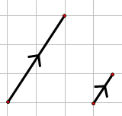
v
Unit Vectors
u
Find the components of the unit vector, u , parallel to vector v , if
So the unit vector is u

Slide 25
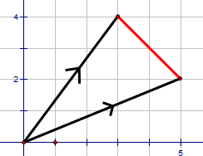
A
Position Vectors
B
A is the point (3,4) and B is the point (5,2).
Write down the components of
Answers
the same !

Slide 26
A
Position Vectors
a
B
b
0

Slide 27
A
Position Vectors
a
B
b
0

Slide 28
Position Vectors
If P and Q have coordinates (4,8) and (2,3)
respectively, find the components of
Notes:
<number>

Slide 29
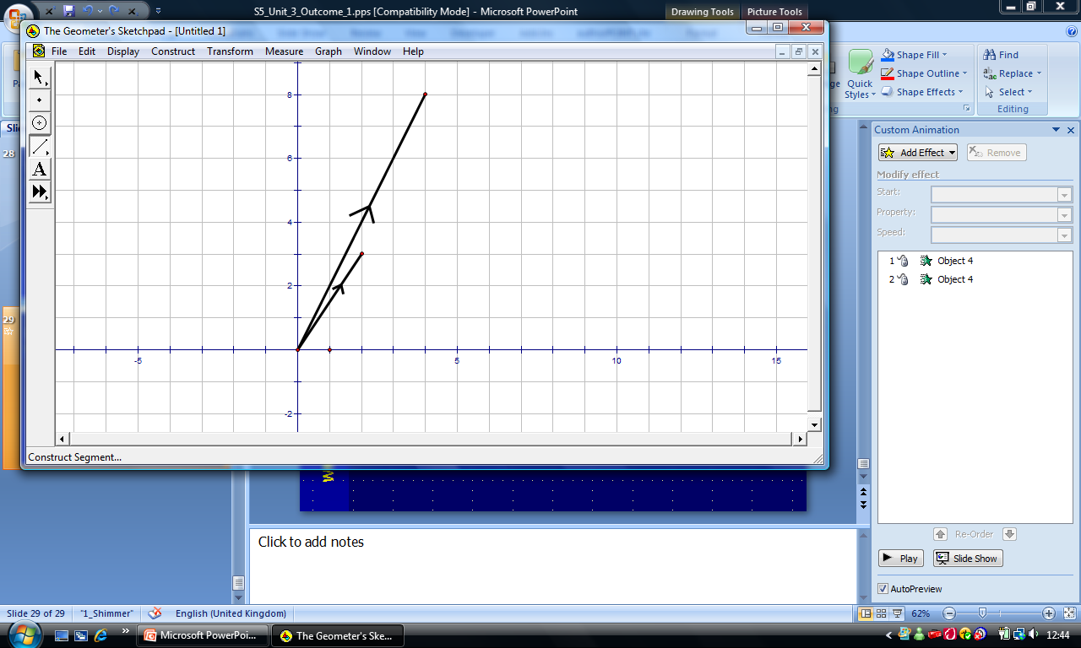
Position Vectors
P
Graphically
P (4,8)
Q (2,3)
p
q - p
Q
q
O
Notes:
<number>

Slide 30
Collinearity
Reminder !
Points are said to be collinear if they lie on the same straight line.
For vectors
Notes:
<number>

Slide 31
Collinearity
Prove that the points A(2,4), B(8,6) and C(11,7) are collinear.
Notes:
<number>

Slide 32
Collinearity
Notes:
<number>

Slide 33
Extra Practice
HHM Ex13I

Slide 34
Section Formula
B
3
2
S
b
1
s
A
a
O
Notes:
<number>

Slide 35
General Section Formula
B
m + n
n
P
b
m
p
A
a
O
Notes:
<number>

Slide 36
General Section Formula
Summarising we have
B
If p is a position vector
of the point P that divides
AB in the ratio m : n
then
n
P
m
A
Notes:
<number>

Slide 37
General Section Formula
A and B have coordinates (-1,5)
and (4,10) respectively.
Find P if AP : PB is 3:2
B
2
P
3
A
Notes:
<number>

Slide 38
Extra Practice
HHM Ex13K

Slide 39

3D Coordinates
In the real world points in space can be located using a 3D coordinate system.
For example, air traffic controllers find the location a plane by its height and grid reference.
z
y
(x, y, z)
x
O
Notes:
<number>

Slide 40
3D Coordinates
Write down the coordinates for the 7 vertices
z
y
E
(0, 1, 2)
A
(6, 1, 2)
(0, 0, 2)
F
2
H
(6, 0, 2)
B
(0,0, 0)
D
(6, 1, 0)
G
1
x
O
6
C
(6, 0, 0)
What is the coordinates of the vertex H so that it makes a cuboid shape.
H(0, 1, 0 )
Notes:
<number>

Slide 41
3D Vectors
3D vectors are defined by 3 components.
For example, the velocity of an aircraft taking off can be illustrated by the vector v.
z
(7, 3, 2)
2
y
v
2
3
3
x
O
7
7
Notes:
<number>

Slide 42
3D Vectors
Any vector can be represented in terms of the i , j and k
Where i, j and k are unit vectors
in the x, y and z directions.
z
y
k
j
O
i
x
Notes:
<number>

Slide 43
3D Vectors
Any vector can be represented in terms of the i , j and k
Where i, j and k are unit vectors
in the x, y and z directions.
z
(7, 3, 2)
y
v
2
v = ( 7i+ 3j + 2k )
3
O
x
7
Notes:
<number>

Slide 44
3D Vectors
Good News
All the rules for 2D vectors apply in the same way for 3D.
Notes:
<number>

Slide 45
Magnitude of a Vector
A vector’s magnitude (length) is represented by
A 3D vector’s magnitude is calculated using Pythagoras Theorem twice.
z
y
v
1
2
O
x
3

Slide 46
Addition of Vectors
Addition of vectors

Slide 47
Addition of Vectors
In general we have
For vectors u and v

Slide 48
Negative Vector
Negative vector
For any vector u

Slide 49
Subtraction of Vectors
Subtraction of vectors

Slide 50
Subtraction of Vectors
For vectors u and v

Slide 51
Multiplication by a Scalar
Multiplication by a scalar ( a number)
Hence if u = kv then u is parallel to v
Conversely if u is parallel to v then u = kv

Slide 52
Multiplication by a Scalar
Show that the two vectors are parallel.
If z = kw then z is parallel to w

Slide 53
Position Vectors
A (3,2,1)
z
a
y
1
2
O
x
3

Slide 54
Position Vectors

Slide 55
Extra Practice
HHM Ex13L
HHM Ex13M
HHM Ex13N (Q1 - 14)

Slide 56
Collinearity in 3D
Reminder !
Points are said to be collinear if they lie on the same straight line.
For vectors
Notes:
<number>

Slide 57
Extra Practice
HHM Ex13N (Q15 - 18)

Slide 58
General Section Formula
Summarising we have
B
If p is a position vector
of the point P that divides
AB in the ratio m : n
then
n
P
m
A
Notes:
<number>

Slide 59
Extra Practice
HHM Ex13N (Q19-24)

Slide 60
The scalar product
Must be
tail to tail
The scalar product is defined as being:
a
θ
b
Notes:
<number>

Slide 61
The Scalar Product
Find the scalar product for a and b when
|a|= 4 , |b|= 5 when (a) θ = 45º (b) θ = 90º
Notes:
<number>

Slide 62
The Scalar Product
Find the scalar product for a and b when
|a|= 4 , |b|= 5 when (a) θ = 45º (b) θ = 90º
Important : If a and b are perpendicular then
a . b = 0
Notes:
<number>

Slide 63
Extra Practice
HHM Ex13O

Slide 64
Extra Practice
HHM Ex13O

Slide 65
Component Form Scalar Product
If
then
Notes:
<number>

Slide 66
Angle between Vectors
To find the angle between two vectors we simply use the scalar product formula rearranged
or
Notes:
<number>

Slide 67
Angle between Vectors
Find the angle between the two vectors below.
Notes:
<number>

Slide 68
Angle between Vectors
Find the angle between the two vectors below.
Notes:
<number>

Slide 69
Perpendicular Vectors
Show that for
a . b =0
a and b are perpendicular
Notes:
<number>

Slide 70
Perpendicular Vectors
Then
If a . b = 0 then a and b are perpendicular
Notes:
<number>

Slide 71
Extra Practice
HHM Ex13P
HHM Ex13Q
HHM Ex13R

Slide 72
Properties of a Scalar Product
Two properties that you need to be aware of
Notes:
<number>

Slide 73
Extra Practice
HHM Ex13T
HHM Ex13U
Applications of Vectors
HHM Ex13S
HHM Ex13T

Slide 74

Vectors
Higher Maths
Strategies
Click to start

Slide 75

Vectors Higher
The following questions are on
Vectors
Non-calculator questions will be indicated
You will need a pencil, paper, ruler and rubber.
Click to continue

Slide 76
Vectors Higher
The questions are in groups
General vector questions (15)
Points dividing lines in ratios
Collinear points (8)
Angles between vectors (5)
Quit
Quit

Slide 77
Vectors Higher
General Vector Questions
Continue
Quit
Quit
Back to menu

Slide 78


Vectors Higher
Vectors u and v are defined by and
Determine whether or not u and v are perpendicular to each other.
Is Scalar product = 0
Hence vectors are perpendicular
Hint
Previous
Quit
Quit
Next

Slide 79
Vectors Higher
For what value of t are the vectors and perpendicular ?
Put Scalar product = 0
Perpendicular ⇒ u.v = 0
Hint
Previous
Quit
Quit
Next

Slide 80
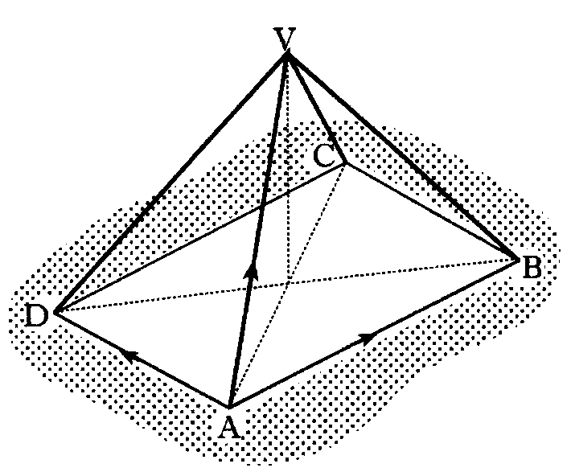
Vectors Higher
VABCD is a pyramid with rectangular base ABCD.
The vectors are given by
Express in component form.
Ttriangle rule Δ ACV
Re-arrange
Triangle rule Δ ABC
also
Hint
Previous
Quit
Quit
Next

Slide 81
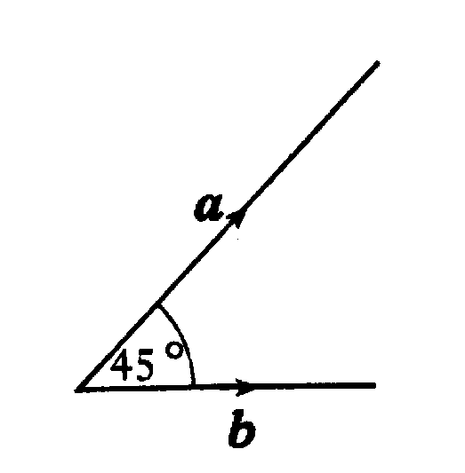
Vectors Higher
The diagram shows two vectors a and b, with | a | = 3 and | b | = 2√2.
These vectors are inclined at an angle of 45° to each other.
a) Evaluate
i) a.a ii) b.b iii) a.b
b) Another vector p is defined by
Evaluate p.p and hence write down | p |.
i)
ii)
iii)
b)
Since p.p = p²
Hint
Previous
Quit
Quit
Next

Slide 82
Vectors Higher
Vectors p, q and r are defined by
a) Express in component form
b) Calculate p.r
c) Find |r|
a)
b)
c)
Hint
Previous
Quit
Quit
Next

Slide 83
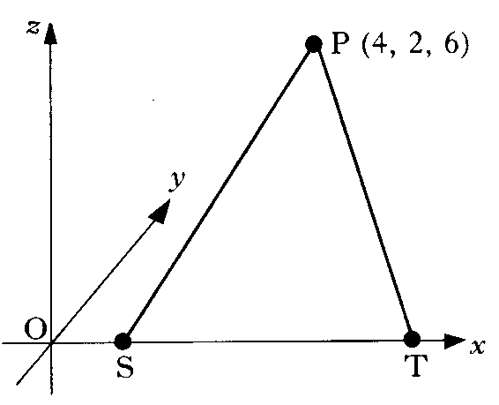
Vectors Higher
The diagram shows a point P with co-ordinates
(4, 2, 6) and two points S and T which lie on the x-axis.
If P is 7 units from S and 7 units from T,
find the co-ordinates of S and T.
Use distance formula
hence there are 2 points on the x axis that are 7 units from P
i.e. S and T
and
Hint
Previous
Quit
Quit
Next

Slide 84
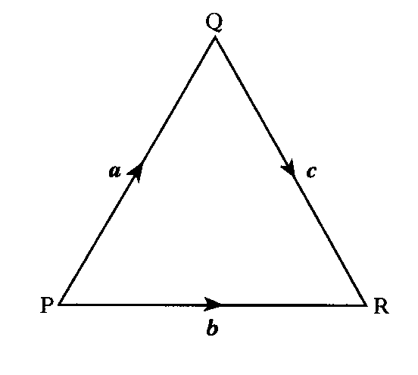
Vectors Higher
The position vectors of the points P and Q are
p = –i +3j+4k and q = 7 i – j + 5 k respectively.
a) Express in component form.
b) Find the length of PQ.
a)
b)
Hint
Previous
Quit
Quit
Next

Slide 85

Vectors Higher
PQR is an equilateral triangle of side 2 units.
Evaluate a.(b + c) and hence identify
two vectors which are perpendicular.
P
60°
a
b
Diagram
60°
60°
Q
R
c
NB for a.c vectors must point OUT of the vertex ( so angle is 120° )
Hence
so, a is perpendicular to b + c
Hint
Previous
Table of
Exact Values
Quit
Quit
Next

Slide 86
Vectors Higher
Calculate the length of the vector 2i – 3j + √3k
Length
Hint
Previous
Quit
Quit
Next

Slide 87
Vectors Higher
Find the value of k for which the vectors and are perpendicular
Put Scalar product = 0
Hint
Previous
Quit
Quit
Next

Slide 88
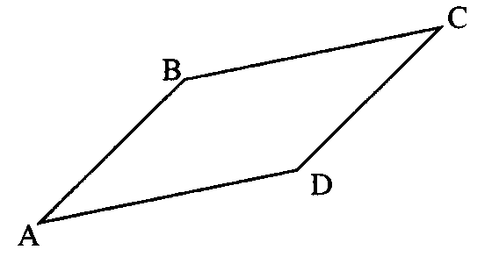
Vectors Higher
A is the point (2, –1, 4), B is (7, 1, 3) and C is (–6, 4, 2).
If ABCD is a parallelogram, find the co-ordinates of D.
D is the displacement
from A
hence
Hint
Previous
Quit
Quit
Next

Slide 89
Vectors Higher
If and write down the components of u + v and u – v
Hence show that u + v and u – v are perpendicular.
look at scalar product
Hence vectors are perpendicular
Hint
Previous
Quit
Quit
Next

Slide 90
Vectors Higher
The vectors a, b and c are defined as follows:
a = 2i – k, b = i + 2j + k, c = –j + k
a) Evaluate a.b + a.c
b) From your answer to part (a), make a deduction about the vector b + c
a)
b)
b + c is perpendicular to a
Hint
Previous
Quit
Quit
Next

Slide 91
Vectors Higher
A is the point ( –3, 2, 4 ) and B is ( –1, 3, 2 )
Find:
a) the components of
b) the length of AB
a)
b)
Hint
Previous
Quit
Quit
Next

Slide 92
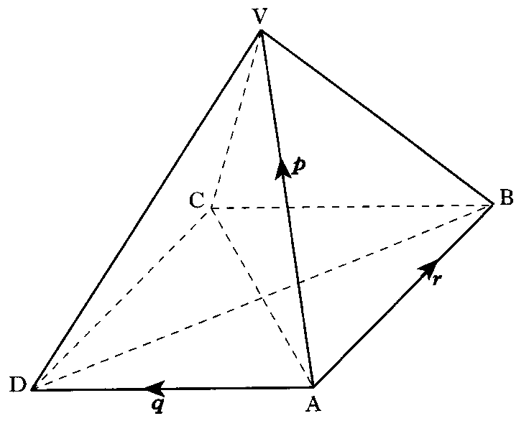
Vectors Higher
In the square based pyramid,
all the eight edges are of length 3 units.
Evaluate p.(q + r)
Triangular faces are all equilateral
Hint
Previous
Table of
Exact Values
Quit
Quit
Next

Slide 93
Vectors Higher
You have completed all 15 questions in this section
Previous
Quit
Quit
Back to start

Slide 94
Vectors Higher
Points dividing lines in ratios
Collinear Points
Continue
Quit
Quit
Back to menu

Slide 95
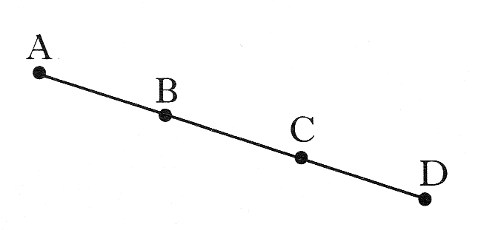
Vectors Higher
A and B are the points (-1, -3, 2)
and (2, -1, 1) respectively.
B and C are the points of trisection of AD.
That is, AB = BC = CD.
Find the coordinates of D
Hint
Previous
Quit
Quit
Next

Slide 96
Vectors Higher
The point Q divides the line joining P(–1, –1, 0) to R(5, 2 –3) in the ratio 2:1.
Find the co-ordinates of Q.
1
R
Q
Diagram
2
P
Hint
Previous
Quit
Quit
Next

Slide 97
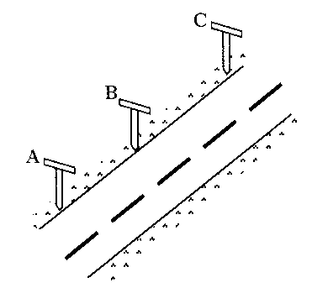
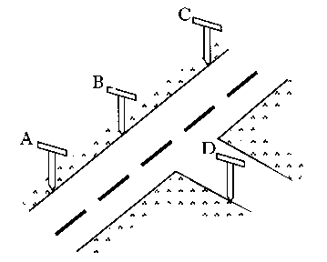
Vectors Higher
a) Roadmakers look along the tops of a set of T-rods to ensure
that straight sections of road are being created.
Relative to suitable axes the top left corners of the T-rods are
the points A(–8, –10, –2), B(–2, –1, 1) and C(6, 11, 5).
Determine whether or not the section of road ABC has been
built in a straight line.
b) A further T-rod is placed such that D has co-ordinates (1, –4, 4).
Show that DB is perpendicular to AB.
a)
are scalar multiples, so are parallel. A is common. A, B, C are collinear
b)
Use scalar product
Hence, DB is perpendicular to AB
Hint
Previous
Quit
Quit
Next

Slide 98
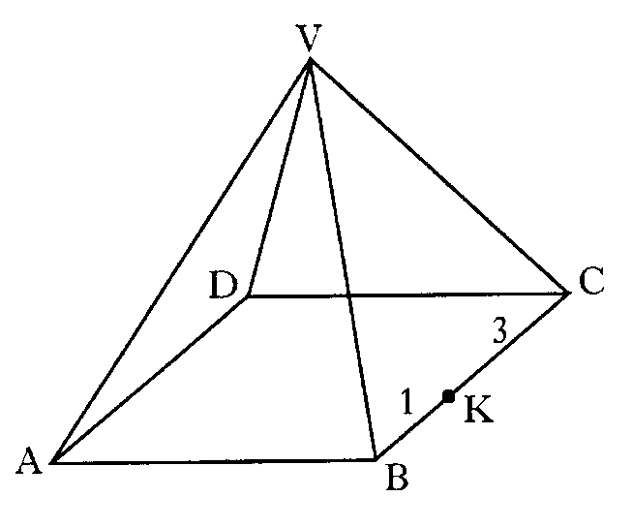
Vectors Higher
VABCD is a pyramid with rectangular base ABCD.
Relative to some appropriate axis,
represents – 7i – 13j – 11k
represents 6i + 6j – 6k
represents 8i – 4j – 4k
K divides BC in the ratio 1:3
Find in component form.
Hint
Previous
Quit
Quit
Next

Slide 99
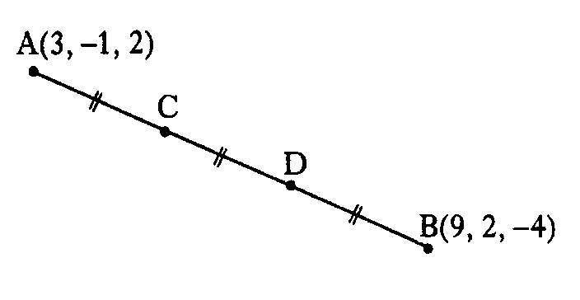
Vectors Higher
The line AB is divided into 3 equal parts by
the points C and D, as shown.
A and B have co-ordinates (3, –1, 2) and (9, 2, –4).
a) Find the components of and
b) Find the co-ordinates of C and D.
a)
b)
C is a displacement of from A
similarly
Hint
Previous
Quit
Quit
Next

Slide 100
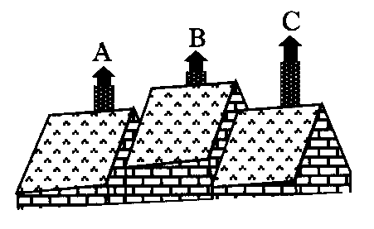
Vectors Higher
Relative to a suitable set of axes, the tops of three chimneys have
co-ordinates given by A(1, 3, 2), B(2, –1, 4) and C(4, –9, 8).
Show that A, B and C are collinear
are scalar multiples, so are parallel. A is common. A, B, C are collinear
Hint
Previous
Quit
Quit
Next

Slide 101
Vectors Higher
A is the point (2, –5, 6), B is (6, –3, 4) and C is (12, 0, 1).
Show that A, B and C are collinear
and determine the ratio in which B divides AC
are scalar multiples, so are parallel. B is common. A, B, C are collinear
3
C
2
B
A
B divides AB in ratio 2 : 3
Hint
Previous
Quit
Quit
Next

Slide 102
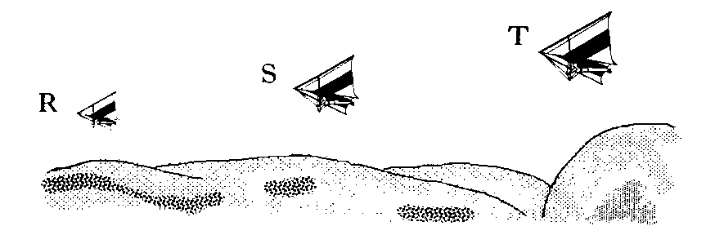
Vectors Higher
Relative to the top of a hill, three gliders
have positions given by
R(–1, –8, –2), S(2, –5, 4) and T(3, –4, 6).
Prove that R, S and T are collinear
are scalar multiples, so are parallel. R is common. R, S, T are collinear
Hint
Previous
Quit
Quit
Next

Slide 103
Vectors Higher
You have completed all 8 questions in this section
Previous
Quit
Quit
Back to start

Slide 104
Vectors Higher
Angle between two vectors
Continue
Quit
Quit
Back to menu

Slide 105
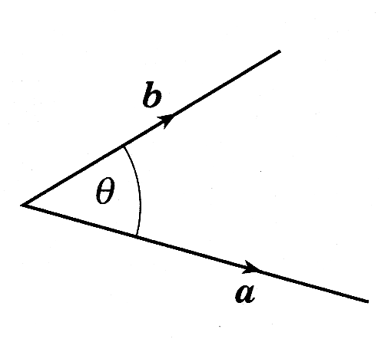
Vectors Higher
The diagram shows vectors a and b.
If |a| = 5, |b| = 4 and a.(a + b) = 36
Find the size of the acute angle
between a and b.
Hint
Previous
Quit
Quit
Next

Slide 106
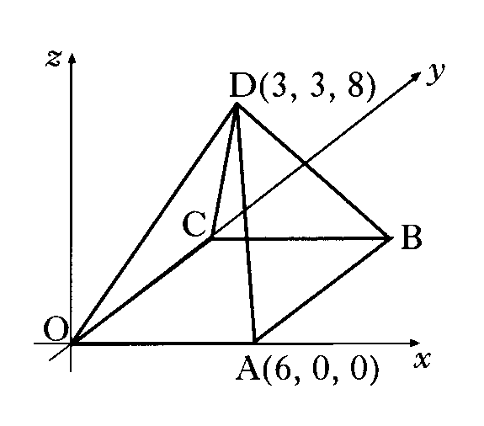
Vectors Higher
The diagram shows a square based pyramid of height 8 units.
Square OABC has a side length of 6 units.
The co-ordinates of A and D are (6, 0, 0) and (3, 3, 8).
C lies on the y-axis.
a) Write down the co-ordinates of B
b) Determine the components of
c) Calculate the size of angle ADB.
a)
B(6, 6, 0)
b)
c)
Hint
Previous
Quit
Quit
Next

Slide 107
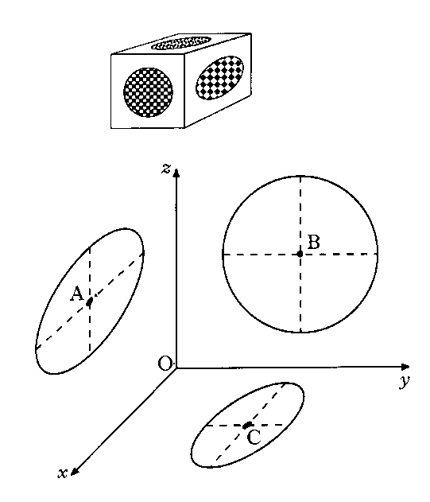
Vectors Higher
A box in the shape of a cuboid designed with circles of different
sizes on each face.
The diagram shows three of the circles, where the origin represents
one of the corners of the cuboid.
The centres of the circles are A(6, 0, 7), B(0, 5, 6) and C(4, 5, 0)
Find the size of angle ABC
Vectors to point
away from vertex
Hint
Previous
Quit
Quit
Next

Slide 108
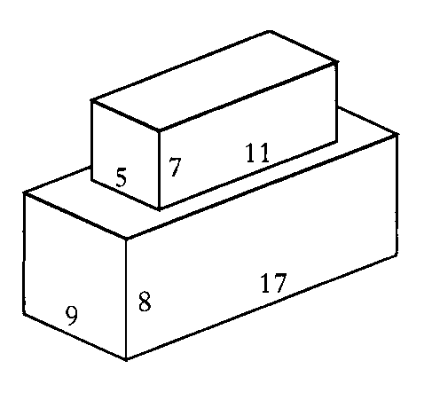
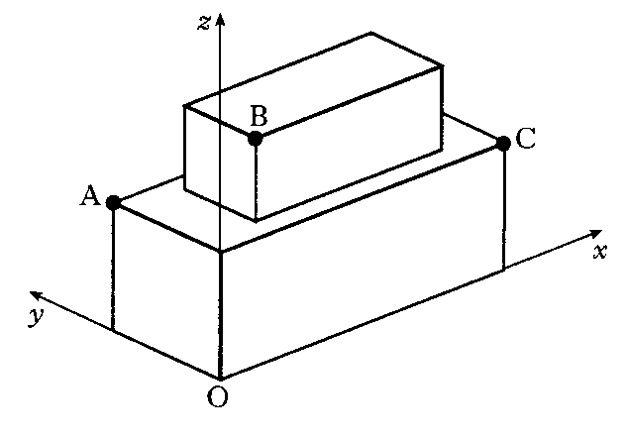
Vectors Higher
A cuboid measuring 11cm by 5 cm by 7 cm is placed centrally on top of another cuboid measuring 17 cm by 9 cm by 8 cm.
Co-ordinate axes are taken as shown.
a) The point A has co-ordinates (0, 9, 8) and C has
co-ordinates (17, 0, 8).
Write down the co-ordinates of B
b) Calculate the size of angle ABC.
a)
b)
Hint
Previous
Quit
Quit
Next

Slide 109
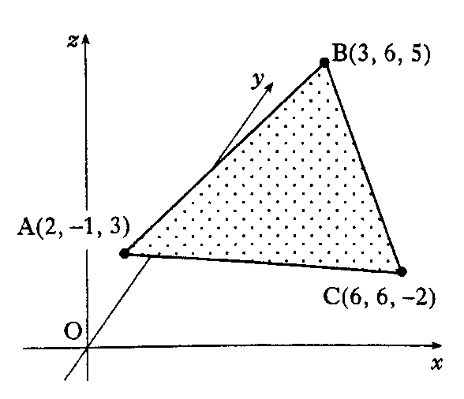
Vectors Higher
A triangle ABC has vertices A(2, –1, 3), B(3, 6, 5) and C(6, 6, –2).
a) Find and
b) Calculate the size of angle BAC.
c) Hence find the area of the triangle.
a)
b)
∠ BAC =
c)
Area of Δ ABC =
Hint
Previous
Quit
Quit
Next

Slide 110
Vectors Higher
You have completed all 5 questions in this section
Previous
Quit
Quit
Back to start

Slide 111
Are you on Target !
Update you log book
Make sure you complete and correct
ALL of the Vector questions in the
past paper booklet.

