Slide 1

Higher Unit 2
N5 Trig Exact Values and Trig Identities
Connection between Radians and degrees & Exact values
Trigonometry identities of the form sin(A+B)
Double Angle formulae
Application & Exam Type Questions
Wave function format ksin(x ± α)
Wave function format ksin(2x ± α)
www.mathsrevision.com

Slide 2
Exact Values
Some special values of Sin, Cos and Tan are useful left as fractions, We call these exact values
60º
2
30º
2
2
√3
60º
60º
60º
2
1
This triangle will provide exact values for
sin, cos and tan 30º and 60º

Slide 3
Exact Values
x | 0º | 30º | 45º | 60º | 90º
Sin xº
Cos xº
Tan xº |  |  |  |  | ∞
½
√3
2
0
1
1
√3
2
½
0
0
√3

Slide 4
Exact Values
Consider the square with sides 1 unit
45º
√2
1
1
45º
1
1
We are now in a position to calculate
exact values for sin, cos and tan of 45º

Slide 5
Exact Values
x | 0º | 30º | 45º | 60º | 90º
Sin xº
Cos xº
Tan xº |  |  |  |  | Undefined
½
1 √2
√3
2
0
1
1
√3
2
1 √2
½
0
0
1
√3

Slide 6
Exact value table
and quadrant rules.
tan150º
= - tan(180 - 150) º
= - tan30º
= ⁻¹/_{√3}
(Q2 so neg)
cos300º
= cos(360 - 300) º
= cos60º
= ¹/₂
(Q4 so pos)
sin120º
= sin(180 - 120) º
= sin60º
= √ 3/2
(Q2 so pos)
tan300º
= - tan(360-300)º
= - tan60º
= - √ 3
(Q4 so neg)

Slide 7
Extra Practice
HHM Ex4D & Ex4E

Slide 8
Trig Identities
An identity is a statement which is true for all values.
eg 3x(x + 4) = 3x² + 12x
eg (a + b)(a – b) = a² – b²
Trig Identities
(1) sin²θ + cos² θ = 1
(2) sin θ = tan θ cos θ
θ ≠ an odd multiple of π/2 or 90°.

Slide 9
Trig Identities
Reason
a² +b² = c²
c
a
sinθº = a/c
θº
b
cosθº = b/c
(1) sin²θº + cos² θº =

Slide 10
Trig Identities
Simply rearranging we get two other forms
sin²θ + cos² θ = 1
sin² θ = 1 - cos² θ
cos² θ = 1 - sin² θ

Slide 11
Extra Practice
HHM Page 352 Ex17 Q2

Slide 12
Radians
Radian measure is an alternative to degrees and is based upon the ratio of
arc Length radius
L
θ
r
θ- theta
(angle at the centre)
So, full circle 360º ⇨2π radians

Slide 13
Radians
Copy Table
360º ⇨ 2π
180º ⇨ π
π
3π
90º ⇨
270º ⇨
2
2
π
2π
4π
5π
60º ⇨
120º ⇨
240º ⇨
300º ⇨
3
3
3
3
π
3π
5π
7π
45º ⇨
135º ⇨
225º ⇨
315º ⇨
4
4
4
4
π
5π
7π
11π
30º ⇨
150º ⇨
210º ⇨
330º ⇨
6
6
6
6

Slide 14
Converting
For any values
then X π
÷180
degrees
radians
÷ π
then x 180
Drill

Slide 15
Converting
Ex1 72º =
⁷²/₁₈₀ X π =
2π /₅
Ex2 330º =
³³⁰/₁₈₀ X π =
11 π /₆
Ex3 2π /₉ =
2π /₉ ÷ π x 180º =
²/₉ X 180º =
40º
Ex4 23π/₁₈ =
23π /₁₈ ÷ π x 180º =
²³/₁₈ X 180º =
230º
Drill

Slide 16
Exact value table
and quadrant rules.
Find the exact value of cos²(^{5π}/₆) – sin²(^{π}/₆)
cos(^{5π}/₆) =
cos150º
= cos(180 - 150)º
= - cos30º
= - ^{√3} /₂
(Q2 so neg)
sin(^{π}/₆)
= sin30º
= ¹/₂
cos²(^{5π}/₆) – sin²(^{π}/₆)
= (- ^{√3} /₂)² – (¹/₂)²
= ¾ - ¹/₄
= ¹/₂

Slide 17
Exact value table
and quadrant rules.
Prove that sin(^{2 π} /₃) = tan (^{2 π} /₃)
cos (^{2 π} /₃)
sin(^{2π}/₃) = sin120º
= sin(180 – 120)º
= sin60º
= ^{√3}/₂
cos(^{2 π} /₃) = cos120º
= cos(180 – 120)º
= - cos60º
= -¹/₂
tan(^{2 π} /₃) = tan120º
= tan(180 – 120)º
= -tan60º
= - √3
sin(^{2 π} /₃) cos (^{2 π} /₃)
LHS =
= √³/₂ ÷ -¹/₂
= ^{√3}/₂ X -2
= - √3
= tan(^{2π}/₃)
= RHS

Slide 18
Trig Identities
Example1
sin θ = ⁵/₁₃ where 0 < θ < ^{π}/₂
Find the exact values of cos θ and tan θ .
cos² θ = 1 - sin² θ
Since θ is between 0 < θ < ^{π}/₂
then cos θ > 0
= 1 – (⁵/₁₃)²
= 1 – ²⁵/₁₆₉
So cos θ = ¹²/₁₃
tan θ = sinθ cos θ
= ¹⁴⁴/₁₆₉
= ⁵/₁₃ ÷ ¹²/₁₃
cos θ = √(¹⁴⁴/₁₆₉)
= ⁵/₁₃ X ¹³/₁₂
= ¹²/₁₃ or -¹²/₁₃
tan θ = ⁵/₁₂

Slide 19
Trig Identities
Given that cos θ = ⁻²/ _{√ 5} where π< θ < ³ ^{π} /₂
Find sin θ and tan θ.
Since θ is between π< θ < ³ ^{π} /₂
sinθ < 0
sin² θ = 1 - cos² θ
= 1 – (⁻²/ _{√ 5} )²
Hence sinθ = ⁻ ¹/_{√5}
= 1 – ⁴/₅
tan θ = sinθ cos θ
= ⁻ ¹/ _{√ 5} ÷ ⁻²/ _{√ 5}
= ¹/₅
= ⁻ ¹/ _{√ 5} X ⁻ ^{√5} /₂
sin θ = √(¹/₅)
= ¹/ _{√ 5} or ⁻ ¹/ _{√ 5}
Hence tan θ = ¹/₂

Slide 20
Extra Practice
HHM Ex4C

Slide 21
Trig Identities
Supplied on a formula sheet !!
The following relationships are always true for two angles A and B.
1a. sin(A + B) = sinAcosB + cosAsinB
1b. sin(A - B) = sinAcosB - cosAsinB
2a. cos(A + B) = cosAcosB – sinAsinB
2b. cos(A - B) = cosAcosB + sinAsinB
Quite tricky to prove but some of following examples should show that they do work!!

Slide 22
Trig Identities
Examples 1
(1) Expand cos(U – V).
(use formula 2b )
cos(U – V) = cosUcosV + sinUsinV
(2) Simplify sinf°cosg° - cosf°sing°
(use formula 1b )
sinf°cosg° - cosf°sing° = sin(f – g)°
(3) Simplify cos8 θ sinθ + sin8 θ cos θ
(use formula 1a )
cos8 θ sin θ + sin8 θ cos θ =
sin(8 θ + θ)
= sin9 θ

Slide 23
Trig Identities
Example 2
By taking A = 60° and B = 30°,
prove the identity for cos(A – B).
NB: cos(A – B) = cosAcosB + sinAsinB
LHS = cos(60 – 30 )°
= cos30°
= ^{√3}/₂
RHS = cos60°cos30° + sin60°sin30°
= ( ½ X ^{√3}/₂ ) + (^{√3}/₂ X ½)
= ^{√3}/₄ + ^{√3}/₄
= ^{√3}/₂
Hence LHS = RHS !!

Slide 24
Trig Identities
Example 3
Prove that sin15° = ¼(√6 - √2)
sin15° = sin(45 – 30)°
= sin45°cos30° - cos45°sin30°
= (¹/_{√2} X ^{√3}/₂ ) - (¹/_{√2} X ½)
= (^{√3}/_{2√2} - ¹/_{2√2})
= (√3 - 1) 2√2
X √2 √2
= (√6 - √2) 4
= ¼(√6 - √2)

Slide 25
Trig Identities
NAB type Question
Example 4
41
y
x
3
β
α
4
40
Show that cos(α - β) = ¹⁸⁷/₂₀₅
Triangle1
Triangle2
If missing side = x
If missing side = y
Then x² = 41² – 40² = 81
Then y² = 4² + 3² = 25
So x = 9
So y = 5
sinα = ⁹/₄₁ and cosα = ⁴⁰/₄₁
sin β = ³/₅ and cosβ = ⁴/₅

Slide 26
Trig Identities
sinα = ⁹/₄₁ and cosα = ⁴⁰/₄₁
sin β = ³/₅ and cosβ = ⁴/₅
cos(α - β) = cosαcosβ + sinαsinβ
= (⁴⁰/₄₁ X ⁴/₅) + (⁹/₄₁ X ³/₅ )
= ¹⁶⁰/₂₀₅ + ²⁷/₂₀₅
= ¹⁸⁷/₂₀₅
Remember this is a NAB type Question

Slide 27
Extra Practice
HHM
Ex11B, Ex11C, Ex11D

Slide 28
Paper 1 type questions
Trig Identities
Example
Simplify sin(θ - ^{π}/₃) + cos(θ + ^{π}/₆) + cos(^{π}/₂ - θ)
sin(θ - ^{π}/₃) + cos(θ + ^{π}/₆) + cos(^{π}/₂ - θ)
= sin θ cos^{π}/₃ – cos θ sin^{π}/₃
+ cos θ cos^{π}/₆ – sin θ sin^{π}/₆
+ cos^{π}/₂ cos θ + sin^{π}/₂ sin θ
= ¹/₂ sin θ – ^{√3}/₂cos θ + ^{√3}/₂ cos θ – ¹/₂sin θ + 0 x cos θ + 1 X sin θ
= sin θ

Slide 29
Paper 1 type questions
Trig Identities
Example
Prove that
(sinA + cosB)² + (cosA - sinB)² = 2(1 + sin(A - B))
LHS = (sinA + cosB)² + (cosA - sinB)²
= sin²A + 2sinAcosB + cos²B + cos²A – 2cosAsinB + sin²B
= (sin²A + cos²A) + (sin²B + cos²B) + 2sinAcosB - 2cosAsinB
= 1 + 1 + 2(sinAcosB - cosAsinB)
= 2 + 2sin(A – B)
= 2(1 + sin(A – B))
= RHS

Slide 30
Extra Practice
HHM Ex11E

Slide 31
Double Angle Formulae

Slide 32
Double Angle formulae
Mixed Examples:
Substitute form the tan (sin/cos) equation
+ve because A is acute
3-4-5 triangle !
Similarly:
A is greater than 45 degrees – hence 2A is greater than 90 degrees.

Slide 33

Double Angle formulae

Slide 34
Double Angle formulae

Slide 35
Double Angle formulae

Slide 36
Extra Practice
HHM Ex11G & Ex11I

Slide 37

Maths4Scotland Higher
Application of Addition and Double Angle Formulae
Non-calculator questions will be indicated
You will need a pencil, paper, ruler and rubber.

Slide 38
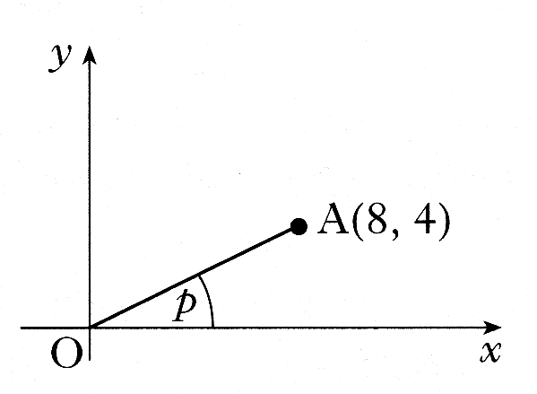
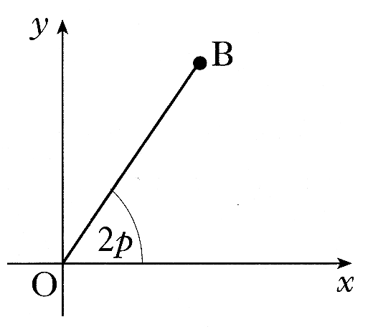
Maths4Scotland Higher
A is the point (8, 4). The line OA is inclined at an angle p radians to the x-axis
a) Find the exact values of: i) sin (2p) ii) cos (2p)
The line OB is inclined at an angle 2p radians to the x-axis.
b) Write down the exact value of the gradient of OB.
Draw triangle
4
Pythagoras
p
8
Write down values for cos p and sin p
Expand sin (2p)
Expand cos (2p)
Use m = tan (2p)

Slide 39
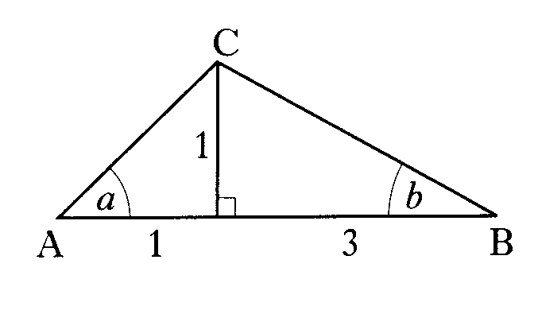
Maths4Scotland Higher
In triangle ABC show that the exact value of
Use Pythagoras
Write down values for
sin a, cos a, sin b, cos b
Expand sin (a + b)
Substitute values
Simplify

Slide 40
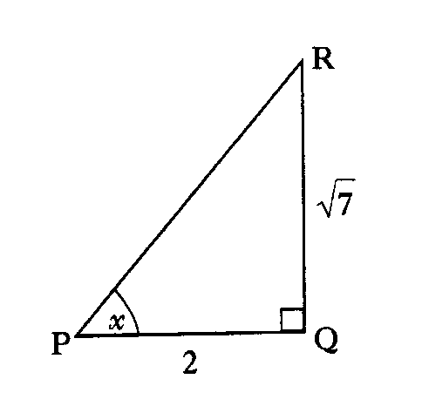
Maths4Scotland Higher
Using triangle PQR, as shown, find the
exact value of cos 2x
Use Pythagoras
Write down values for
cos x and sin x
Expand cos 2x
Substitute values
Simplify

Slide 41
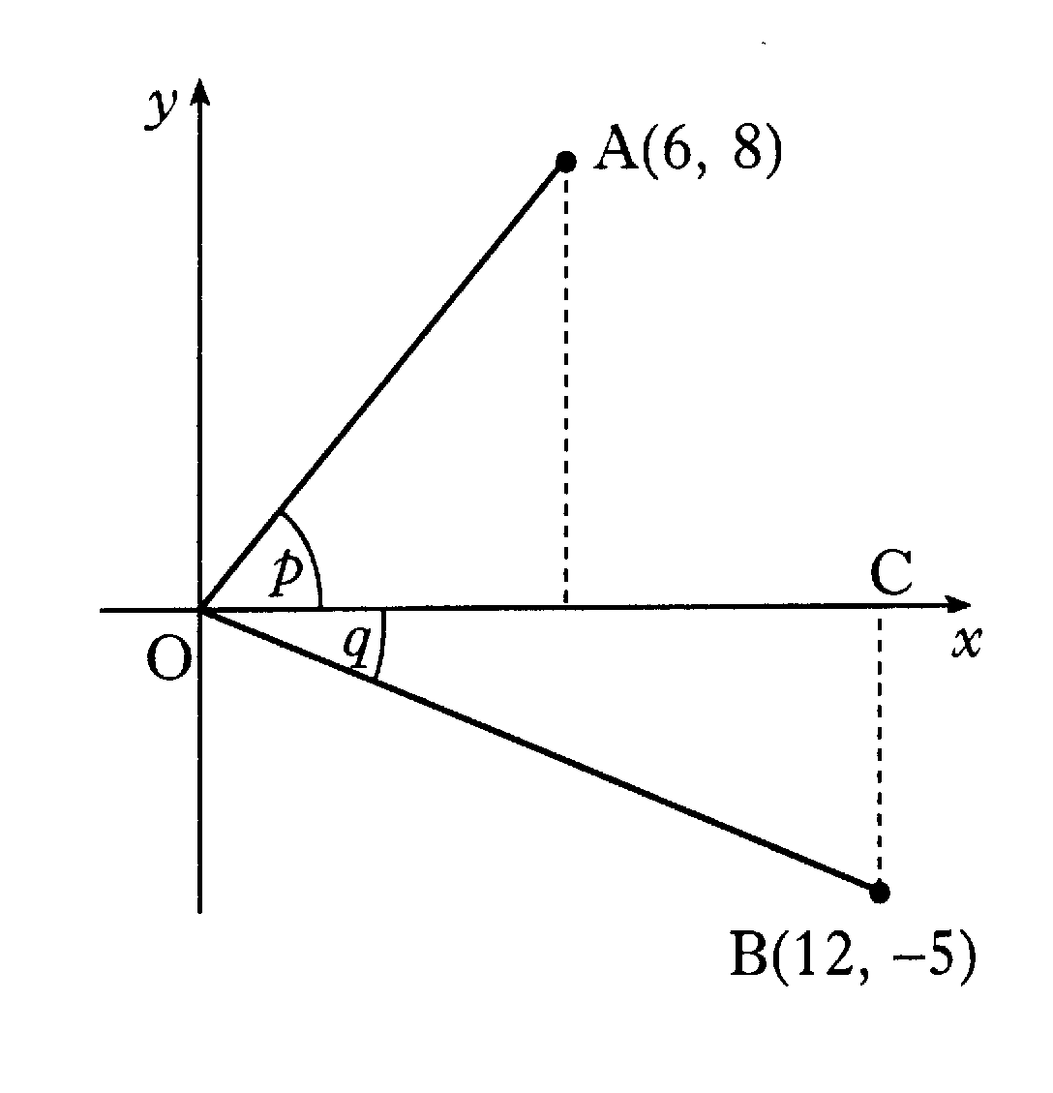
Maths4Scotland Higher
On the co-ordinate diagram shown, A is the point (6, 8) and
B is the point (12, -5). Angle AOC = p and angle COB = q
Find the exact value of sin (p + q).
10
8
6
Mark up triangles
12
5
Use Pythagoras
13
Write down values for
sin p, cos p, sin q, cos q
Expand sin (p + q)
Substitute values
Simplify

Slide 42
Maths4Scotland Higher
A and B are acute angles such that and .
Find the exact value of
a) b) c)
5
13
3
5
A
B
4
12
Draw triangles
Use Pythagoras
Hypotenuses are 5 and 13 respectively
Write down sin A, cos A, sin B, cos B
Expand sin 2A
Expand cos 2A
Expand sin (2A + B)
Substitute

Slide 43
Maths4Scotland Higher
If x° is an acute angle such that
show that the exact value of
5
4
x
3
Draw triangle
Use Pythagoras
Hypotenuse is 5
Write down sin x and cos x
Expand sin (x + 30)
Substitute
Simplify

Slide 44
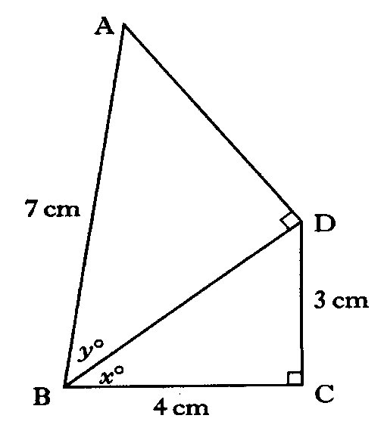

Maths4Scotland Higher
The diagram shows two right angled triangles
ABD and BCD with AB = 7 cm, BC = 4 cm and CD = 3 cm.
Angle DBC = x° and angle ABD is y°.
Show that the exact value of
5
Use Pythagoras
Write down
sin x, cos x, sin y, cos y.
Expand cos (x + y)
Substitute
Simplify
Hint
Previous
Quit
Quit
Next

Slide 45
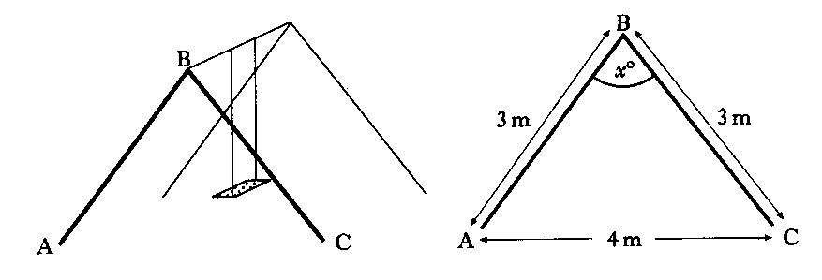
Maths4Scotland Higher
The framework of a child’s swing has dimensions
as shown in the diagram. Find the exact value of sin x°
Draw triangle
Draw in perpendicular
Use Pythagoras
x
Use fact that sin x = sin ( ½ x + ½ x)
3
3
h
Write down sin ½ x and cos ½ x
2
4
Expand sin ( ½ x + ½ x)
Substitute
Simplify

Slide 46
Maths4Scotland Higher
Given that
find the exact value of
a
Draw triangle
Use Pythagoras
3
Write down values for
cos a and sin a
Expand sin 2a
Substitute values
Simplify

Slide 47
Maths4Scotland Higher
Find algebraically the exact value of
Expand sin (θ +120)
Expand cos (θ +150)
Use table of exact values
Combine and substitute
Simplify

Slide 48
Maths4Scotland Higher
If find the exact value of
a) b)
5
3
θ
Draw triangle
Use Pythagoras
Opposite side = 3
4
Write down values for
cos θ and sin θ
Expand sin 2θ
Expand sin 4θ (4θ = 2θ + 2θ)
Expand cos 2θ
Find sin 4θ

Slide 49
Maths4Scotland Higher
For acute angles P and Q
Show that the exact value of
13
5
12
3
P
Q
5
4
Draw triangles
Use Pythagoras
Adjacent sides are 5 and 4 respectively
Write down sin P, cos P, sin Q, cos Q
Expand sin (P + Q)
Substitute
Simplify

Slide 50

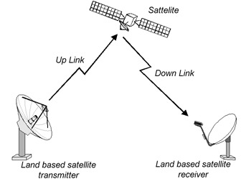
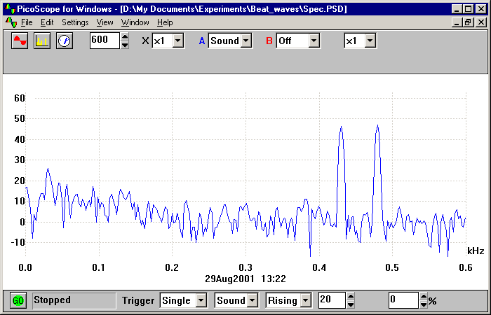

The Wave Function
Heart beat
Many wave shapes, whether occurring as sound, light, water or electrical waves, can be described mathematically as a combination of sine and cosine waves.
Spectrum Analysis
Electrical

Slide 51
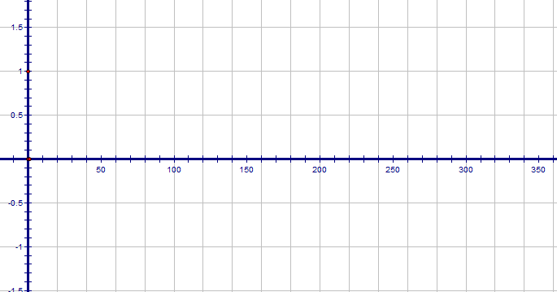
General shape for y = sinx + cosx
Like y = sin(x) shifted left
Like y = cosx shifted right
Vertical height different
The Wave Function
Demo
y = sin(x)+cos(x)
y = sin(x)
y = cos(x)

Slide 52
The Wave Function
Whenever a function is formed by adding cosine and sine functions the result can be expressed as a related cosine or sine function. In general:
With these constants the expressions on the right hand sides = those on the left hand side
FOR ALL VALUES OF x

Slide 53
The Wave Function
Worked Example:
Re-arrange
The left and right hand sides must be equal for all values of x.
So, the coefficients of cos x and sin x must be equal:
A pair of simultaneous equations to be solved

Slide 54
The Wave Function
Find tan ratio note: sin(+) and cos(+)
Square and add

Slide 55

The Wave Function
Note: sin(+) and cos(+)
90º
S
A
180º
0º
T
C
270º
Demo

Slide 56

Expand and equate coefficients
The Wave Function
Example
Find tan ratio note: sin(+) and cos(+)
Square and add
90º
S
A
180º
0º
T
C
270º

Slide 57
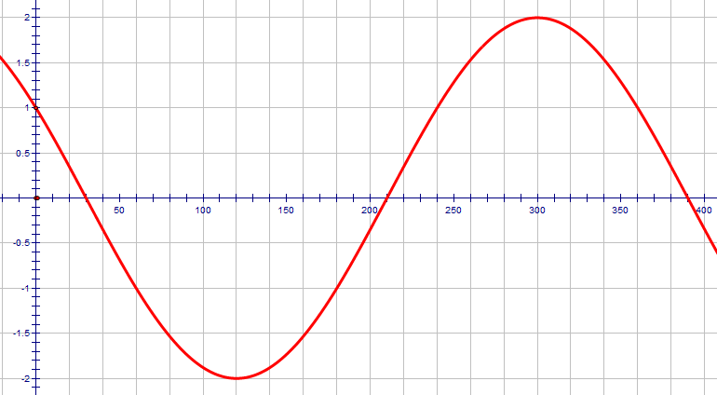
The Wave Function
Finally:
Demo

Slide 58
Extra Practice
HHM
Ex16C , Ex16D , Ex16E

Slide 59
Expand and equate coefficients
The Wave Function
Example
Square and add
Find tan ratio noting sign of sin(+) and cos(+)
90º
S
A
180º
0º
T
C
270º
Demo

Slide 60
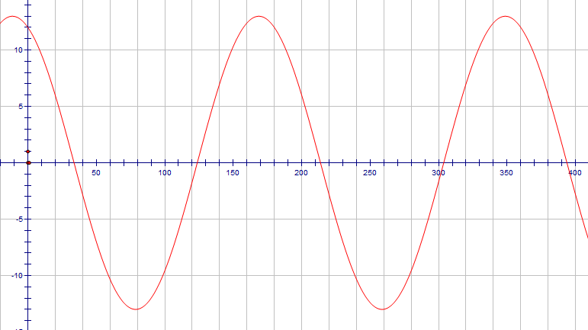
The Wave Function
Finally:

Slide 61
Extra Practice
HHM Ex16F

Slide 62
Are you on Target !
Update you log book
Make sure you complete and correct
ALL of the Trigonometry questions in the past paper booklet.

