Slide 1

Higher Unit 2
Exponential & Log Graphs
Special “e” and Links between Log and Exp
Rules for Logs
Solving Exponential Equations
Experimental & Theory
Harder Exponential & Log Graphs
Exam Type Questions

Slide 2
The Exponential & Logarithmic Functions
Exponential Graph
Logarithmic Graph
y
y
(0,1)
(1,0)
x
x

Slide 3
A Special Exponential Function – the “Number” e
The letter e represents the value 2.718….. (a never ending decimal). This number occurs often in nature
f(x) = 2.718..^{x} = e^{x} is called the exponential function to the base e.

Slide 4
Extra Practice
HMM Ex15D

Slide 5
Linking the Exponential and the Logarithmic Function
In Unit 1 we found that the exponential function has an inverse function, called the logarithmic function.
The log function is the inverse of the exponential function, so it ‘undoes’ the exponential function:

Slide 6
Linking the Exponential and the Logarithmic Function
2
3
4

Slide 7
Linking the Exponential and the Logarithmic Function
2
3
4
Examples
4
3
81
(a) log₃81 = “ to what power gives ?”
4
2
(b) log₄2 = “ to what power gives ?”
-3
3
(c) log₃ = “ to what power gives ?”

Slide 8
Extra Practice
HMM Ex15E

Slide 9
Rules of Logarithms
Three rules to learn in this section

Slide 10
Rules of Logarithms
Examples
Simplify:
a) log₁₀2 + log₁₀500
  b) log₃63 – log₃7
Since
Since
Since
Since

Slide 11
Since
Rules of Logarithms
Example
Since

Slide 12
Extra Practice
HMM Ex15F

Slide 13
Using your Calculator
You have 2 logarithm buttons on your calculator:
log
which stands for log₁₀
and its inverse
log
ln
which stands for log_{e}
and its inverse
ln
2
Try finding log₁₀100 on your calculator

Slide 14
Logarithms & Exponentials
We have now reached a stage where trial and error is no longer required!
Solve e^{x} = 14 (to 2 dp)
Solve ln(x) = 3.5 (to 3 dp)
ln(e^{x}) = ln(14)
e^{lnx} = e^{3.5}
x = ln(14)
x = e^{3.5}
x = 2.64
x = 33.115
Check e^{2.64} = 14.013
Check ln33.115 = 3.499

Slide 15
Logarithms & Exponentials
Solve 3^{x} = 52 ( to 5 dp )
ln3^{x} = ln(52)
xln3 = ln(52) (Rule 3)
x = ln(52) ÷ ln(3)
x = 3.59658
Check: 3^{3.59658} = 52.0001….

Slide 16
Solving Exponential Equations
Example
Solve
Since
5¹ = 5 and 5² = 25
so we can see that x lies between 1 and 2
Taking logs of both sides and applying the rules

Slide 17
Solving Exponential Equations
Example
For the formula P(t) = 50e^{-2t}:
a) Evaluate P(0)
b) For what value of t is P(t) = ½P(0)?
(a)
Remember
a⁰ always equals 1

Slide 18
ln = log_{e} e
log_{e}e = 1
Solving Exponential Equations
Example
For the formula P(t) = 50e^{-2t}:
b) For what value of t is P(t) = ½P(0)?

Slide 19
Solving Exponential Equations
Example
  The formula A = A₀e^{-kt} gives the amount of a radioactive substance after time t minutes. After 4 minutes 50g is reduced to 45g.
  (a) Find the value of k to two significant figures.
(b) How long does it take for the substance to
reduce to half it original weight?
(a)

Slide 20
Solving Exponential Equations
Example
(a)

Slide 21
Solving Exponential Equations
Example
ln = log_{e} e
log_{e}e = 1

Slide 22
Solving Exponential Equations
Example
(b) How long does it take for the substance to
reduce to half it original weight?
ln = log_{e} e
log_{e}e = 1

Slide 23
Extra Practice
HMM Ex15G and Ex15H

Slide 24
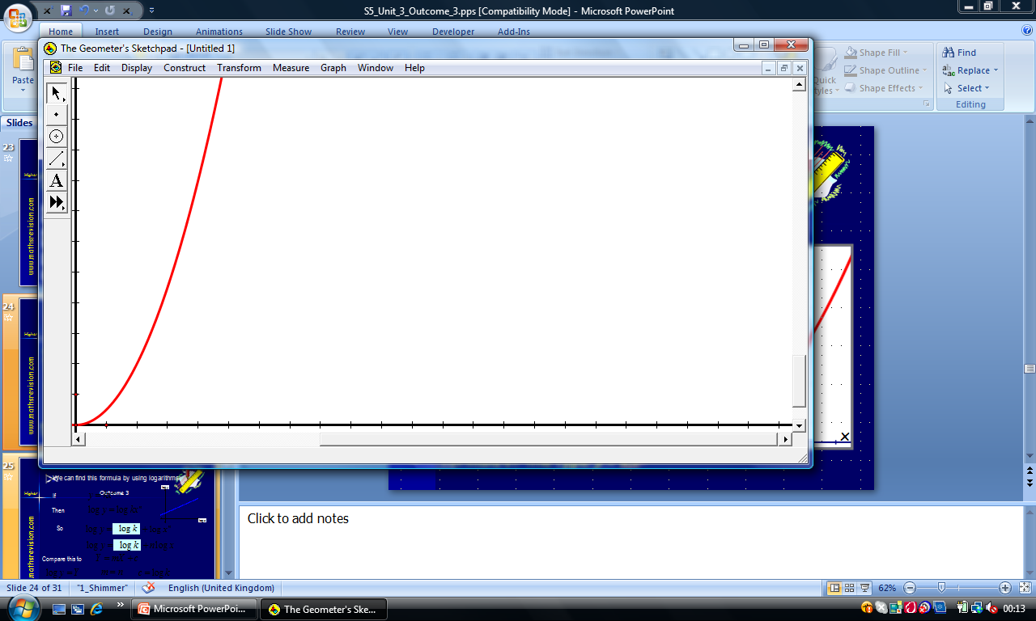
Experiment and Theory
  When conducting an experiment scientists may analyse the data to find if a formula connecting the variables exists.
  Data from an experiment may result in a graph of the form shown in the diagram, indicating exponential growth. A graph such as this implies a formula of the type y = kx^{n}
y
x

Slide 25
Experiment and Theory
We can find this formula by using logarithms:
If
log y
(0,log k)
Then
log x
So
Compare this to
So

Slide 26
Experiment and Theory
From
log y
We see taking logs both sides we can reduce this problem to a straight line problem where:
(0,log k)
log x
Y
Y
=
m
m
X
X
+
c
c

Slide 27
Since log/log (straight line) graph so equation will have format
Experiment and Theory
y = kx^{n}
Using Y = mX + c
ln(y)
ln(y) = 5ln(x) + 0.69
ln(y) = 5ln(x) + ln(e^{0.69})
m = 5
ln(y) = 5ln(x) + ln(2)
0.69
ln(y) = ln(x⁵) + ln(2)
ln(y) = ln(2x⁵)
ln(x)
y = 2x⁵
Express y in terms of x.

Slide 28
Since log/log (straight line) graph so equation will have format
Experiment and Theory
y = kx^{n}
log₁₀y
Using Y = mX + c
m = ^{-0.3}/₁ = -0.3
0.3
Taking logs
log₁₀y = -0.3log₁₀x + 0.3
log₁₀y = -0.3log₁₀x + log₁₀10^{0.3}
1
log₁₀x
log₁₀y = -0.3log₁₀x + log₁₀2
Find the formula connecting x and y.
log₁₀y = log₁₀x^{-0.3} + log₁₀2
log₁₀y = log₁₀2x^{-0.3}
straight line with intercept 0.3
y = 2x^{-0.3}

Slide 29
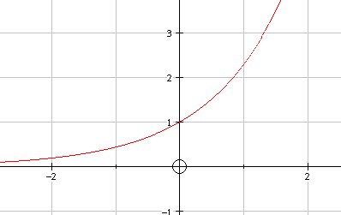
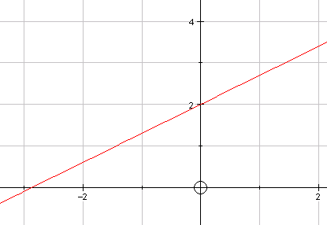
Experimental Data
When scientists & engineers try to find relationships between variables in experimental data the figures are often very large or very small and drawing meaningful graphs can be difficult. The graphs often take exponential form so this adds to the difficulty.
By plotting log values instead we often convert from

Slide 30
The variables Q and T are known
to be related by a formula in the form
T = kQ^{n}
The following data is obtained from experimenting
Q 5 10 15 20 25
T 300 5000 25300 80000 195300
Plotting a meaningful graph is too difficult so taking log values instead we get ….
log₁₀Q 0.7 1 1.2 1.3 1.4
log₁₀T 2.5 3.7 4.4 4.9 5.3

Slide 31
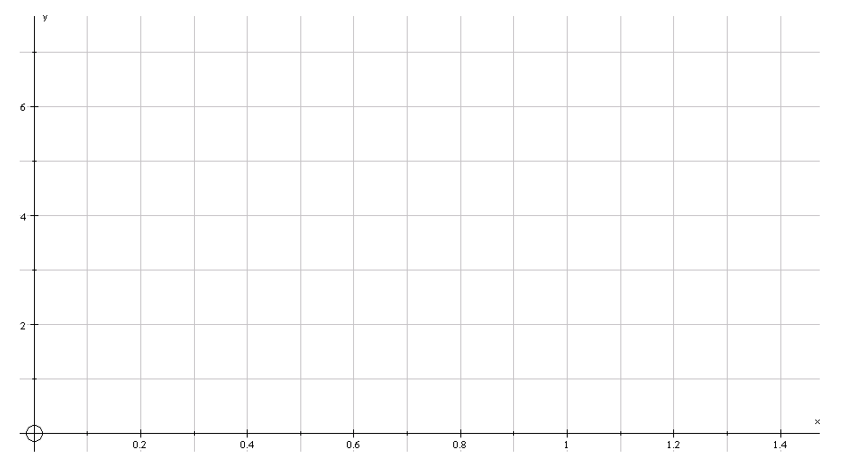
m = 5.3 - 2.5 1.4 - 0.7
Point on line (a,b) = (1,3.7)
= 4
log₁₀T
log₁₀Q

Slide 32
Experiment and Theory
Since the graph does not cut the y-axis use
Y – b = m(X – a)
where X = log₁₀Q and Y = log₁₀T ,
log₁₀T – 3.7 = 4(log₁₀Q – 1)
log₁₀T – 3.7 = 4log₁₀Q – 4
log₁₀T = 4log₁₀Q – 0.3
log₁₀T = log₁₀Q⁴ – log₁₀10^{0.3}
log₁₀T = log₁₀Q⁴ – log₁₀2
log₁₀T = log₁₀(^{Q4}/₂)
T = ¹/₂Q⁴

Slide 33
Experiment and Theory
Example
The following data was collected during an experiment:
X | 50.1 | 194.9 | 501.2 | 707.9
y | 20.9 | 46.8 | 83.2 | 102.3
a) Show that y and x are related by the formula y = kx^{n}
.
b) Find the values of k and n and state the formula that
connects x and y.

Slide 34
X | 50.1 | 194.9 | 501.2 | 707.9
y | 20.9 | 46.8 | 83.2 | 102.3
a) Taking logs of x and y and plotting points we get:
Since we get a straight line the formula connecting X and Y is of the form

Slide 35
Experiment and Theory
b) Since the points lie on a straight line, formula is of the form:
Graph has equation
Compare this to
Selecting 2 points on the graph and substituting them into the straight line equation we get:

Slide 36
Experiment and Theory
( any will do ! )
The two points picked are and
Sim. Equations Solving we get
Sub in B to find value of c

Slide 37
Experiment and Theory
So we have
Compare this to
so
and

Slide 38
Experiment and Theory
solving
You can always check this on your graphics calculator
so

Slide 39
Extra Practice
HMM Ex15I and Ex15J

Slide 40
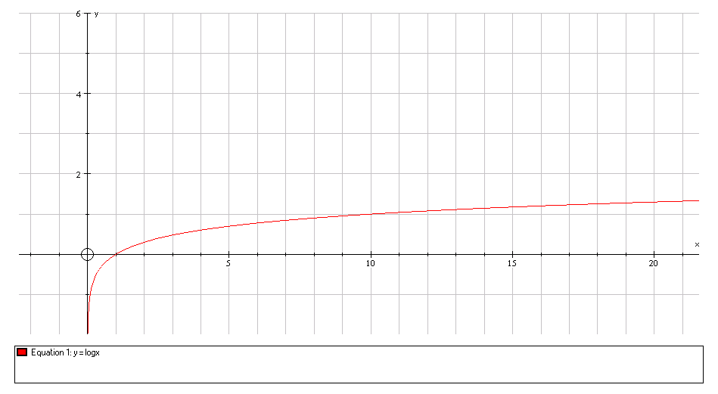
Transformations of
Log & Exp Graphs
In this section we use the rules from Unit 1 Outcome 2
Here is the graph of y = log₁₀x.
Make sketches of
y = log₁₀1000x and y = log₁₀(¹/_{x}) .

Slide 41
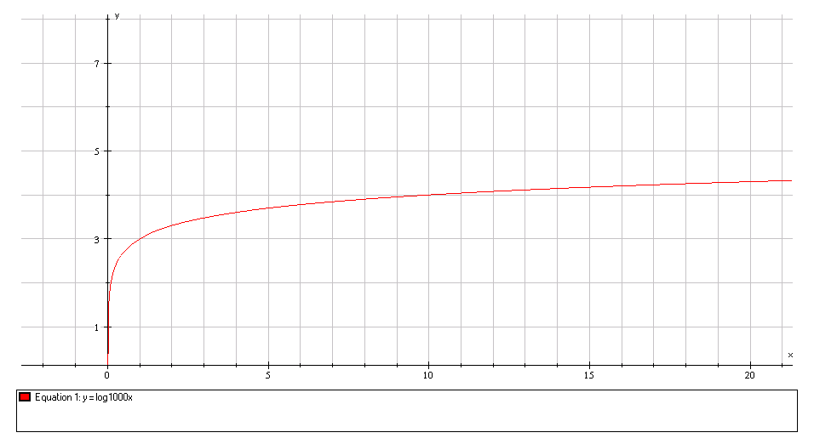
Graph Sketching
log₁₀1000x = log₁₀1000 + log₁₀x
= log₁₀10³ + log₁₀x
= 3 + log₁₀x
If f(x) = log₁₀x
then this is f(x) + 3
(10,4)
(1,3)
y = log₁₀1000x
(10,1)
(1,0)
y = log₁₀x

Slide 42
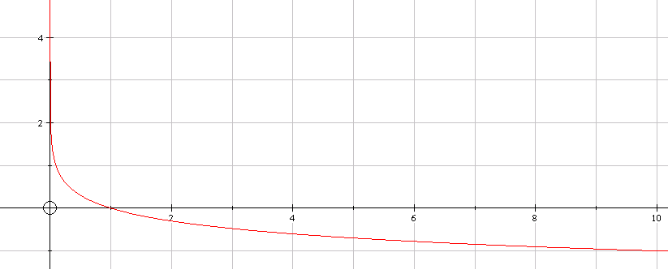
Graph Sketching
log₁₀(¹/_{x})
= log₁₀x⁻¹
= -log₁₀x
If f(x) = log₁₀x
-f(x)
( reflect in x - axis )
y = log₁₀x
(10,1)
(1,0)
y = -log₁₀x
(10,-1)

Slide 43
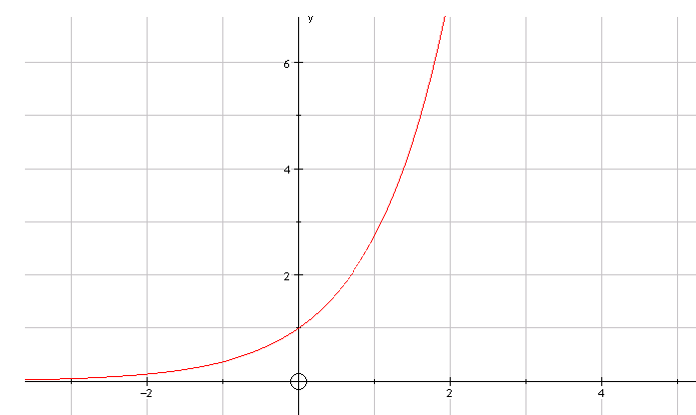
Graph Sketching
Here is the graph of y = e^{x}
y = e^{x}
(1,e)
Sketch the graph of
y = -e^{(x+1)}
(0,1)

Slide 44
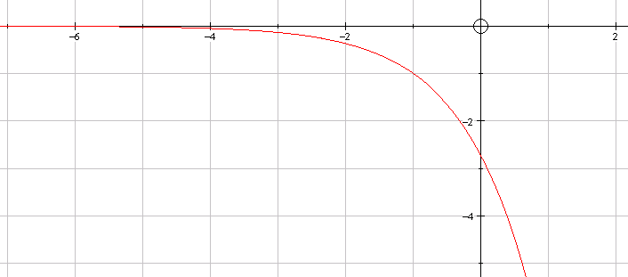
Graph Sketching
If f(x) = e^{x}
-e^{(x+1)} = -f(x+1)
reflect in x-axis
move 1 left
(-1,1)
(0,-e)
y = -e^{(x+1)}

Slide 45

Revision
www.maths4scotland.co.uk
Logarithms & Exponentials
Higher Mathematics
Next

Slide 46



Logarithms Revision
Reminder
All the questions on this topic will depend
upon you knowing and being able to use,
some very basic rules and facts.
When you see this button
click for more information
Click to show
Back
Next
Quit

Slide 47
Logarithms Revision
Three Rules of logs
Back
Next
Quit

Slide 48
Logarithms Revision
Two special logarithms
Back
Next
Quit

Slide 49
Logarithms Revision
Relationship between log and exponential
Back
Next
Quit

Slide 50
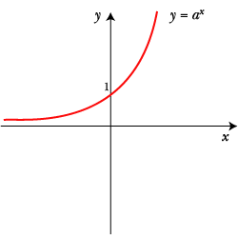
Logarithms Revision
Graph of the exponential function
Back
Next
Quit

Slide 51
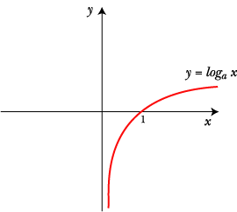
Logarithms Revision
Graph of the logarithmic function
Back
Next
Quit

Slide 52
Logarithms Revision
Related functions of
Move graph left a units
Move graph right a units
Reflect in x axis
Reflect in y axis
Move graph up a units
Move graph down a units
Click to show
Back
Next
Quit

Slide 53
Logarithms Revision
Calculator keys
ln
=
log
=
Back
Next
Quit

Slide 54
Logarithms Revision
Calculator keys
=
ln
2
.
5
=
= 0.916…
=
log
7
.
6
=
= 0.8808…
Back
Click to show
Next
Quit

Slide 55
Logarithms Revision
Solving exponential equations
Take log_{e} both sides
Use log ab = log a + log b
Use log a^{x} = x log a
Use log_{a} a = 1
Back
Next
Quit
Show

Slide 56
Logarithms Revision
Solving exponential equations
Take log_{e} both sides
Use log ab = log a + log b
Use log a^{x} = x log a
Use log_{a} a = 1
Back
Next
Quit
Show

Slide 57
Logarithms Revision
Solving logarithmic equations
Change to exponential form
Change to exponential form
Back
Next
Quit
Show

Slide 58
Logarithms Revision
Simplify
expressing your answer in the form
where A, B and C are whole numbers.
Back
Next
Quit
Show

Slide 59
Logarithms Revision
Simplify
Back
Next
Quit
Show

Slide 60
Logarithms Revision
Find x if
Back
Next
Quit
Show

Slide 61
Logarithms Revision
Given
find algebraically the value of x.
Back
Next
Quit
Show

Slide 62
Logarithms Revision
Find the x co-ordinate of the point where the graph of the curve
with equation
intersects the x-axis.
When y = 0
Re-arrange
Exponential form
Re-arrange
Back
Next
Quit
Show

Slide 63
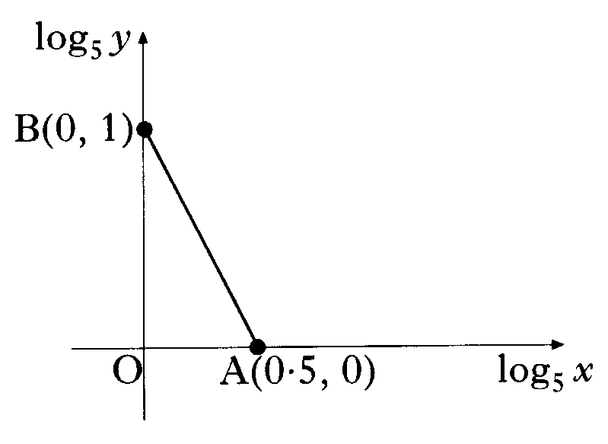
Logarithms Revision
The graph illustrates the law
If the straight line passes through A(0.5, 0)
and B(0, 1). Find the values of k and n.
Gradient
y-intercept
Back
Next
Quit
Show

Slide 64
Logarithms Revision
Before a forest fire was brought under control, the spread of fire was described by a law of the form
where
is the area covered by the fire when it was first detected
and A is the area covered by the fire t hours later.
If it takes one and a half hours for the area of the forest fire to double,
find the value of the constant k.
Back
Next
Quit
Show

Slide 65
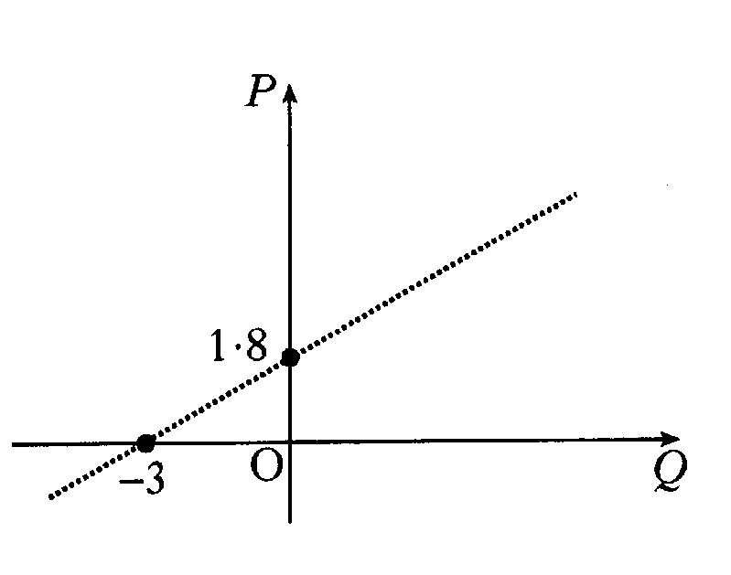
Logarithms Revision
The results of an experiment give rise to the graph shown.
Write down the equation of the line in terms of P and Q.
It is given that
and
b) Show that p and q satisfy a relationship of the form
stating the values of a and b.
Gradient
y-intercept
Back
Next
Quit
Show

Slide 66
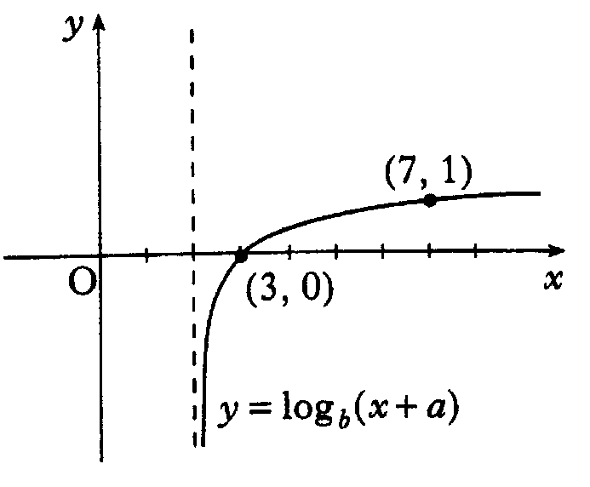
Logarithms Revision
The diagram shows part of the graph of
.Determine the values of a and b.
Use (7, 1)
Use (3, 0)
Hence, from (2)
and from (1)
Back
Next
Quit
Show

Slide 67
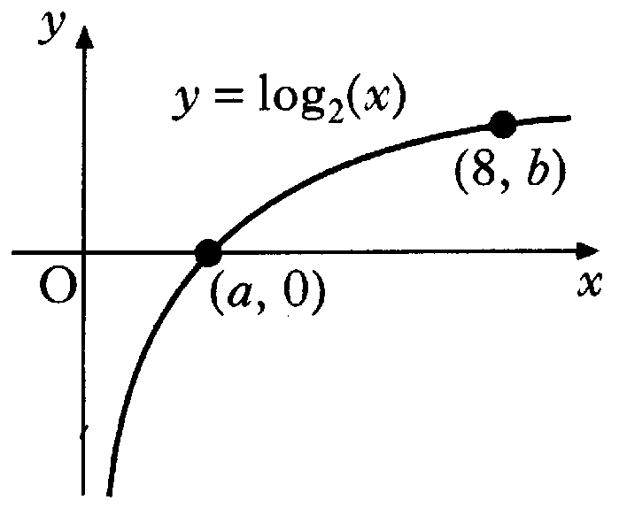
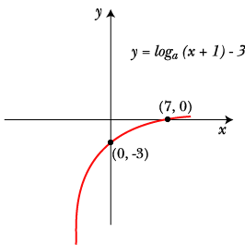
Logarithms Revision
The diagram shows a sketch of
part of the graph of
a) State the values of a and b.
b) Sketch the graph of
Graph moves
1 unit to the left and 3 units down
Back
Next
Quit
Show

Slide 68
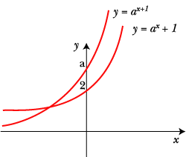
Logarithms Revision
a) i) Sketch the graph of
ii) On the same diagram, sketch the graph of
Prove that the graphs intersect at a point where the x-coordinate is
Back
Next
Quit
Show

Slide 69
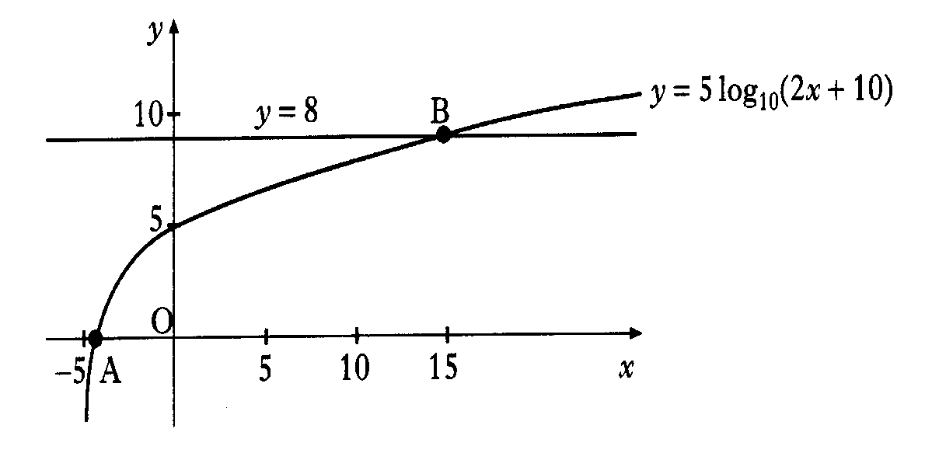
Logarithms Revision
Part of the graph of
is shown in the diagram.
This graph crosses the x-axis at the point A and the straight line
at the point B. Find algebraically the x co-ordinates of A and B.
Back
Next
Quit
Show

Slide 70
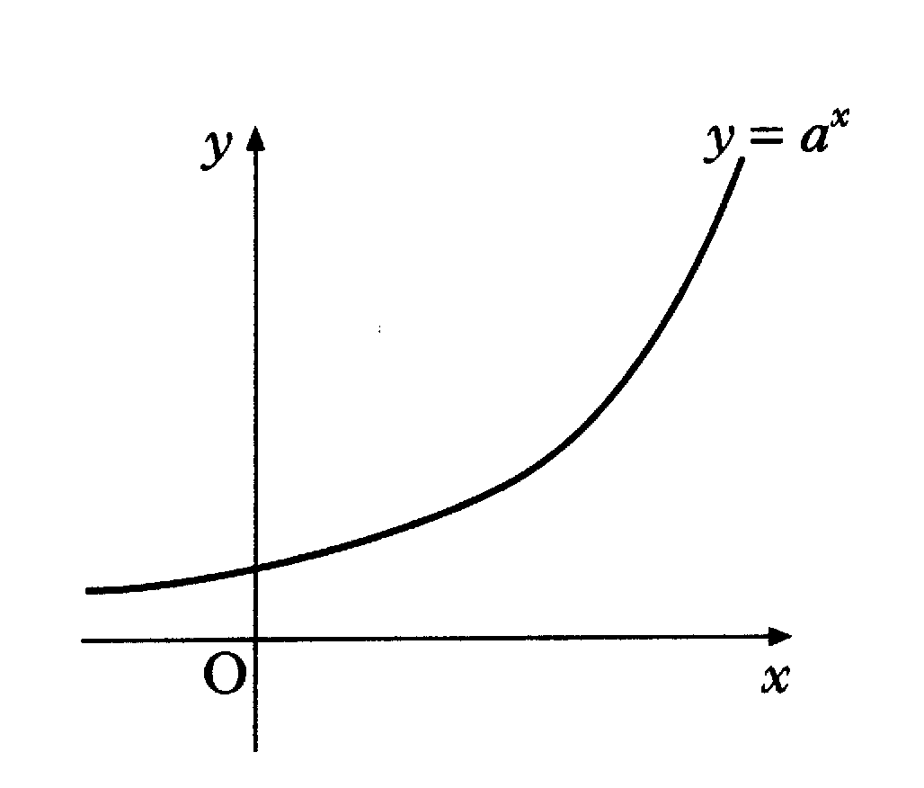
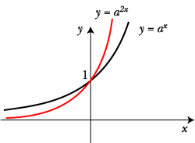
Logarithms Revision
The diagram is a sketch of part of the graph of
If (1, t) and (u, 1) lie on this curve, write down the values of t and u.
Make a copy of this diagram and on it sketch the graph of
Find the co-ordinates of the point of intersection of
with the line
b)
a)
c)
Back
Next
Quit
Show

Slide 71
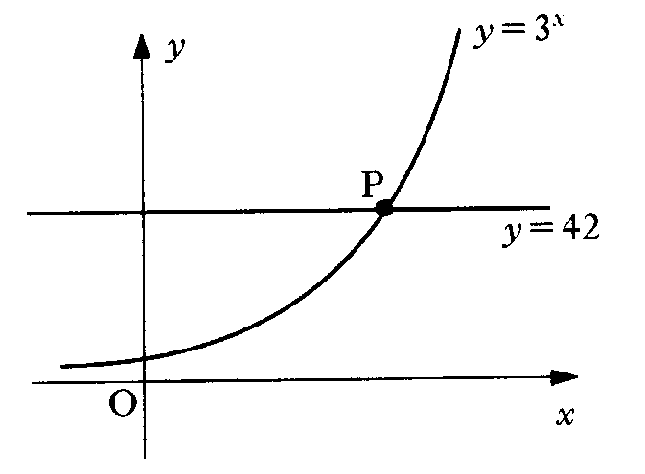
Logarithms Revision
The diagram shows part of the graph with equation
and the straight line with equation
These graphs intersect at P.
Solve algebraically the equation
and hence write down, correct to 3 decimal places, the co-ordinates of P.
Back
Next
Quit
Show

Slide 72
Are you on Target !
Update you log book
Make sure you complete and correct
ALL of the Logs and Exponentials questions in the past paper booklet.

