Slide 1

Higher Unit 1
Application 1.4 Calculus
What is Integration
The Process of Integration
Area under a curve
Area under a curve above and below x-axis
Area between to curves
Working backwards to find function
Exam

Slide 2
You have 1 minute to come up with the rule.
Integration
Integration can be thought of as the opposite of differentiation
(just as subtraction is the opposite of addition).
we get

Slide 3
Integration
Application 1.4 Calculus
Differentiation
multiply by power
decrease power by 1
divide by new power
increase power by 1
Integration
Where does this + C come from?

Slide 4
Integration
Application 1.4 Calculus
Integrating is the opposite of differentiating, so:
differentiate
integrate
But:
differentiate
integrate
Integrating 6x….......which function do we get back to?

Slide 5
Integration
Application 1.4 Calculus
Solution:
When you integrate a function
remember to add the
Constant of Integration……………+ C

Slide 6
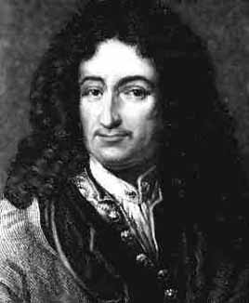
Integration
Notation
Application 1.4 Calculus
means “integrate 6x with respect to x”
means “integrate f(x) with respect to x”
∫
This notation was “invented” by
Gottfried Wilhelm von Leibniz

Slide 7
Integration
Application 1.4 Calculus
Examples:

Slide 8
Integration
Just like differentiation, we must arrange the function as a series of powers of x before we integrate.
Application 1.4 Calculus

Slide 9
Integration techniques
Integration
Area
under curve
=
Integration
Area under curve
=
Name :

Slide 10
Extra Practice
Application 1.4 Calculus
HHM Ex9G and Ex9H
HHM Ex9I
Q1 a,b,e,fi,j,m,n,q,r
Demo

Slide 11
Definite Integrals
Evaluate

Slide 12
Definite Integrals
Evaluate

Slide 13
Definite Integrals
Evaluate

Slide 14
Definite Integrals
Find p, given

Slide 15
Extra Practice
Application 1.4 Calculus
HHM Ex9K and Ex9L Q1 , Q2

Slide 16
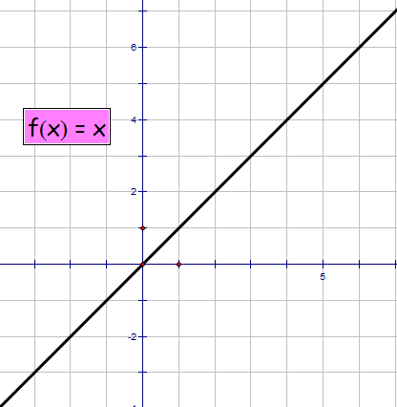
Real Application of Integration
Find area between the function and the x-axis
between x = 0 and x = 5
A = ½ bh = ½x5x5 = 12.5

Slide 17
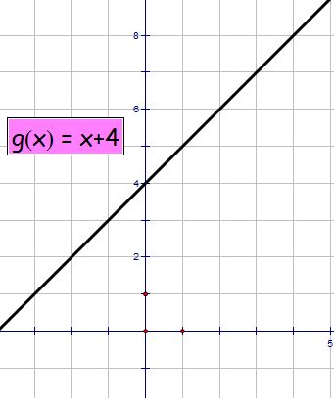
Real Application of Integration
Find area between the function and the x-axis
between x = 0 and x = 4
A = ½ bh = ½x4x4 = 8
A = lb = 4 x 4 = 16
A_{T} = 8 + 16 = 24

Slide 18
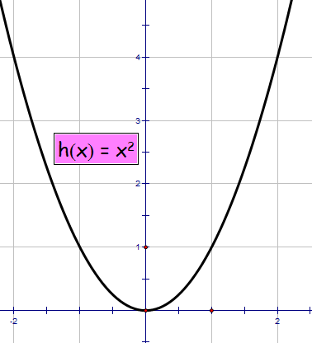
Real Application of Integration
Find area between the function and the x-axis
between x = 0 and x = 2

Slide 19
Area under a Curve
Application 1.4 Calculus
The integral of a function can be used to determine the area between the x-axis and the graph of the function.
NB: this is a definite integral. It has lower limit a and an upper limit b.

Slide 20
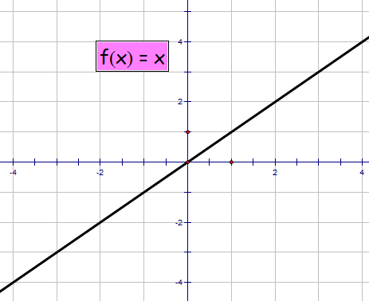
Real Application of Integration
Find area between the function and the x-axis
between x = -3 and x = 3
?
Houston we have a problem !

Slide 21
By convention we simply take the positive value since we cannot get a negative area.
Areas under the x-axis ALWAYS give negative values
Real Application of Integration
We need to do separate integrations for above and below the x-axis.

Slide 22
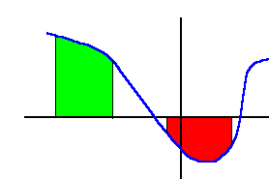
Area under a Curve
Application 1.4 Calculus
y=f(x)
Very Important Note:
c
d
When calculating integrals:
a
b
areas above the x-axis are positive
areas below the x-axis are negative
When calculating the area between a curve and the x-axis:
make a sketch
calculate areas above and below the x-axis separately
ignore the negative signs and add

Slide 23
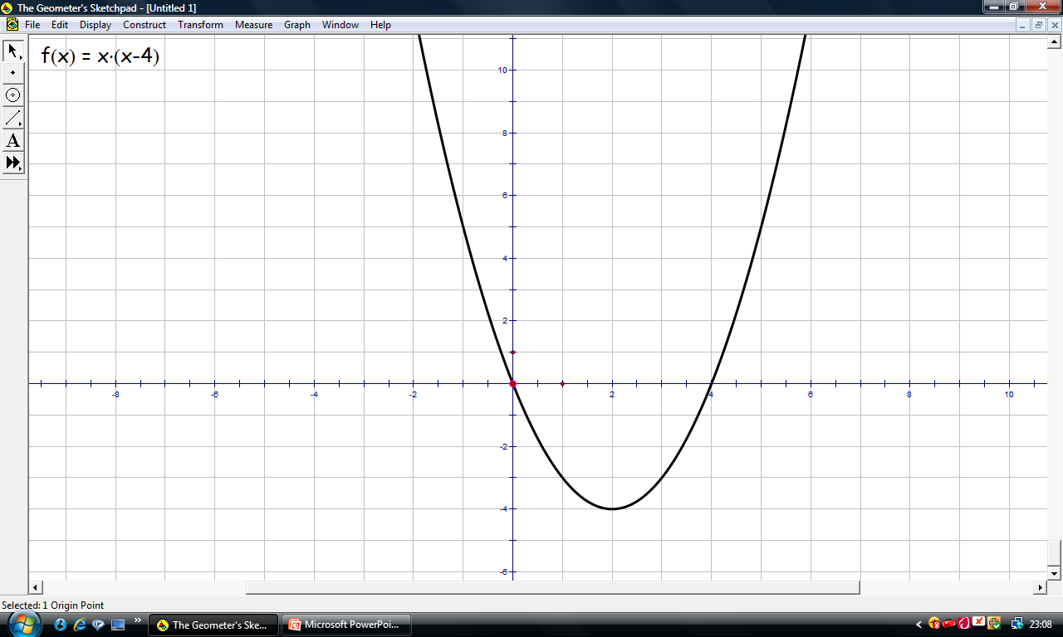
Real Application of Integration
Integrate the function g(x) = x(x - 4) between x = 0 to x = 5
We need to sketch the function and find the roots before we can integrate

Slide 24
Real Application of Integration
We need to do separate integrations for above and below the x-axis.
Since under x-axis
take positive value

Slide 25
Real Application of Integration

Slide 26
Extra Practice
Application 1.4 Calculus
HHM Ex9M and Ex9N

Slide 27
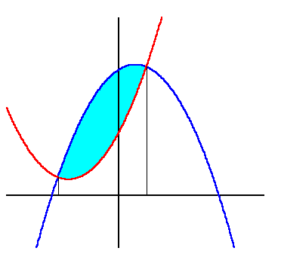
Area under a Curve
Application 1.4 Calculus
The Area Between Two Curves
To find the area between two curves we evaluate:

Slide 28
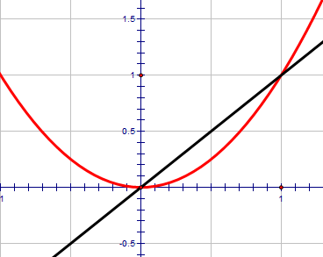
Area between Two Functions
Find upper and lower limits.
then integrate
top curve – bottom curve.

Slide 29
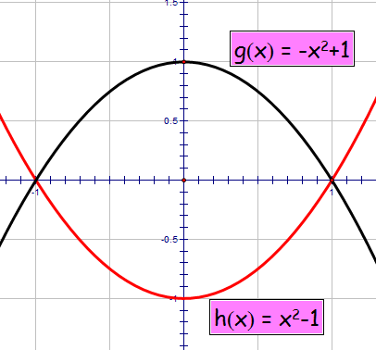
Area between Two Functions
Find upper and lower limits.
then integrate
top curve – bottom curve.
Take out common factor

Slide 30
Area between Two Functions

Slide 31
Extra Practice
Application 1.4 Calculus
HHM Ex9K and Ex9L Q1 , Q2

Slide 32
Integration
Application 1.4 Calculus
To get the function f(x) from the derivative f’(x)
we do the opposite, i.e. we integrate.
Hence:

Slide 33
Integration
Application 1.4 Calculus
Example :

Slide 34
Extra Practice
Application 1.4 Calculus
HHM Ex9Q

Slide 35



Calculus Revision
Integrate
Integrate term by term
simplify
Back
Next
Quit

Slide 36
Calculus Revision
Integrate
Integrate term by term
Back
Next
Quit

Slide 37
Calculus Revision
Integrate
Straight line form
Back
Next
Quit

Slide 38
Calculus Revision
Integrate
Straight line form
Back
Next
Quit

Slide 39
Calculus Revision
Straight line form
Integrate
Back
Next
Quit

Slide 40
Calculus Revision
Split into separate fractions
Integrate
Back
Next
Quit

Slide 41
Calculus Revision
Integrate
Straight line form
Back
Next
Quit

Slide 42
Calculus Revision
Integrate
Multiply out brackets
Integrate term by term
simplify
Back
Next
Quit

Slide 43
Calculus Revision
Integrate
Standard Integral
(from Chain Rule)
Back
Next
Quit

Slide 44
Calculus Revision
Integrate
Multiply out brackets
Split into
separate fractions
Back
Next
Quit

Slide 45
Calculus Revision
The graph of
passes through the point (1, 2).
If
express y in terms of x.
simplify
Use the point
Evaluate c
Back
Next
Quit

Slide 46
Calculus Revision
A curve for which
passes through the point (–1, 2).
Express y in terms of x.
Use the point
Back
Next
Quit

Slide 47
Area under a Curve
Application 1.4 Calculus
Examples:

Slide 48
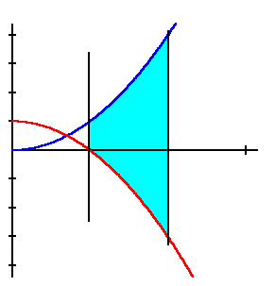
Area under a Curve
Example:
Application 1.4 Calculus

Slide 49
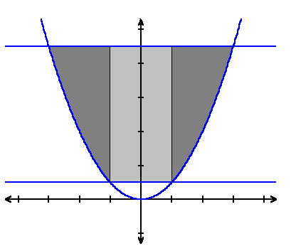
Area under a Curve
Application 1.4 Calculus
Complicated Example:
The cargo space of a small bulk carrier is 60m long. The shaded part of the diagram represents the uniform cross-section of this space.
9
Find the area of this cross-section and hence find the volume of cargo that this ship can carry.
1

Slide 50

Area under a Curve
The shape is symmetrical about the y-axis. So we calculate the area of one of the light shaded rectangles and one of the dark shaded wings. The area is then double their sum.
The rectangle: let its width be s
The wing: extends from x = s to x = t
The area of a wing (W ) is given by:

Slide 51
Area under a Curve
Application 1.4 Calculus
The area of a rectangle is given by:
The area of the complete shaded area is given by:
The cargo volume is:

Slide 52
Exam Type Questions
Application 1.4 Calculus
At this stage in the course we can only do
Polynomial integration questions.
In Unit 3 we will tackle trigonometry integration

Slide 53
Are you on Target !
Update you log book
Make sure you complete and correct
ALL of the Integration questions in
the past paper booklet.

