Slide 1
Straight Line
Applications 1.1
Prior Knowledge
Median Line
Distance Formula
The Midpoint Formula
Intersecting Lines
m = tan θ
Concurrent Lines
Collinearity
Gradients of Perpendicular Lines
Perpendicular Bisector
Mindmap
Altitude Line
www.mathsrevision.com
Notes:
<number>

Slide 2
Circle
Recurrence Relations
Vector
Where is
Straight Line Theory
Used in Higher
Logs & Exponentials
Differentiation
Notes:
<number>

Slide 3
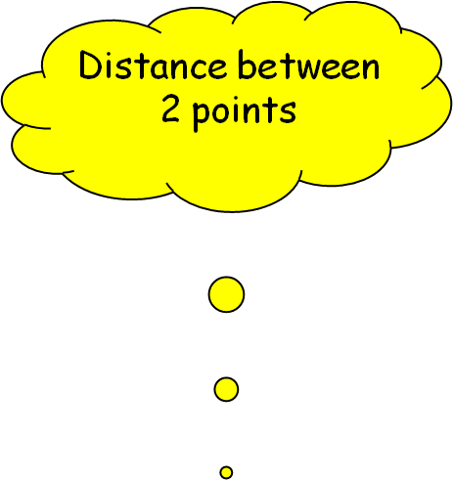
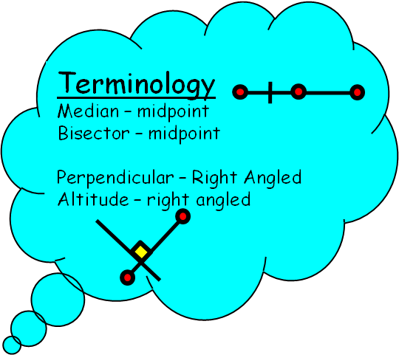

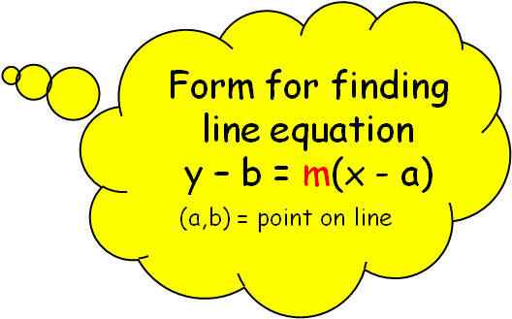

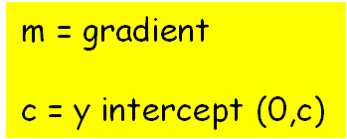
m < 0
m = undefined
m = 0
m > 0
Possible values for gradient
Straight Line
y = mx + c
Parallel lines have same gradient
For Perpendicular lines the following is true.
m₁.m₂ = -1
m = tan θ
θ

Slide 4
Straight Line Facts
y = mx + c
Y – axis Intercept
Another version of the straight line formula is
ax + by + c = 0

Slide 5
Questions
Find the gradient and y – intercept for equations.
(a) 4x + 2y + 10 = 0
m = -2 c = -5
(b) 3x - 5y + 1 = 0
m = 3/5 c = 1/5
(c) 4 - x – 3y = 0
m = - 1/3 c = 4/3
Demo

Slide 6
The Equation of the Straight Line y – b = m (x - a)
The equation of any line can be found if we know
the gradient and one point on the line.
Demo
y
y
P (x, y)
y - b
=
m =
m
(x – a)
m
y - b
y - b
A (a, b)
b
x – a
x - a
a
x
Gradient, m
O
x
Point (a, b)
y – b = m ( x – a )
Point on the line ( a, b )

Slide 7

Sloping left to right up has +ve gradient
m > 0
Sloping left to right down has -ve gradient
m < 0
Horizontal line has zero gradient.
m = 0
y = c
Vertical line has undefined gradient.
x = a
www.mathsrevision.com
Jul 11, 2026
<number>

Slide 8
Lines with the same gradient
means lines are Parallel
m > 0
www.mathsrevision.com
Jul 11, 2026
<number>

Slide 9
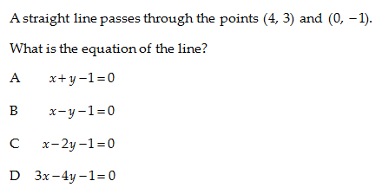
Straight Line Theory

Slide 10
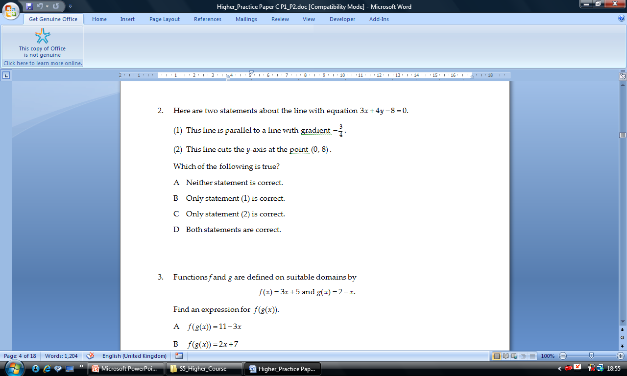
Straight Line Theory

Slide 11
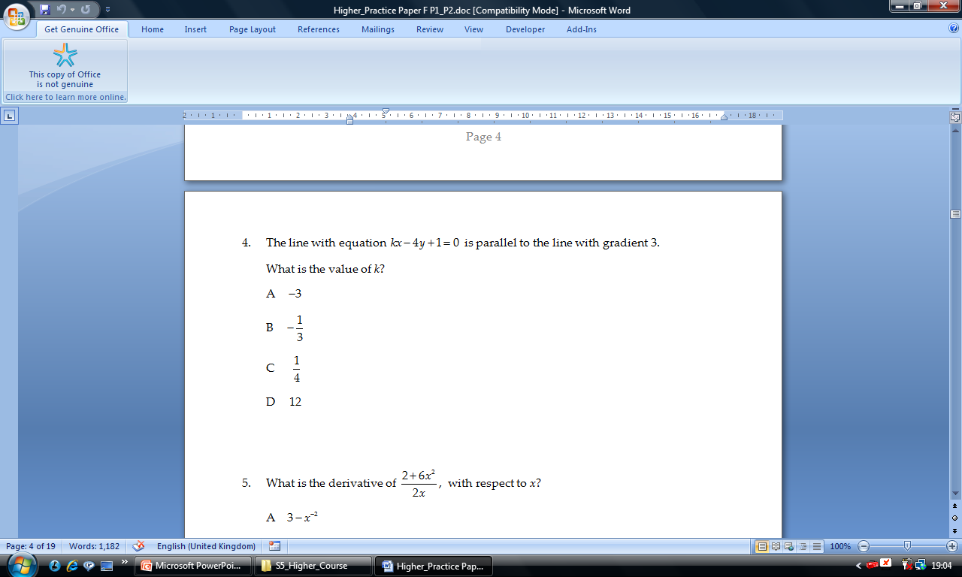
Straight Line Theory

Slide 12
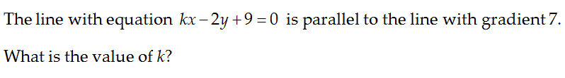
Straight Line Theory

Slide 13
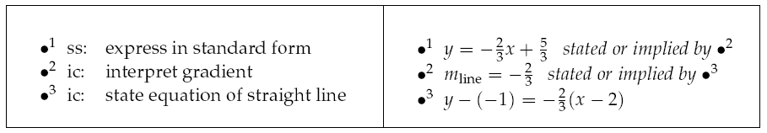
Straight Line Theory

Slide 14
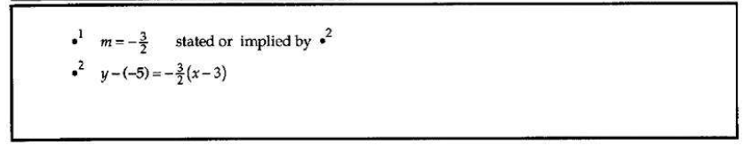
Straight Line Theory

Slide 15
Straight Line Equation
Quick Check
Page 2

Slide 16
Distance Formula
Length of a straight line
y
B(x_{2,}y₂)
This is just
Pythagoras’ Theorem
A(x₁,y₁)
y₂ – y₁
x₂ – x₁
C
O
x

Slide 17
Distance Formula
The length (distance ) of ANY line can be given by the formula :
Just Pythagoras Theorem in disguise
Demo

Slide 18
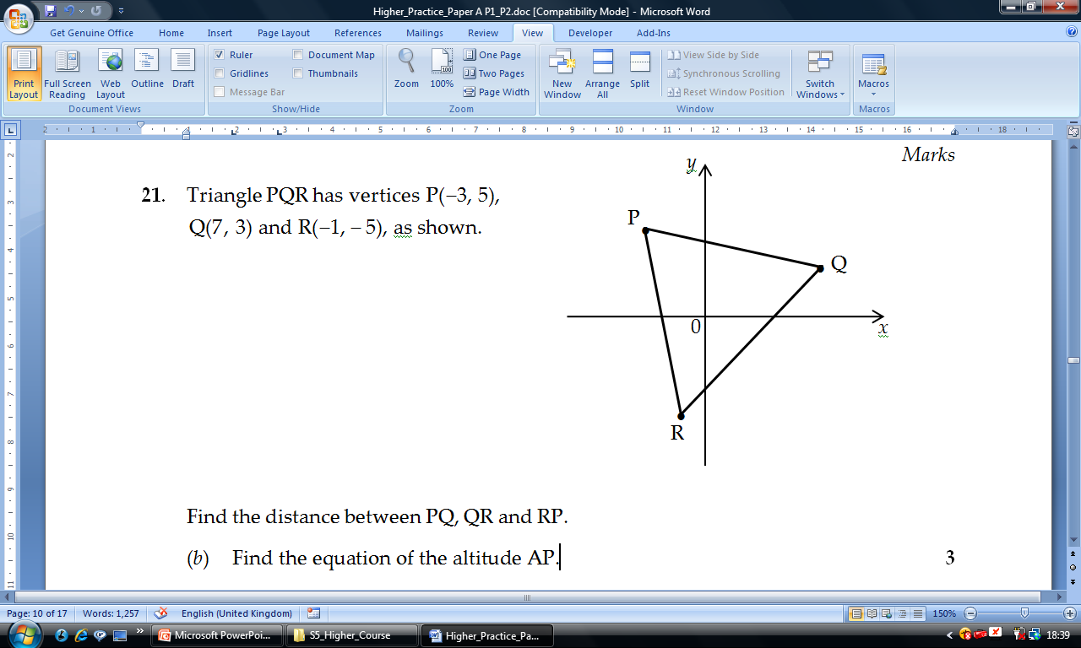
2√26
2√26
Isosceles Triangle !
8√2
Demo

Slide 19
Distance Formula
Ex 1.1
Page 3

Slide 20
Mid-Point of a line
y
The Mid-Point
(Median / Bisector)
between 2 points is given by
B(x_{2,}y₂)
y₂
Simply add both x coordinates together and divide by 2.
Then do the same with the y coordinates.
M
A(x₁,y₁)
y₁
x₁
x
O
x₂
Online Demo

Slide 21


Slide 22
Distance Formula
Ex 1.2
Page 4

Slide 23

The gradient of a line is ALWAYS
equal to the tangent of the angle
made with the line and the positive x-axis
θ
m = tan θ
0º ≤ θ < 180º
H
V
O
O
O
m =
=
tan θ =
θ
H
A
A
A
Demo
www.mathsrevision.com
Jul 11, 2026
<number>

Slide 24
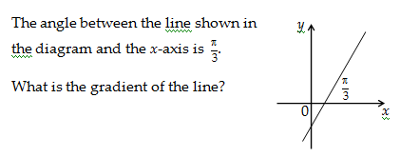
m = tan θ
60º
60º
m = tan 60º = √3
Notes:
<number>

Slide 25
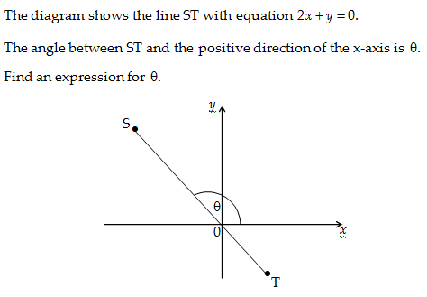
m = tan θ
y = -2x
m = tan θ
θ = tan⁻¹ (-2)
θ = 180 – 63.4
θ = 116.6º

Slide 26
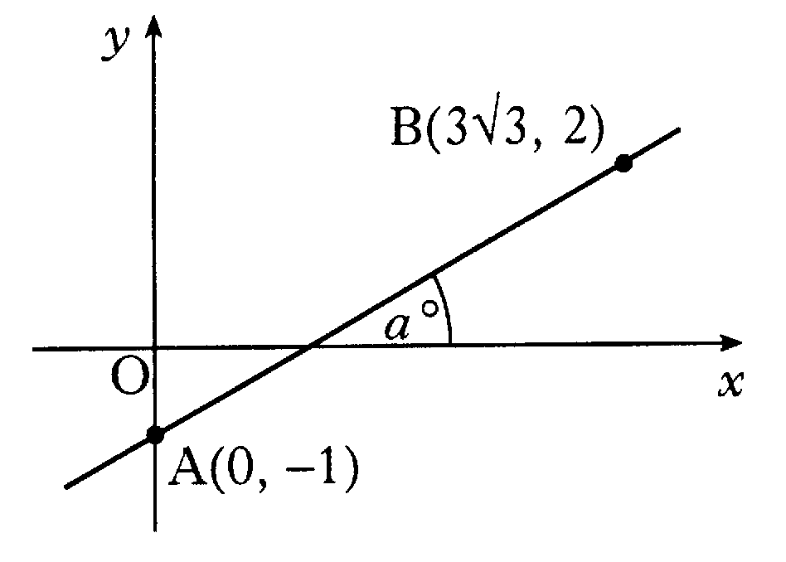


Exam Type Questions
Find the size of the angle a° that the line
joining the points A(0, -1) and B(3√3, 2)
makes with the positive direction of the x-axis.
Find gradient of the line:
Use table of exact values

Slide 27
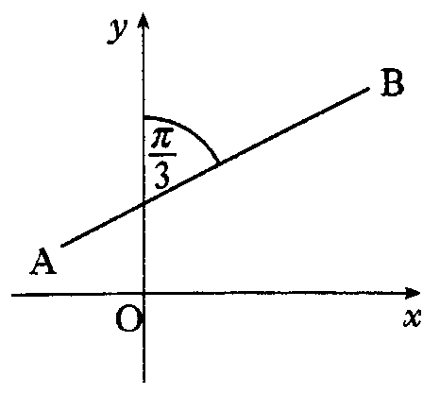

Typical Exam Questions
The line AB makes an angle of 60º with
the y-axis, as shown in the diagram.
Find the exact value of the gradient of AB.
60º
Find angle between AB and x-axis:
(x and y axes are perpendicular.)
Use table of exact values

Slide 28
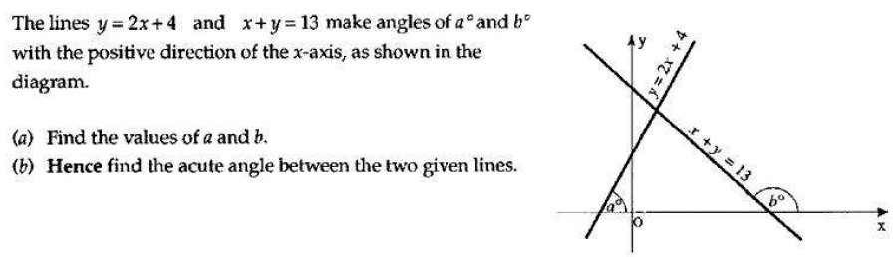
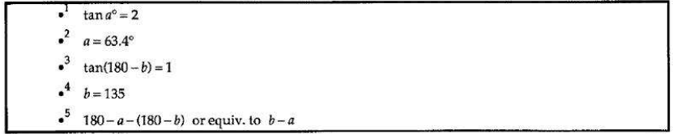
Typical Exam Questions
Notes:
<number>

Slide 29
m = tanθ
Ex 1.3
Page 5

Slide 30
Collinearity
Points are said to be collinear
if they lie on the same straight.
y
The coordinates A,B C are collinear since they lie on the same straight line.
D,E,F are not collinear they do not lie on the same straight line.
C
B
F
A
E
D
x₁
x
O
x₂

Slide 31
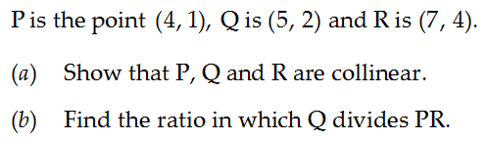
Straight Line Theory
Ratio
D_{PQ}:D_{PQ}
1:2
D_{PQ}=2√2
D_{PQ}=√2
Since m_{PQ} = m_{QR} and
they have a point in common Q
PQR are collinear.

Slide 32
Collinear Points
Ex 1.4
Page 6

Slide 33
Gradient of perpendicular lines
Investigation
If 2 lines with gradients m₁ and m₂ are perpendicular then m₁ × m₂ = -1
When rotated through 90º about the origin A (a, b) → B (-b, a)
y
B(-b,a)
-a
A(a,b)
-b
-b
O
a
x
Demo
Conversely:
If m₁ × m₂ = -1 then the two lines with gradients m₁ and m₂ are perpendicular.
Notes:
<number>

Slide 34
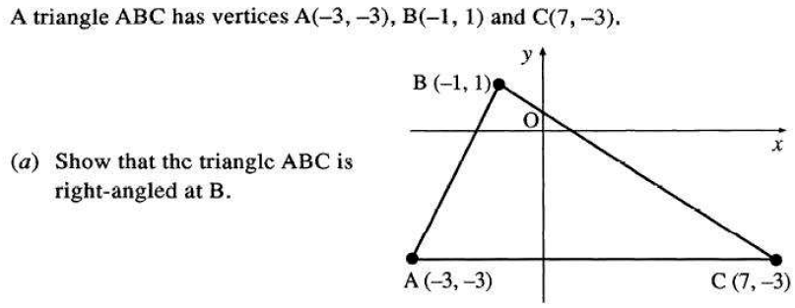
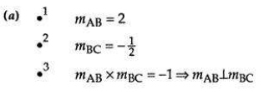
Straight Line Theory

Slide 35
Collinear Points
Ex 1.5
Page 8

Slide 36

Perpendicular bisector - a line that cuts another line
into two equal parts at an angle of 90º
A
B
D
C
Demo
www.mathsrevision.com
Jul 11, 2026
<number>

Slide 37
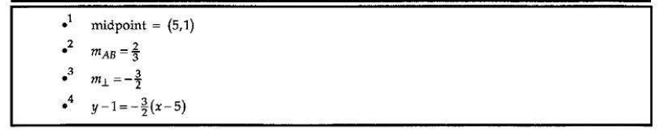
Straight Line Theory

Slide 38
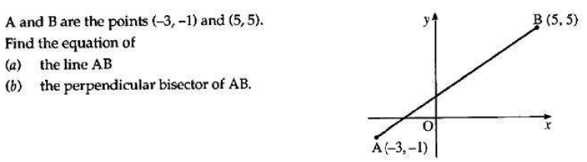
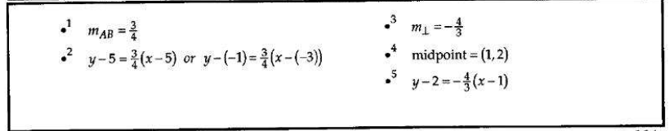
Straight Line Theory

Slide 39
Perpendicular Bisector
Ex 1.6
Page 10

Slide 40
A
D
Altitude means a perpendicular line
from a vertex to the base.
B
C
Demo
www.mathsrevision.com
Jul 11, 2026
<number>

Slide 41
Common Straight Strategies for Exam Questions
Finding the Equation of an Altitude
A
To find the equation of an altitude:
B
• Find the gradient of the side it is
perpendicular to ( ).
m_{AB}
C
• To find the gradient of the altitude, flip the gradient
of AB and change from positive to negative:
m_{altitude} =
–1
m_{AB}
• Substitute the gradient
and the point C into
Important
Write final equation in the form
y – b = m ( x – a )
A x + B y + C = 0
with A x positive.

Slide 42
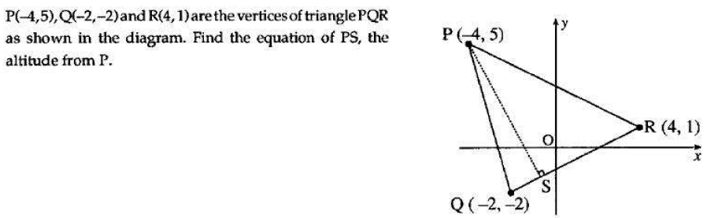
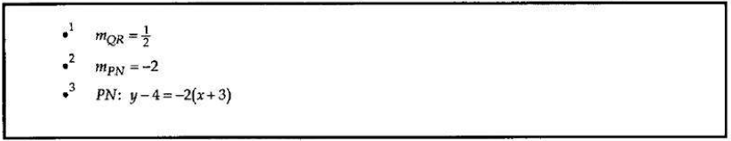
Straight Line Theory

Slide 43
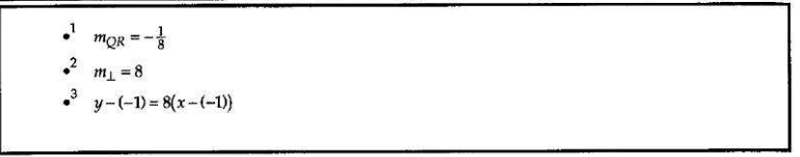
Straight Line Theory
Notes:
<number>

Slide 44
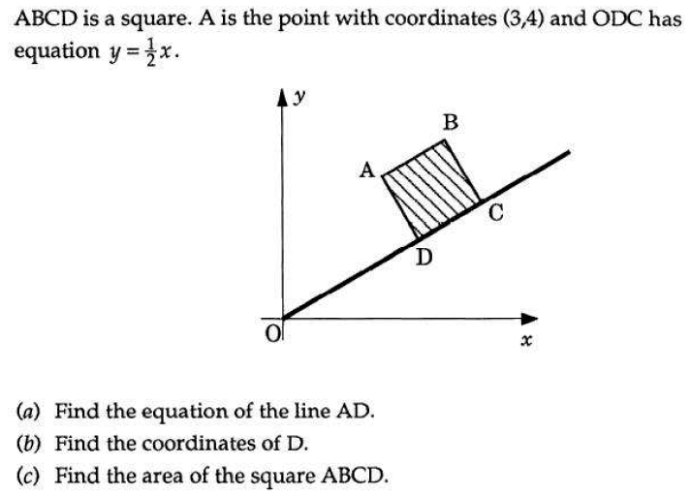
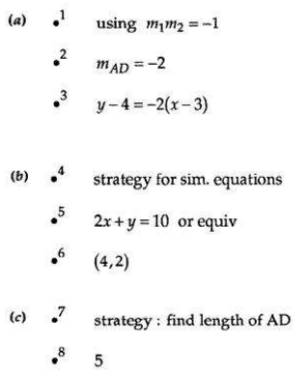
Straight Line Theory
Notes:
<number>

Slide 45
Altitude Line
Ex 1.7
Page 11

Slide 46
A
Median means a line
from a vertex to
the midpoint of the base.
B
C
D
Demo
www.mathsrevision.com
Jul 11, 2026
<number>

Slide 47
Common Straight Strategies for Exam Questions
Finding the Equation of a Median
Q
M
=
To find the equation of a median:
=
P
• Find the midpoint of the side it bisects, i.e.
x₂ x₁
y₂ y₁
O
+
+
( )
M =
,
2
2
• Calculate the gradient of the median OM.
• Substitute the gradient and either
point on the line (O or M) into
Important
Write answer in the form
y – b = m ( x – a )
A x + B y + C = 0
with A x positive.

Slide 48
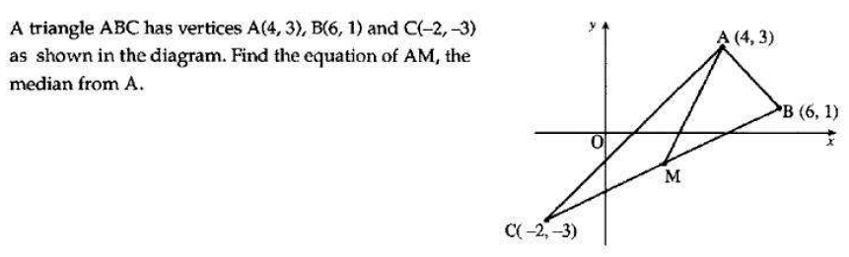
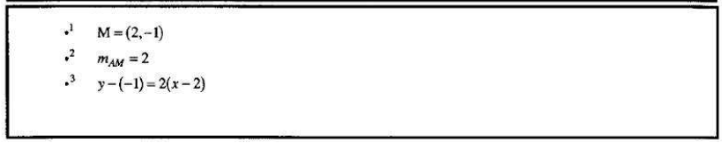
Straight Line Theory
Notes:
<number>

Slide 49
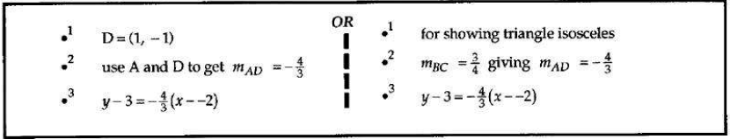
Straight Line Theory
Notes:
<number>

Slide 50
Median Line
Ex 1.8
Page 12

Slide 51
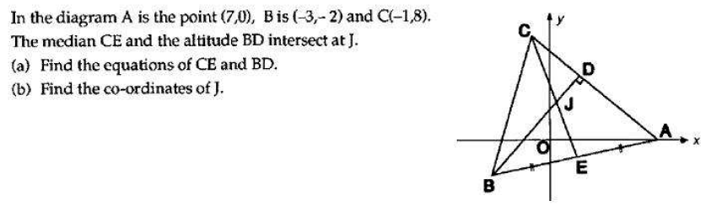
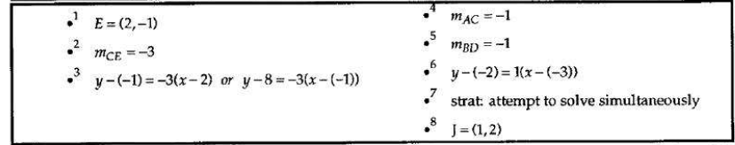
Straight Line Theory
Notes:
<number>

Slide 52
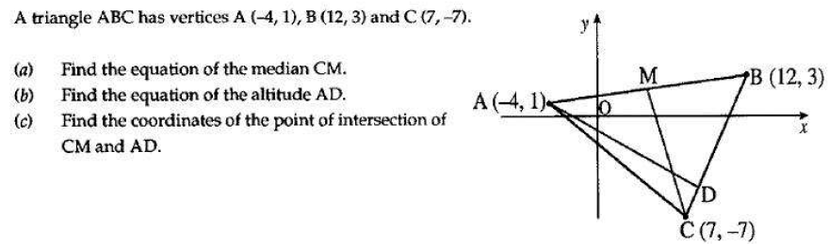
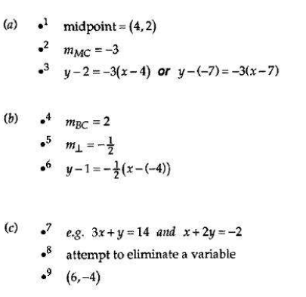
Straight Line Theory

Slide 53
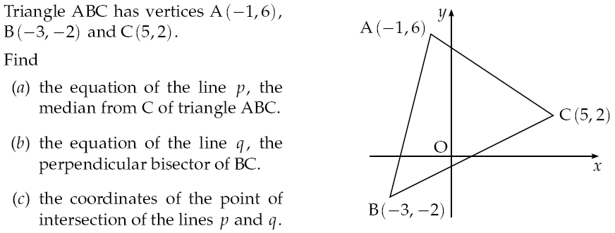
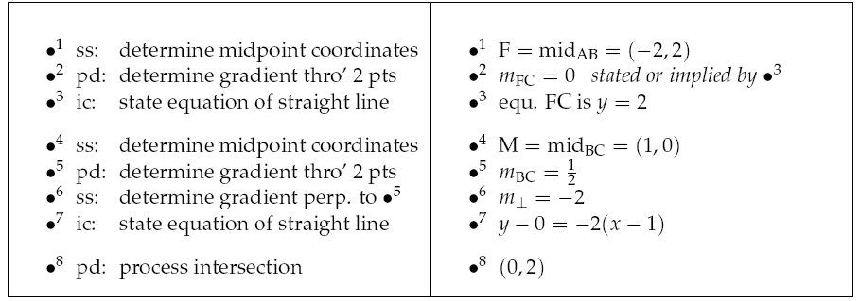
Straight Line Theory
Notes:
<number>

Slide 54
Intersecting Point
Ex 1.9
Page 14

Slide 55
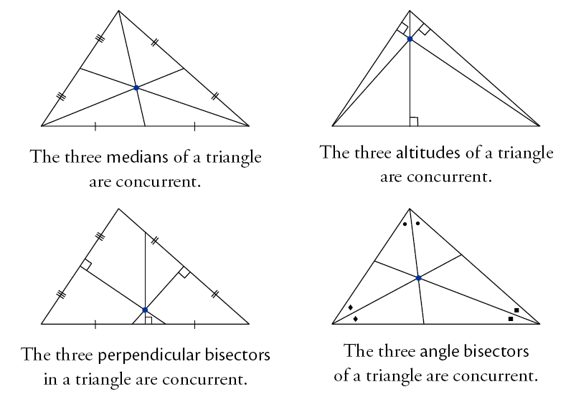
Any number of lines are said to be concurrent
if there is a point through which they all pass.
For three lines to be concurrent,
they must all pass through a single point.
Altitude
Intersection
Median Line
Intersection
Perpendicular
Bisector Intersection

Slide 56
Concurrent Lines
Ex 1.10 & 1.11
Page 10

Slide 57
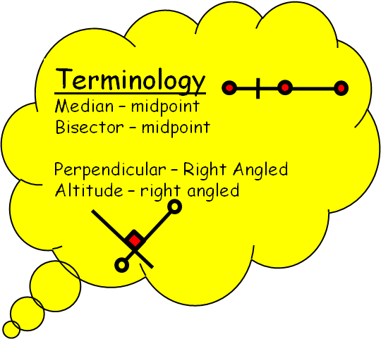
m < 0
m = undefined
m = 0
m₁.m₂ = -1
m > 0
Possible values for gradient
Straight Line
y = mx + c
Parallel lines have same gradient
For Perpendicular lines the following is true.
m₁.m₂ = -1
m = tan θ
θ

Slide 58
Are you on Target !
Update you log book
Make sure you complete and correct
ALL of the Straight Line questions in
the past paper booklet.

